Slide 1
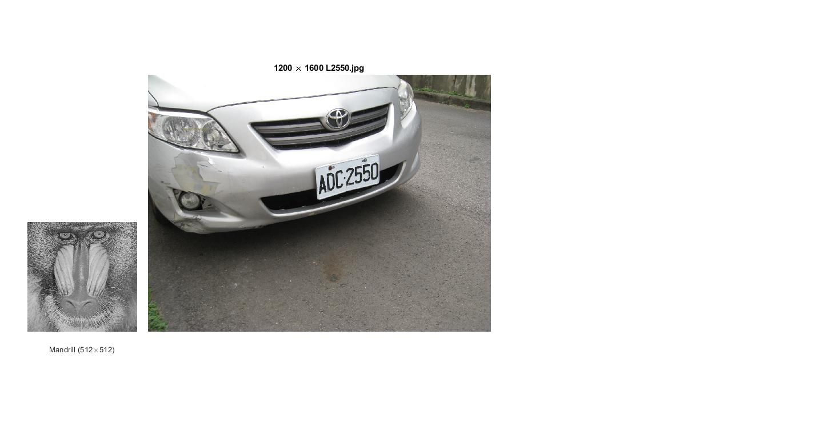
Display of Multiple Images on a Single Sheet
m=512; n=512;
subplot(1,2,1)
set(gca,'unit','inch','position',[0.5 2.1, 2.0, 2.0]);
fin=fopen('mandrill.raw','r');
X=fread(fin, m*n, 'uint8=>uint8'); fclose(fin);
Y=reshape(X,m,n); Z=Y';
imshow(Z)
title('Mandrill (512\times512)')
subplot(1,2,2)
set(gca,'unit','inch','position',[2.7, 2.1, 6.25, 4.6875]);
m=1200; n=1600;
X=imread('L2550.jpg');
imshow(X)
title('1200 \times 1600 L2550.jpg')

