Slide 1
Steganography: Embedding and Extracting Information from Media
Chaur-Chin Chen (陳朝欽)
Institute of Information Systems & Applications
Department of Computer Science
National Tsing Hua University
HsinChu (新竹), Taiwan (台灣)
cchen@cs.nthu.edu.tw
May 25, 2017

Slide 2
Outline
Image representation and display
raw, jpeg, tiff, gif, bmp, png, jfif, j2p, etc.
DCT-(JPEG Image)-Based Steganography
RGB-(Tiff Image)-Based Steganography
Cover image selection: Natural vs. Artificial Images
(a) MRF-synthesized images
(b) (artificial or natural) Microarray images
Experimental Results
Encryption and Decryption
Image sharing and recovering

Slide 3
Salaries for Information Technologies (2011~2016)
Min Med 75% Max
Google 92000, 126232, 137600, 318240
Facebook 85000, 138294, 150000, 247200
Uber-SF 76107, 120000, 140000, 175000
IBM-CA 61735, 99047, 140000, 222700
IBM-R△ 52998, 83666, 100000, 206348
MSFT 78540, 118142, 125676, 161000

Slide 4
A Gray Level Image is a Matrix
A 2d gray level image is nothing but a mapping f
from a region to a matrix
f(0,0) f(0,1) f(0,2) …. …. f(0,n-1)
f(1,0) f(1,1) f(1,2) …. …. f(1,n-1)
. . .
. . .
f(m-1,0) f(m-1,1) f(m-1,2) … …. f(m-1,n-1)
An image of m rows, n columns, f(i,j) is in [0,255]

Slide 5
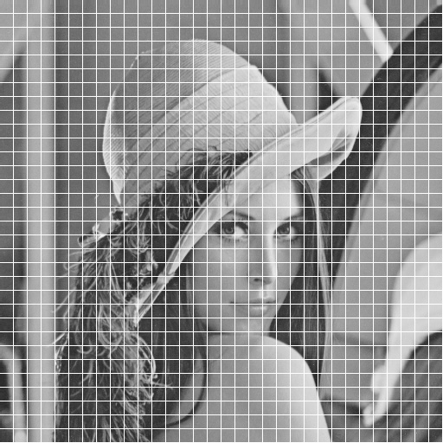
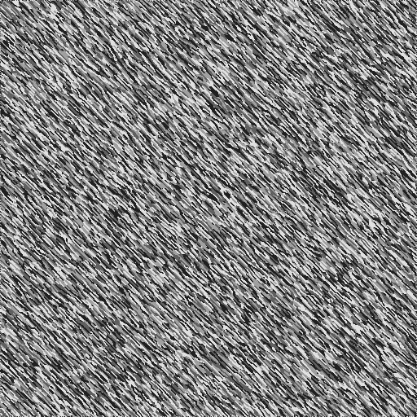
Gray Level Images and A Pixel

Slide 6
Image Representation (Gray/Color)
A gray level image is usually represented by an m x n matrix whose elements are all integers in {0,1, …, 255} corresponding to brightness scales
A color image is usually represented by 3 m x n matrices whose elements are all integers in {0,1, …, 255} corresponding to 3 primary primitives of colors such as Red, Green, Blue

Slide 7


Gray and Color Image Data
0, 64, 144, 196,
225, 169, 100, 36
(R, G, B) for a color pixel
Red – (255, 0, 0)
Green – ( 0, 255, 0)
Blue – ( 0, 0, 255)
Cyan – ( 0,255, 255)
Magenta – (255, 0, 255)
Yellow – (255, 255, 0)
Gray – (128, 128, 128)

Slide 8
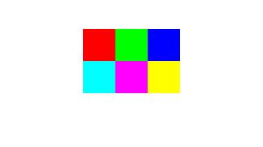
RGB Hex Triplet Color Chart
Red = FF0000
Green = 00FF00
Blue = 0000FF
Cyan = 00FFFF
Magenta= FF00FF
Yellow = FFFF00

Slide 9

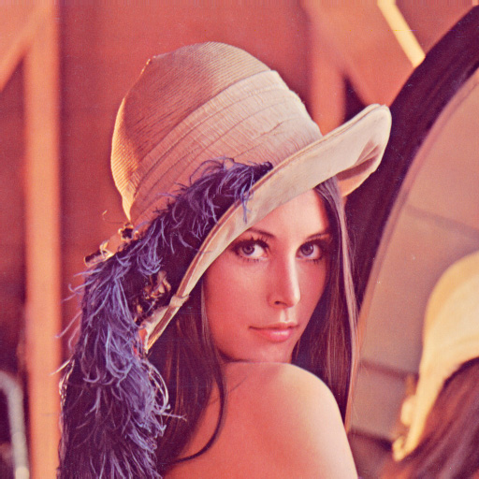
Pixels in a Gray Level Image

Slide 10
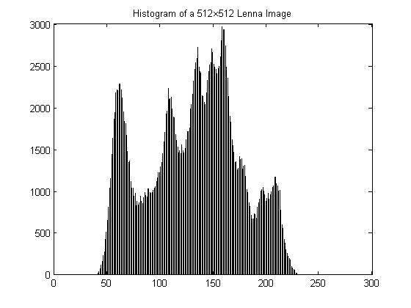
Image Lenna and Its Histogram

Slide 11
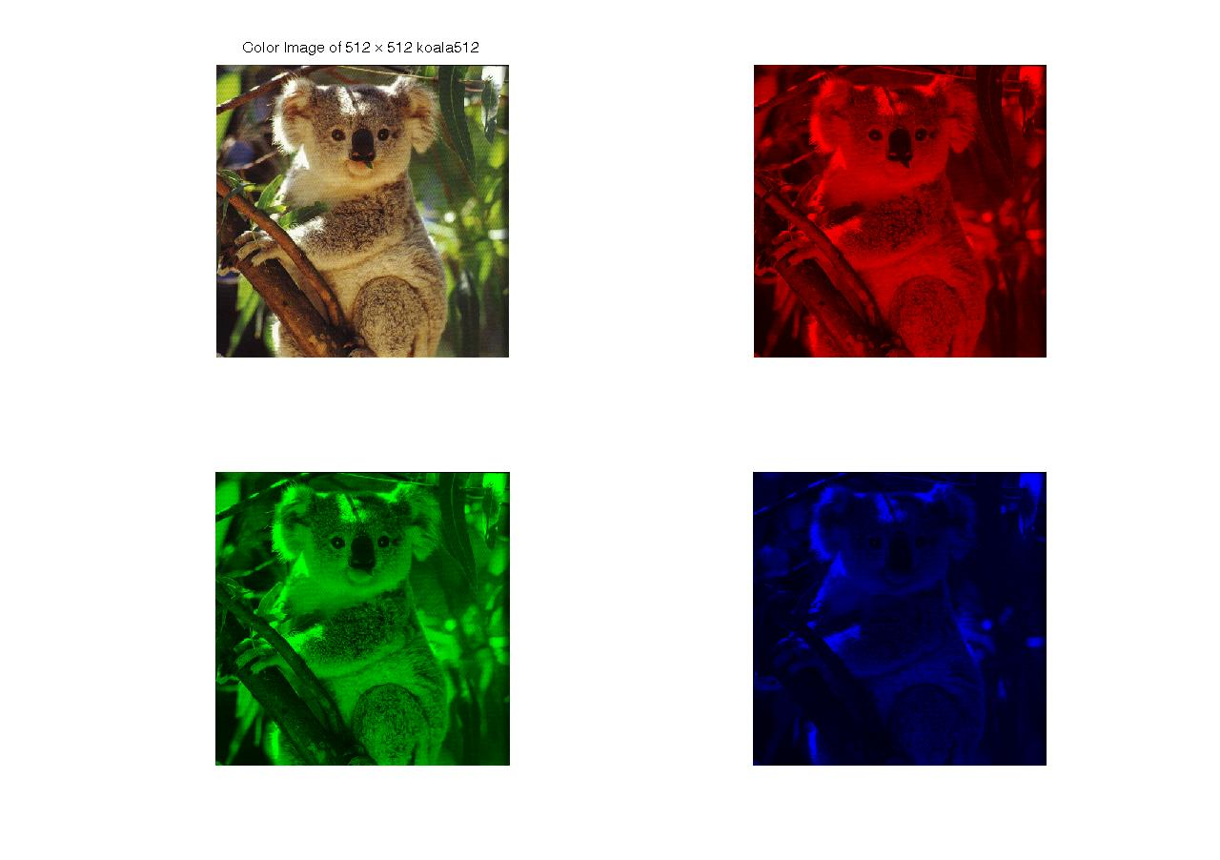
Koala and Its RGB Components

Slide 12
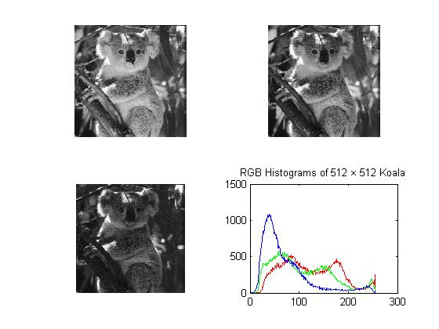
(R,G,B) Histograms of Koala

Slide 13
Image File Formats (1/2)
The American National Standards Institute (ANSI) sets standards for voluntary use in US. One of the most popular computer standards set by ANSI is the American Standard Code for Information Interchange (ASCII) which guarantees all computers can exchange text in ASCII format
BMP – Bitmap format from Microsoft uses Raster-based 1~24-bit colors (RGB) without compression or allows a run-length compression for 1~8-bit color depths
GIF – Graphics Interchange Format from CompuServe Inc. is Raster-based which uses 1~8-bit colors with resolutions up to 64,000*64,000 LZW (Lempel-Ziv-Welch, 1984) lossless compression with the compression ratio up to 2:1

Slide 14
Some Image File Formats (2/2)
Raw – Raw image format uses a 8-bit unsigned character to store a pixel value of 0~255 for a Raster-scanned gray image without compression. An R by C raw image occupies R*C bytes or 8RC bits of storage space
TIFF – Tagged Image File Format from Aldus and Microsoft was designed for importing image into desktop publishing programs and quickly became accepted by a variety of software developers as a standard. Its built-in flexibility is both a blessing and a curse, because it can be customized in a variety of ways to fit a programmer’s needs. However, the flexibility of the format resulted in many versions of TIFF, some of which are so different that they are incompatible with each other
JPEG – Joint Photographic Experts Group format is the most popular lossy method of compression, and the current standard whose file name ends with “.jpg” which allows Raster-based 8-bit grayscale or 24-bit color images with the compression ratio more than 16:1 and preserves the fidelity of the reconstructed image
EPS – Encapsulated PostScript language format from Adulus Systems uses Metafile of 1~24-bit colors with compression
JP2 - JPEG 2000 based on 5/3 and 9/7 wavelet transforms

Slide 15
Steganography By Using JPEG Images
Steganography is a method of data hiding by embedding
secret message within a cover media (for example, an
image, audio or video file).
The JPEG format is the most commonly used image format on the Internet.
Many JPEG steganographic algorithms such as J-Steg,
F5, and Outguess have been developed before 2012
although the embedding capacity is relatively low.

Slide 16
The JPEG Image Format
Figure 2.1. A block diagram of JPEG compression.

Slide 17
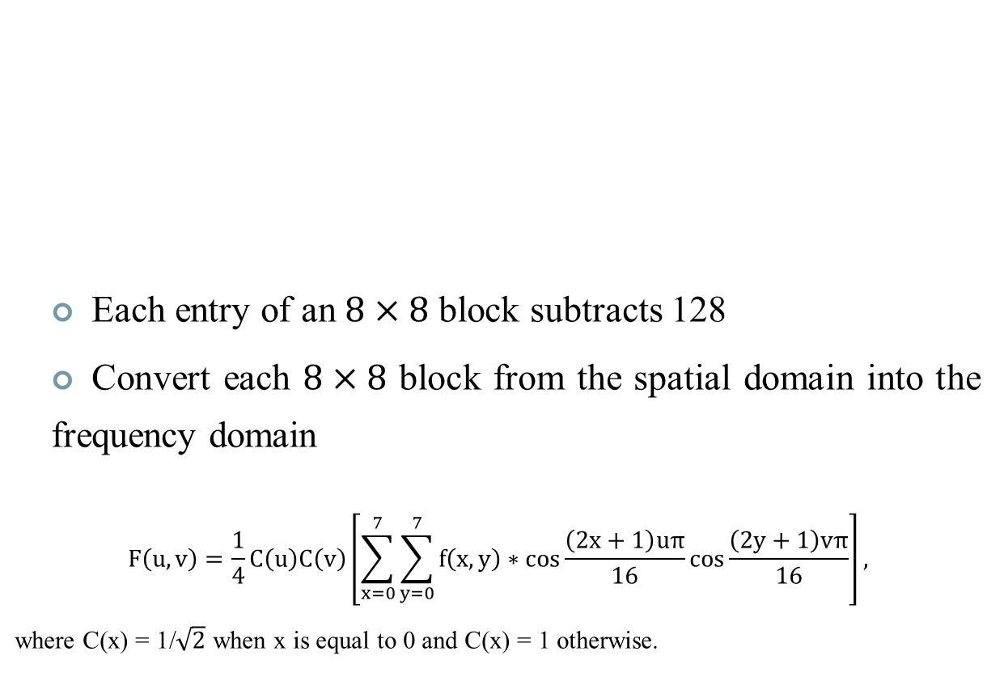

The JPEG Image Format: Step1: Discrete cosine transform
103 | 106 | 105 | 100 | 90 | 91 | 82 | 69
104 | 97 | 105 | 112 | 100 | 96 | 88 | 90
83 | 97 | 94 | 103 | 96 | 86 | 87 | 88
86 | 82 | 105 | 107 | 99 | 95 | 95 | 89
89 | 90 | 93 | 103 | 91 | 101 | 93 | 93
78 | 99 | 94 | 91 | 95 | 87 | 93 | 83
81 | 79 | 90 | 89 | 86 | 84 | 85 | 75
20 | 20 | 20 | 20 | 19 | 22 | 19 | 20

Slide 18
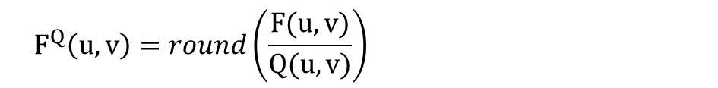
The JPEG Image Format: Step2: Quantization
DCT coefficients
Quantization table
-357 | 17 | -28 | -8 | -4 | 7 | -1 | -4
121 | 21 | -7 | -2 | 4 | 3 | 2 | -4
-98 | 20 | 7 | 7 | -2 | -2 | 2 | 1
79 | 10 | 0 | 5 | -10 | -1 | -3 | 0
-62 | 0 | 3 | 4 | -2 | 5 | 8 | -3
37 | 4 | -7 | -2 | -5 | 4 | -1 | 8
-42 | 3 | 3 | -3 | -7 | -11 | -11 | 0
9 | 1 | 4 | 2 | 0 | -1 | -1 | -7
16 | 11 | 10 | 16 | 24 | 40 | 51 | 61
12 | 12 | 14 | 19 | 26 | 58 | 60 | 55
14 | 13 | 16 | 24 | 40 | 57 | 69 | 56
14 | 17 | 22 | 29 | 51 | 87 | 80 | 62
18 | 22 | 37 | 56 | 68 | 109 | 103 | 77
24 | 35 | 55 | 64 | 81 | 104 | 113 | 92
49 | 64 | 78 | 87 | 103 | 121 | 120 | 101
72 | 92 | 95 | 98 | 112 | 100 | 103 | 99
Quantized DCT coefficients
-22 | 2 | -3 | -1 | 0 | 0 | 0 | 0
10 | 2 | -1 | 0 | 0 | 0 | 0 | 0
-7 | 2 | 0 | 0 | 0 | 0 | 0 | 0
6 | 1 | 0 | 0 | 0 | 0 | 0 | 0
-3 | 0 | 0 | 0 | 0 | 0 | 0 | 0
2 | 0 | 0 | 0 | 0 | 0 | 0 | 0
-1 | 0 | 0 | 0 | 0 | 0 | 0 | 0
0 | 0 | 0 | 0 | 0 | 0 | 0 | 0

Slide 19
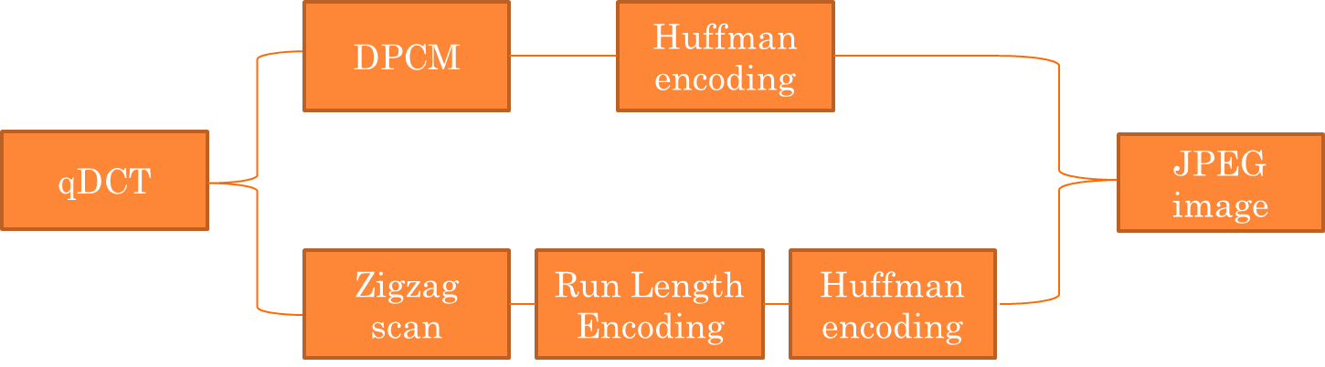
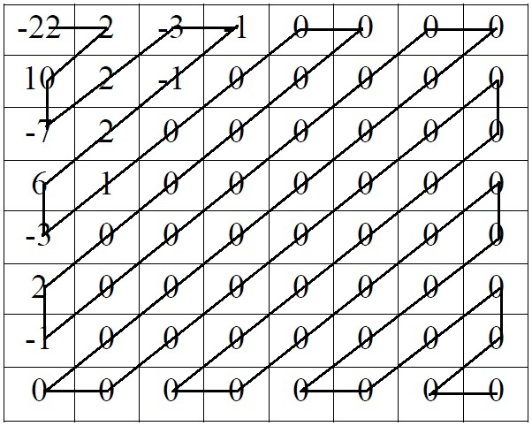
The JPEG Image Format: Step3: Entropy coding
DC
AC

Slide 20
Some DCT-Based Steganographic Algorithms
J-Steg
JPhide
OutGuess
F5
Notes:
These steganographic algorithms usually use the qDCT coefficients to embed secret message, and are hard to be detected by visual attack.

Slide 21
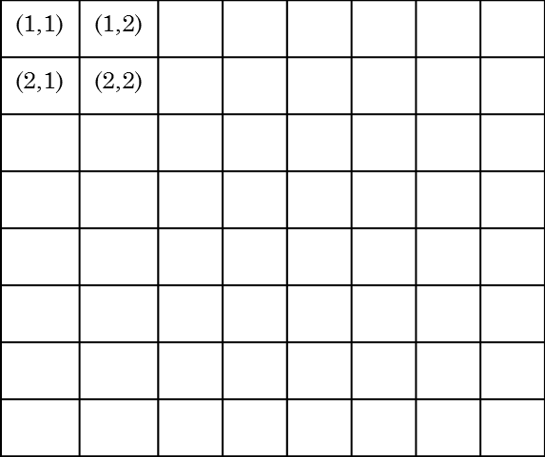
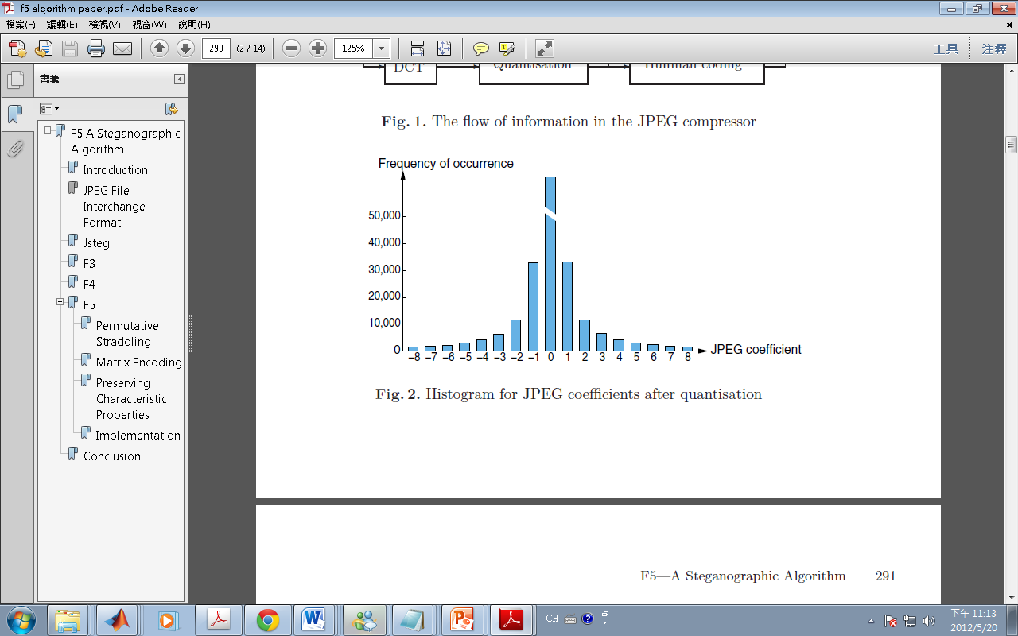
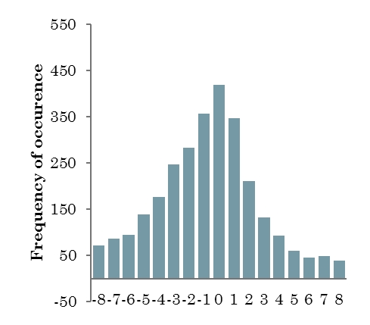
Properties of good jpeg steganographic Algorithms
sufficient capacity
good imperceptibility
qDCT histogram preserving
.
.
Value of the qDCT coefficient at (2.1)

Slide 22
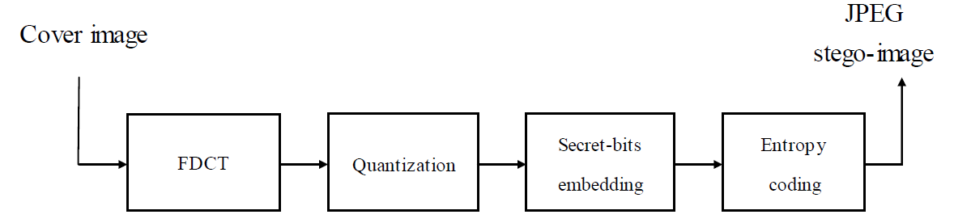
Some DCT-Based Steganographic Algorithms: JPEG Embedding Process
Figure 1.1. A block diagram of the JPEG embedding process.

Slide 23
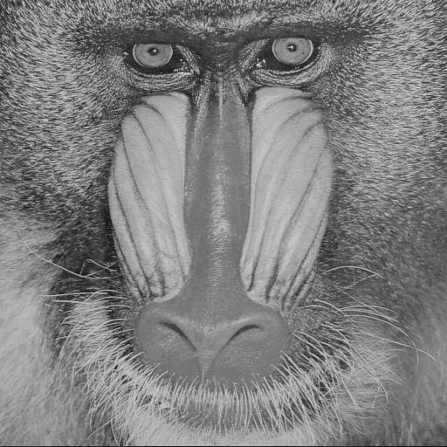

The JPEG image Mandrill and the corresponding stego-images
blocks:4096, secret bits:82816
JPEG image, PSNR=34.74
Stego-image, PSNR=32.07
nonzero AC coefficients:89561
nonzero AC coefficients:75356

Slide 24


The JPEG image Lena and the corresponding stego-images
blocks:4096, secret bits:43056
JPEG image, PSNR=40.74
Stego-image, PSNR=36.83
nonzero AC coefficients:42094
nonzero AC coefficients:35290

Slide 25
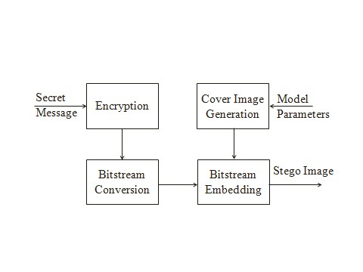
A Novel Flowchart of Data Hiding

Slide 26
A Random Bit Sequence
Alex → [65, 108, 97, 101, 120]
→ [(00000001),(01101100),
(01100101),(01101110)]
→ [(0000 0001),(0110 1100),
(0110 0101),(0110 1110)]
8 4-bit words are added into a cover image 224, 192, 160, 96, 96, 160,192, 224 to have
224, 193, 166, 108,102,165,198,238

Slide 27
Gray Level Images and A Pixel

Slide 28
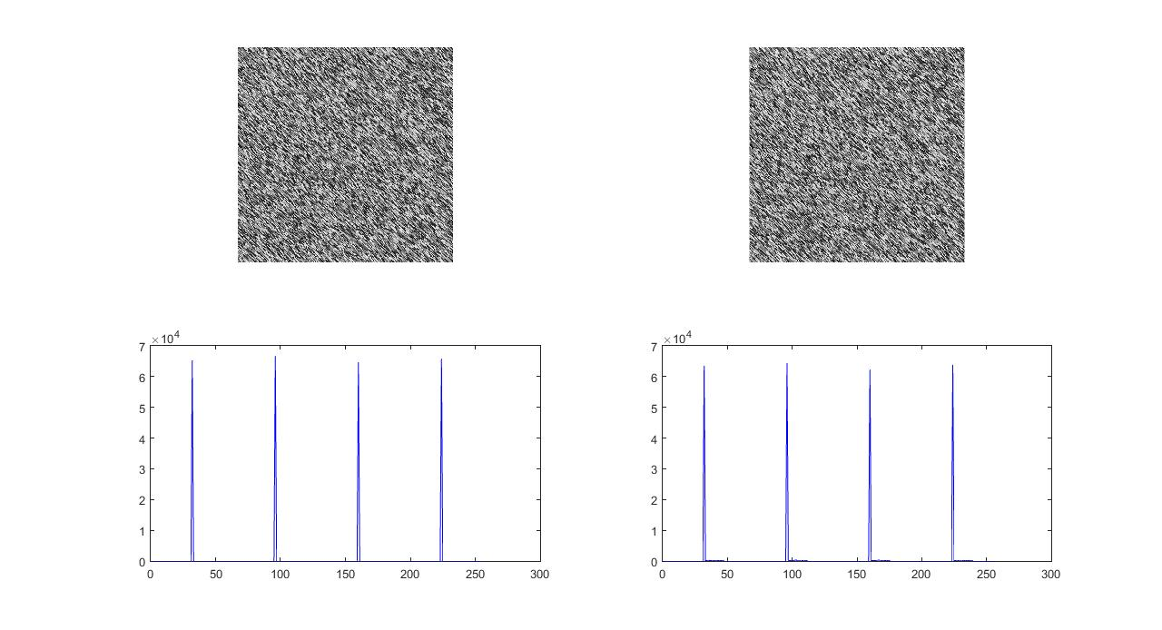
Results of Embedding Steve.txt (25 lines, 1094 words, 6646 characters)

Slide 29
A Secret Message
Experience The Niagara Falls
The New Niagara Falls, Canada-with eclectic restaurants, contemporary hotels, and electrifying attractions-is a true Canadian vacation destination for couples and families alike. Grown ups have upscale hotels, modern casinos, nightlife and concerts, fine dining, golf courses and spas, and wine country is just down the road. For children, Niagara Falls is a veritable theme park with ultra tall buildings (Skylon Tower), water parks inside hotels, Ferris wheels and kid-friendly restaurants (Clifton Hill), and we even sneak in some education at Niagara Falls attractions like the Butterfly Conservatory and Marineland. Let's not forget the Falls. From the Maid of the Mist to Journey Behind the Falls, there are plenty of ways to experience this great wonder of the world. Situated just 20 minutes from Buffalo International Airport and an hour from the Toronto area, a Niagara Falls vacation is easy to get to and fun to plan. Use the Vacation Planning tools on our site to help you choose your Niagara Falls hotels and attractions and pull together the perfect itinerary. Start your trip at Niagara Falls Tourism. We'll introduce you to this new Ontario vacation destination!

Slide 30
Text Message to Bit Sequence
cake → [99, 97, 107, 101]
→ [(01100011),(01100001),
(01101011),(01100101)]
→ [(0110 0011),(0110 0001),
(0110 1011),(0110 0101)]
Each 4-bit word is then embedded into the 4 LSBs of the blue signals which were never used in a real two-color microarray image.

Slide 31
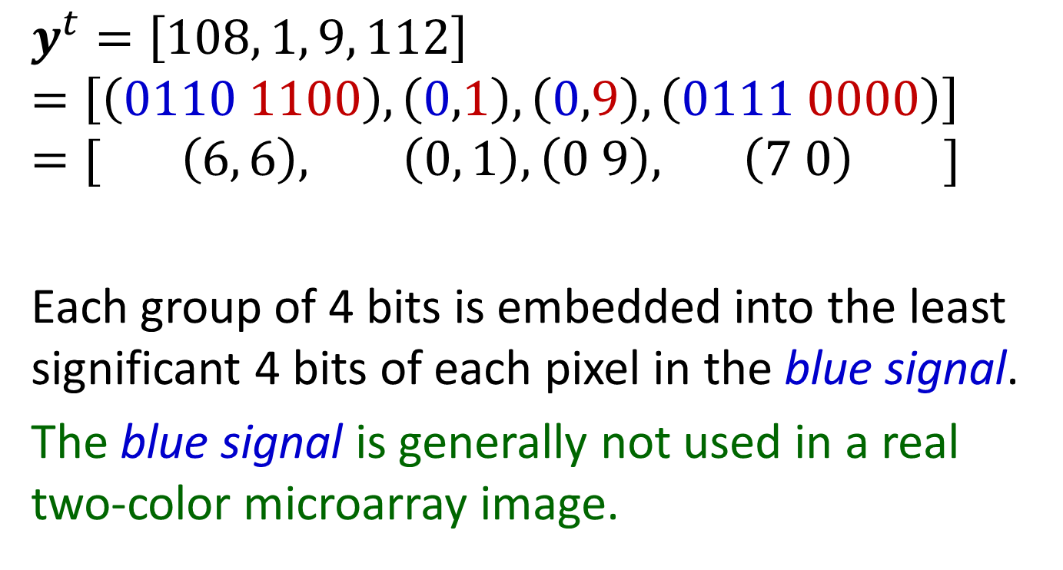
Each group of 4 bits is embedded

Slide 32
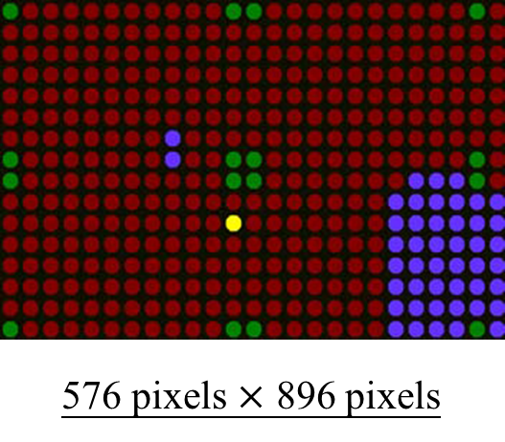
A Microarray Image Template

Slide 33
Hill Ciphers
A Hill cipher is an encryption method based on a matrix multiplication under some modular arithmetic. In our experiment, we assume that our secret message is a text composed of general ASCII characters including EOL(10), space (32), and other control keys (0~31) etc. This work adopts a 4 by 4 Hill matrix.
Secret message is partitioned as a length of 4 characters represented as 4-d vector.

Slide 34
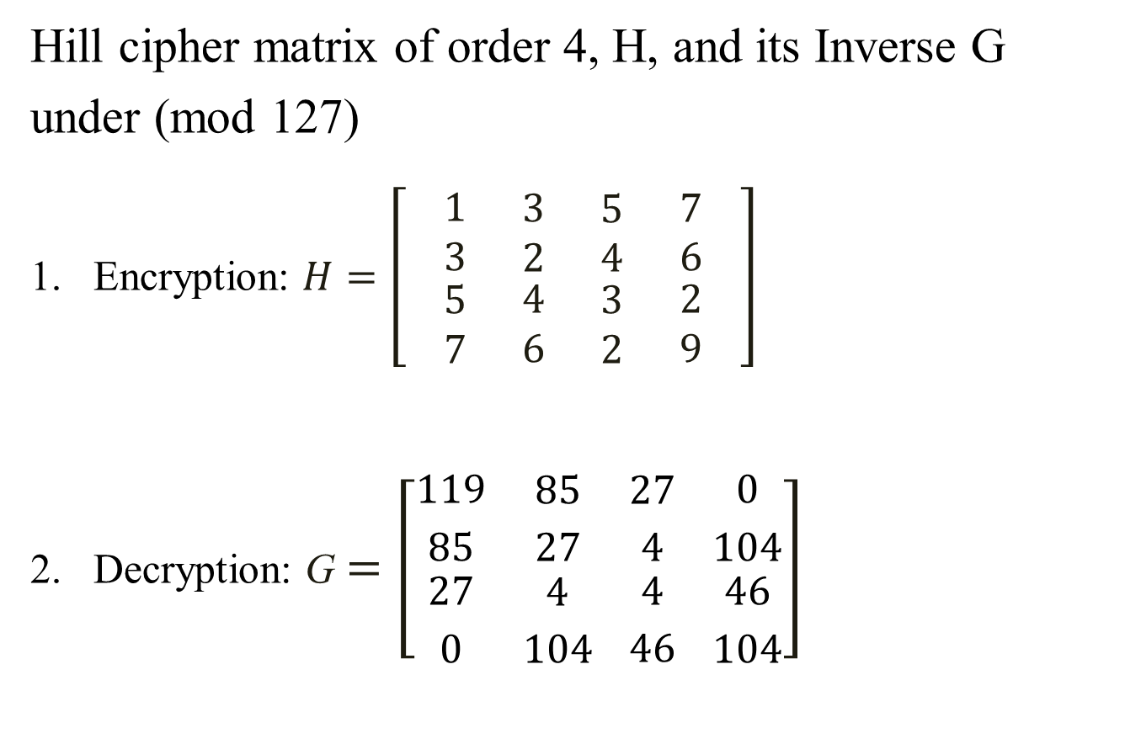
A Hill Cipher Matrix of order 4
Modular Inverse
Notes:
提到了hill cipher的 key
Key的使用分成兩個階段
進行加密時，使用到H這個四成四的矩陣，對秘密訊息加密。
進行解密時，會將H矩陣進行一個modular inverse的運算，產生一個對應的矩陣

Slide 35
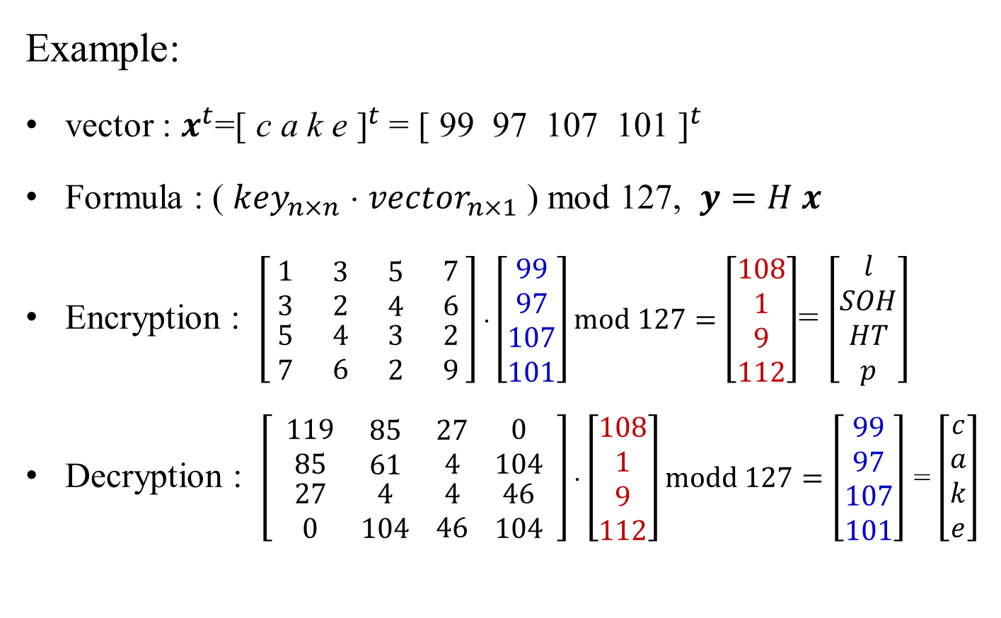
Encryption and Decryption
Notes:
那接下來有個範例，假設現在有個純文字檔
1.檔案中的內容是cake
2.將cake轉換成ascii code
3.那套用到公式。
4.而公式中的mod 128是因為純文字檔的內容轉換成ascii只會對應到0~127
5.透過運算後，要讓加密過後的文字，跟原本的不一樣。
那這是加解密的部分。

Slide 36
Each group of 4 bits is embedded

Slide 37
A Secret Message
Experience The Niagara Falls
The New Niagara Falls, Canada-with eclectic restaurants, contemporary hotels, and electrifying attractions-is a true Canadian vacation destination for couples and families alike. Grown ups have upscale hotels, modern casinos, nightlife and concerts, fine dining, golf courses and spas, and wine country is just down the road. For children, Niagara Falls is a veritable theme park with ultra tall buildings (Skylon Tower), water parks inside hotels, Ferris wheels and kid-friendly restaurants (Clifton Hill), and we even sneak in some education at Niagara Falls attractions like the Butterfly Conservatory and Marineland. Let's not forget the Falls. From the Maid of the Mist to Journey Behind the Falls, there are plenty of ways to experience this great wonder of the world. Situated just 20 minutes from Buffalo International Airport and an hour from the Toronto area, a Niagara Falls vacation is easy to get to and fun to plan. Use the Vacation Planning tools on our site to help you choose your Niagara Falls hotels and attractions and pull together the perfect itinerary. Start your trip at Niagara Falls Tourism. We'll introduce you to this new Ontario vacation destination!

Slide 38
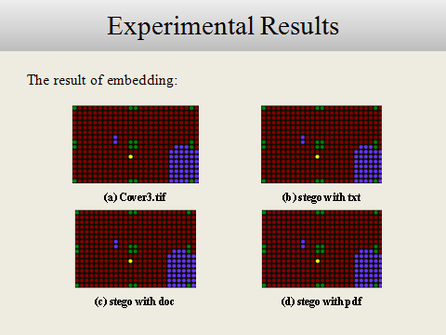

Slide 39
Conclusion
This talk (paper) proposes a practical user-friendly steganographic system for data hiding based on using a Hill cipher and a microarray image template. Three major programs written in ANSI C programs are used to implement this system:
gen384 for generating a microarray image
ench4 for data encryption and embedding
dech4 for secret extraction and decryption

Slide 40
Salaries for Information Technologies (2011~2016)
Min Med 75% Max
Google 92000, 126232, 137600, 318240
Facebook 85000, 138294, 150000, 247200
Uber-SF 76107, 120000, 140000, 175000
IBM-CA 61735, 99047, 140000, 222700
IBM-R△ 52998, 83666, 100000, 206348
MSFT 78540, 118142, 125676, 161000

Slide 41
A Novel Flowchart of Data Hiding

Slide 42
Thank you for your attention!
Questions and Comments?

Slide 43
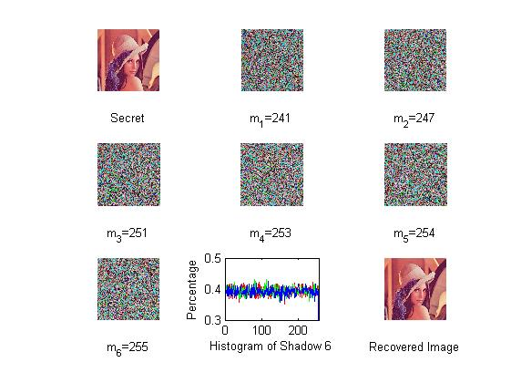
Image Sharing and Recovering

Slide 44
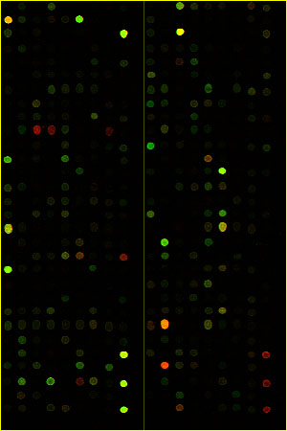
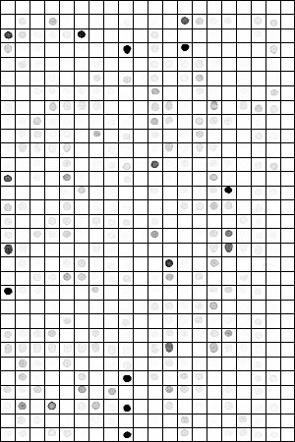
Microarray Image Data Analysis

Slide 45
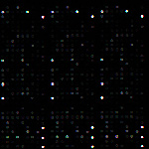
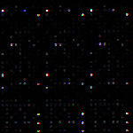
Microarray Image Data Analysis
Each gene expression
is a feature which is
measured as average
spot brightness
Top: Tumor Tissues
Bottom: Normal Tissues

