Slide 1
CSC6032 – Advanced Operating Systems
Prof. Yeh-Ching Chung
School of Data Science
Chinese University of Hong Kong, Shenzhen

Slide 2
Outline
Basic concepts of File System
NFS
Andrew File System
Replicated file systems
Ficus
Coda
Serverless file systems

Slide 3
Basic Distributed FS Concepts
You are here, the file’s there, what do you do about it?
Important questions
What files can I access?
How do I name them?
How do I get the data?
How do I synchronize with others?

Slide 4
What Files Can Be Accessed
Several possible choices
Every file in the world
Every file stored in this kind of system
Every file in my local installation
How many files do you have? Do you need to know that many files?
Selected volumes
Selected individual files

Slide 5
What dictates the choice
Why not make every file available?
Naming issues
Scaling issues
Local autonomy
Security
Network traffic

Slide 6
Naming Files in a Distributed System
How much transparency?
Does every user/machine/sub-network need its own namespace?
How do I find a site that stores the file that I name? Is it implicit in the name?
Can my naming scheme scale?
Must everyone agree on my scheme?

Slide 7
How do I get remote files?
Fetch it over the network?
How much caching?
Replication?
What security is required for data transport?

Slide 8
Synchronization and Consistency
Will there be trouble if multiple sites want to update a file?
Can I get any guarantee that I always see consistent versions of data?
i.e., will I ever see old data after new?
How soon do I see new data?

Slide 9
NFS (Networked File System)
Version 3
Provides distributed filing by remote access
With a high degree of transparency
Method of providing highly transparent access to remote files
Developed by Sun

Slide 10
NFS Characteristics
Volume-level access
RPC-based (uses XDR)
Stateless remote file access
Location (not name) transparent
Implementation for many systems
All interoperate, even non-Unix ones
Currently based on VFS

Slide 11
VFS/Vnode Review
VFS—Virtual File System
Common interface allowing multiple file system implementations on one system
Plugged in below user level
Files represented by v-nodes (virtual nodes)
A v-node is a name for an entry in a client-side registry of server connection information

Slide 12
NFS Diagram
NFS
Client
NFS
Server
/
/
/tmp
/mnt
/home
/bin
x
y
foo
bar

Slide 13
NFS File Handles
On clients, files are represented by v-nodes
The client internally represents remote files as handles
Opaque to client
But meaningful to server
To name remote file, provide handle to server

Slide 14
NFS Handle Diagram
Client side
Server side
User process
file descriptor
handle
NFS server
VFS level
vnode
vnode
VFS level
NFS level
handle
inode
Other file system

Slide 15
How to Make this Work
Could integrate it into the kernel
Non-portable, non-distributable
Instead, use existing features
VFS for common interface
RPC for data transport

Slide 16
Using RPC for NFS
Must have some process at server that answers the RPC requests
Continuously running daemon process
Somehow, must perform mounts over machine boundaries
A second daemon process for this

Slide 17
NFS Processes
nfsd daemons—server daemons that accept RPC calls for NFS
rpc.mountd daemons—server daemons that handle mount requests
biod daemons—optional client daemons that can improve performance

Slide 18
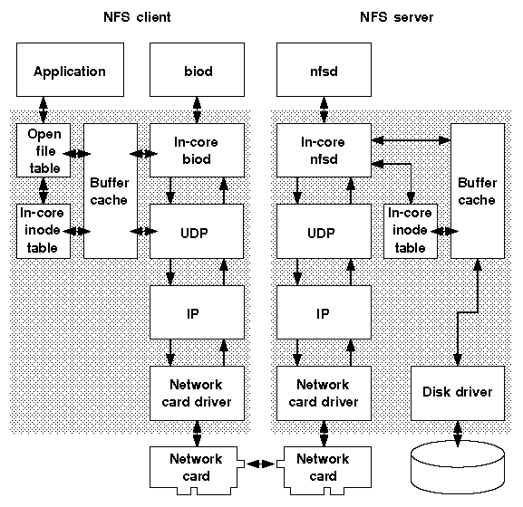
NFS from the Client Side
User issues a normal file operation
Like read()
Passes through v-node interface to client-side NFS implementation
Client-side NFS implementation formats and sends an RPC packet to perform operation
A client blocks until RPC returns

Slide 19
NFS RPC Procedures
16 RPC procedures to implement NFS
Some for files, some for systems
Include directory, link, read, write, etc., operations
Lookup() is the key operation
Because it fetches handles
Other NFS file operations use the handle

Slide 20
Mount Operations
Must mount an NFS file system on the client before you can use it
Requires local and remote operations
Local operations indicate mount point has an NFS-type VFS at that point in hierarchy
Remote operations go to remote rpc.mountd
Mount provides “primal” file handle

Slide 21
NFS on the Server Side
The server side is represented by the local VFS that stores the data along with rpc.mountd and nfsd daemons
NFS is stateless—servers do not keep track of clients
Each NFS operation must be self-contained (from the server point of view)

Slide 22
Implications of Statelessness
Self-contained NFS RPC requests
NFS operations should be idempotent
No static variables
NFS should use a stateless transport protocol (e.g., UDP)
Servers do not worry about client crashes
Server crashes will not leave junk

Slide 23
More Implications of Statelessness
Servers do not know what file is open by a client
Unlike in most local VFS file systems
Make it harder to provide certain semantics
Scales nicely, though

Slide 24
Preserve UNIX File Operation Semantics
NFS works hard to provide identical semantics to local UFS operations
Some of this is tricky
Especially given statelessness of server
For example, how do you avoid discarding pages of unlinked file a client has open

Slide 25
File Handles
Method clients use to identify files
Created by the server on file lookup
Must be unique mappings of server file identifier to universal identifier
File handles become invalid when server frees or reuses i-node
The i-node (index node) is a data structure in a Unix-style file system that describes a file-system object such as a file or a directory.
i-node generation number in handle shows when stale

Slide 26
NFS Daemon – nfsd
Handle incoming RPC requests
Often multiple nfsd daemons per site
An nfsd daemon makes kernel calls to do the real work
Allow multiple threads

Slide 27
NFS Daemon – biod
Does readahead for clients
To make use of kernel file buffer cache
Only improves performance—NFS works correctly without biod daemon
Also flushes buffered writes for clients

Slide 28
NFS Daemon – rpc.mount
Runs on server to handle VFS-level operations for NFS
Particularly remote mount requests
Provides initial file handle for a remote volume
Also checks that incoming requests are from privileged ports (in UDP/IP packet source address)

Slide 29
NFS Daemon – rpc.lock
NFS server is stateless, so it does not handle file locking
rpc.lockd provides locking
Runs on both client and server
Client side catches request, forwards to server daemon
rpc.lockd handles lock recovery when server crashes

Slide 30
NFS Daemon – rpc.statd
Also runs on both client and server
Used to check status of a machine
Server’s rpc.lockd asks rpc.statd to store lock info (in file system)
And to monitor status of locking machine
If client crashes, clear its locks from server

Slide 31
Recover Locks After a Crash
If server crashes and recovers, its rpc.lockd contacts clients to reestablish locks
If client crashes, rpc.statd contacts client when it becomes available again
Client has short grace period to revalidate locks
Then they’re cleared

Slide 32
Caching in NFS
How do you handle invalid client caches?
Write through caching
Other clients poll the server periodically
No guarantees for multiple writers

Slide 33
What Can You Cache
Data blocks read ahead by biod daemon
Cached in normal file system cache area
File attributes
Specially cached by NFS
Directory attributes handled a little differently than file attributes

Slide 34
Security in NFS
NFS inherits RPC mechanism security
Some RPC mechanisms provide decent security
Some do not
Mount security provided via knowing which ports are permitted to mount what

Slide 35
The Andrew File System
A different approach to remote file access
Meant to service a large organization
Such as a university campus
Scaling is a major goal

Slide 36
Basic Andrew Model
Files are stored permanently at file server machines
Users work from workstation machines
With their own private namespace
Andrew provides mechanisms to cache user’s files from shared namespace

Slide 37
User Model of Andrew File System
Sit down at any AFS workstation anywhere
Log in and authenticate who I am
Access all files without regard to which workstation I am using

Slide 38
The Local Namespace
Each workstation stores a few files
Mostly system programs and configuration files
Workstations are treated as generic, interchangeable entities

Slide 39
Vice and Virtue
Vice is the system run by the file servers
Distributed system
Virtue is the protocol clients use to communicate to Vice

Slide 40
Overall Architecture
System is viewed as a WAN composed of LANs
Each LAN has a Vice cluster server
Which stores local files
But Vice makes all files available to all clients

Slide 41
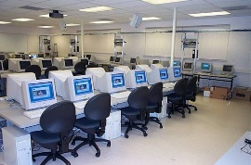
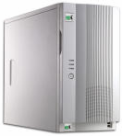
Andrew Architecture Diagram
WAN
LAN
LAN
LAN

Slide 42
Caching the User Files
Goal is to offload work from servers to clients
When must servers do work?
To answer requests
To move data
Whole files cached at clients

Slide 43
Why Whole-file Caching
Minimizes communications with server
Most files used in entirety, anyway
Easier cache management problem
Requires substantial free disk space on workstations
Does not address huge file problems

Slide 44
The Shared Namespace
An Andrew installation has globally shared namespace
All client’s files in the namespace with the same names
High degree of name and location transparency

Slide 45
How Servers Provide the Namespace
Files are organized into volumes
Volumes are grafted together into overall namespace
Each file has globally unique ID
Volumes are stored at individual servers
But a volume can be moved from server to server

Slide 46
Finding a File
At high level, files have names
Directory translates name to unique ID
If client knows where the volume is, it sends unique ID to appropriate server

Slide 47
Finding a Volume
What if you enter a new volume?
How do you find which server stores the volume?
Volume-location database stored on each server
Once information on volume is known, client caches it

Slide 48
Making a Volume
When a volume moves from server to server, update database
Heavyweight distributed operation
What about clients with cached information?
Old server maintains forwarding info
Also eases server update

Slide 49
Handle Cached Files
Files fetched transparently when needed
File system traps opens
Sends them to local Venus process

Slide 50
The Venus Daemon
Responsible for handling single client cache
Caches files on open
Writes modified versions back on close
What if there is a failure?
Cached files saved locally after close
Cache directory entry translations, too

Slide 51
Consistency for AFS
If my workstation has a locally cached copy of a file, what if someone else changes it?
Callbacks used to invalidate my copy
Requires servers to keep info on who caches files

Slide 52
Write Consistency in AFS (1)
What if I write to my cached copy of a file?
Need to get write permission from server
Which invalidates other copies
Permission obtained on open for write
Need to obtain new data at this point

Slide 53
Write Consistency in AFS (2)
Initially, written only to local copy
On close, Venus sends update to server
Extra mechanism to handle failures

Slide 54
Storage of Andrew Files
Stored in UNIX file systems
Client cache is a directory on local machine
Low-level names do not match Andrew names

Slide 55
Venus Cache Management
Venus keeps two caches
Status
Data
Status cache kept in virtual memory
For fast attribute lookup
Data cache kept on disk

Slide 56
Venus Process Architecture
Venus is single user process
But multithreaded
Uses RPC to talk to server
RPC is built on low level datagram service

Slide 57
AFS Security
Only servers are trusted here
Client machines might be corrupted
No client programs run on servers
Clients must authenticate themselves to servers
Encrypted transmissions

Slide 58
AFS File Protection
AFS supports access control lists
A file has list of users who can access it
And permitted modes of access
Maintained by Vice
Used to mimic UNIX access control

Slide 59
AFS Read-only Replication
For volumes containing files that are used frequently, but not changed often
E.g., executables
AFS allows multiple servers to store read-only copies

