Slide 1
CSC6032 – Advanced Operating Systems
Prof. Yeh-Ching Chung
School of Data Science
Chinese University of Hong Kong, Shenzhen

Slide 2
Outline
Distributed implications for RPC
Distributed shared memory
Causally ordered multicast systems

Slide 3
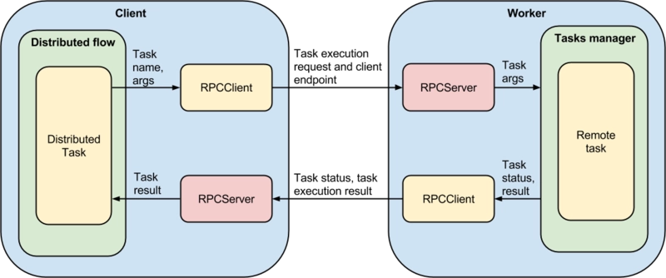
RPC in Distributed OS
What are the new problems when ‘remote’ means ‘not on this machine’
Finding remote servers
Data transport mechanisms
Handling heterogeneity

Slide 4
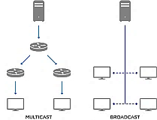
Find Remote RPC Servers
In general, a caller’s local site will not know the location of the called program
How to find it
Broadcast
Intelligent multicast
Consult a server

Slide 5
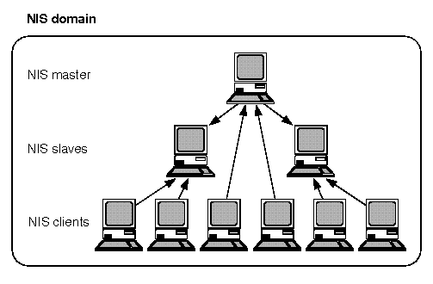
UNIX RPC
Consult the Network Information Service (NIS)
Network Information Service (NIS) is a client-server directory service protocol used for distributed systems to maintain consistent data and configuration files throughout a network
A naming service that keeps track of a variety of name-to-location mapping
Including names for RPC servers

Slide 6
Domain Name System (DNS)
The Domain Name System (DNS) turns domain names into IP addresses, which browsers use to load internet pages.
Every device connected to the internet has its own IP address, which is used by other devices to locate the device
DNS servers make it possible for people to input normal words into their browsers, such as Fortinet.com, without having to keep track of the IP address for every website
DNS acts like a phonebook for the internet. Whenever people type domain names into the address bar of web browsers, the DNS finds the right IP address. The site’s IP address is what directs the device to go to the correct place to access the site’s data.

Slide 7
Network Information System (NIS)
The Network Information Service, or NIS (originally called Yellow Pages or YP), is a client-server service protocol for distributed system configuration data such as user and host names between computers on a computer network.
A NIS/YP system maintains and distributes a central directory of user and group information, hostnames, e-mail aliases and other text-based tables of information in a computer network.
Administrators have the ability to configure NIS to serve password data to outside processes to authenticate users using various versions of the Unix crypt(3) hash algorithms.

Slide 8
Characteristics of NIS
Server daemons to consult server’s database
Client site daemons to forward local requests to appropriate server daemon
Databases are distributed
Replicated with weak consistency
A protocol is said to support weak consistency if
All accesses to synchronization variables are seen by all processes (or nodes, processors) in the same order (sequentially)
All other accesses may be seen in different order on different processes (or nodes, processors).
The set of both read and write operations in between different synchronization operations is the same in each process.

Slide 9
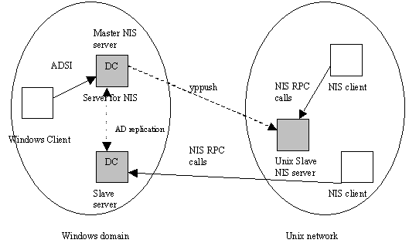
Get Server Information From NIS
Several system calls consult the local client daemon
For example: www.cuhk.edu.cn
When possible, it answers them locally
When not, it makes a remote request

Slide 10
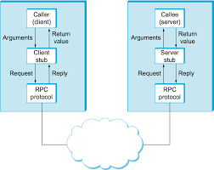
Set Up an RPC Connection
Server runs on a particular port on a particular machine
The port is unique within that machine
Client uses NIS to find out where the machine is (given, say, its name)
Need to find IP address

Slide 11
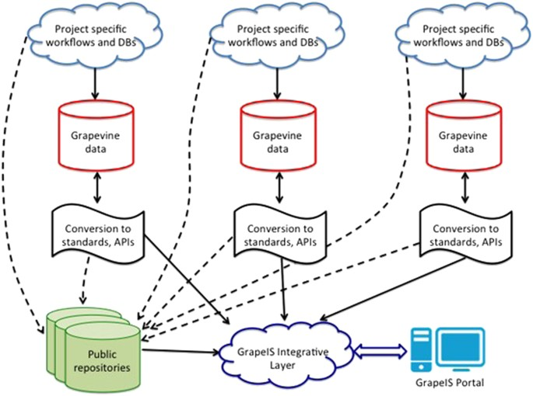
Mesa RPC
Use Grapevine system
An optimistically replicated name server
Servers register locations with Grapevine
Client look up services by name

Slide 12
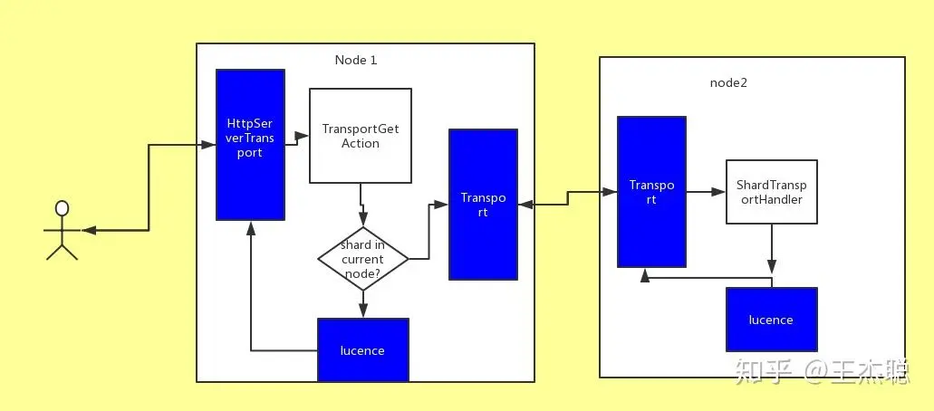
Transport Mechanisms for RPC
Really transparent to RPC facility
Just getting bits from here to there
But choice has strong implications
Performance
Security

Slide 13
RPC Transport Characteristics
Generally small amounts of information transported
But not always
Communications tend to be self-contained
Sender tends to block waiting reply
But another process may run at sending end
You may care about security

Slide 14
Security for RPC
RPC data transport is subject to the following security problems
Eavesdropping, corruption, masquerading, replay, etc.
For complete safety, encryption and authentication must be applied

Slide 15
Encryption
Use an algorithm to conceal the contents of a message from outsiders
Typically using a shared secret
The key
Good encryption makes data look random

Slide 16
Authentication
Assure that messages come from who they claim to be
Typically by signing a message
Signature must be creatable only by the sender
Must be checkable by receiver
Keys are typically used, again

Slide 17
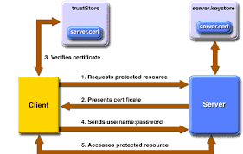
Encryption and Authentication for RPC
How many keys?
One for all RPC communications?
One per machine?
One per RPC server?
One per client/server pair?
How to distribute them?

Slide 18
UNIX RPC Security
No encryption built in
Several levels of authentication provided
None
UID/GID attached (but not verified)
DES-based authentication (not very strong)

Slide 19
Heterogeneity and RPC
RPC is meant to be largely transparent
Do not worry about location of server
Do not worry about other server characteristics
What if the server is a different type of machine?

Slide 20
UNIX RPC and XDR
XDR: External Data Representation
A library that deals with heterogeneity
Based on an ARPA standard
Similar to an ISO standard
Basic idea - data travels between client and server in a canonical format
Each machine translate to local format

Slide 21
XDR Diagram
Client
Server
XDR
XDR
Network

Slide 22
Who Uses XDR
Must be built into the application—UNIX RPC does not use it by default
But protocol compilers typically do the work of using XDR for real programs
Must be sure to use it consistently

Slide 23
Another Option for Handling Heterogeneity
Most modern machines don’t use heterogeneous data formats
So XDR translations may be wasted
Sometimes receiver-makes-right is used instead
Puts burden on non-conformists

Slide 24
Receiver-makes-right Diagram
Client
Server
Conversion
Network

Slide 25
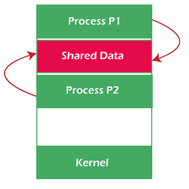
Synchronization for Cooperating Processes
If processes need to see a common view of the world, what can we do?
Various approaches, including
Distributed shared memory (DSM)
Causally ordered message multicasting

Slide 26
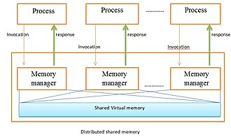
Distributed Shared Memory
Cooperating processes share a coherent memory space
Can this be provided between processes that cannot access the same physical memory?
Yes, and sometimes at a reasonable cost
DSM must be highly transparent to be successful

Slide 27
DSM Diagram
Shared memory space

Slide 28
Approaches to DSM
Central server
Migration
Read replication
Full replication

Slide 29
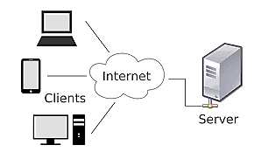
Central Server DSM
A server maintains all data pages
Returns data on reads
Makes updates on writes
Care needed to avoid duplicating writes
Server duties can be split among several sites

Slide 30
Pros/Cons of Central Server DSM
+ Relatively simple to implement
+ Synchronization methods pretty clear
- Most data references are remote
- Prone to bottlenecks

Slide 31
Migration DSM
Data lives where most recently used
When off-site memory is requested, it migrates to the requesting site
Typically at block or page levels
With locality of reference, work well
But possibility of thrashing
Servers keep track of data locations

Slide 32
Pros/Cons of Migration DSM
+ If locality good, most accesses are local
+ Synchronization behavior fairly easy
- Thrashing dangers
- Possible bottlenecks at location servers
- May put heavy burden on communications

Slide 33
Read-Replication DSM
Copies of readable blocks stored
If block is written, invalidate other copies
Each block has owner that permanently stores it
If writes frequent, invalidation can be complicated and expensive

Slide 34
Pros/Cons of Read Replication DSM
+ Reads are usually local
+ Synchronization not too difficult
- Requires invalidations
- Possibly heavy burden on owners of popular pages
- Writes are never local (unless site owns the page)

Slide 35
Full-Replication DSM
Full-service replicas of data blocks/pages stored at several machines
Requires consistency mechanism
For same reasons as replicated files
But different mechanisms may be appropriate

Slide 36
Pros/Cons of Full Replication DSM
+ Access usually local
+ Bottlenecks generally less likely
- Synchronization tricky
- Requires full replication mechanism
- Likely to be overkill unless data sharing very common

Slide 37
Memory Coherence in Replicated DSM Schemes
If more than one copy of a data item exists, problems arise when data is written
Consistency model describes what level of consistency a DSM system provides

Slide 38
Consistency Models for DSM
Strict consistency (as if only one copy)
A write to a variable by any processor needs to be seen instantaneously by all processors
Sequential consistency (serializability)
Sequential consistency is a conservative memory model that does not allow any instruction reordering on each core
General consistency (eventual consistency)
A system supports general consistency if all the copies of a memory location eventually contain the same data when all the writes issued by every processor have completed
Processor consistency (per machine)
A write followed by a read is allowed to execute out of program orde
Weak consistency (up to programmer)
No guarantees about the ordering of operations or the state of the data at any given time

Slide 39
Protocols to Provide DSM Coherence
Write-invalidate protocol
Invalidate other copies on write
Expensive for those other copies
Write-update protocol
Update other copies on writes
Higher network traffic results
Requires some kind of locking

Slide 40
Control Thrashing in DSM
How to prevent 2 sites sharing a page for write from thrashing the net
One way is to lock a written page down at a site for some period
Another site must wait for the time period to expire to write
Used in Mirage system

Slide 41
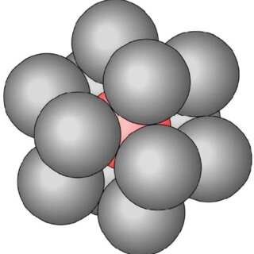
Granularity in DSM
How big should the unit of shared memory be?
Should be related to hardware’s page size
Size of page has many implications

Slide 42
Pros/Cons of Large Pages for DSM
+ Takes advantage of locality
+ Minimize cost of running page code
+ Can minimize communications cost
If lots of data being moved
- Leads to greater contention

Slide 43
Pros/Cons of Small Page Size for DSM
+ Less contention
Minimizes false sharing
+ Lower cost to move small objects
- Greater overheads

Slide 44
False Sharing in DSM
Occurs when an apparent, but not real, conflict occurs between two copies of a page
Caused by viewing replication unit as a page, rather than a memory location

Slide 45
False Sharing Example (1)
Site A
Site B

Slide 46
False Sharing Example (2)
There appears to be a conflict, but there really is not
Update x
Update y
Site A
Site B

Slide 47
Effects of False Sharing
Depends on approach used
In migration systems, causes more page migration
In write-invalidate replication systems, causes more invalidations
In update-propagation replication systems, causes more locking

Slide 48
Page Replacement in DSM
When a local node needs to bump a shared memory page, what does it do?
LRU alone not a sufficient answer
Must consider private vs. shared pages
And replication issues
And read-only pages
LRU within classes often used

Slide 49
Another Way to Provide Distributed Consistency
Assume a set of cooperating processes start out consistent
With a distributed state
And assume the only interactions are through messages
If all processes see the messages in the same order, all see a consistent state

Slide 50
Event Ordering and Clocks
Derived from work by Lamport in late 70s
How can you tell which of two events occurred first in a distributed system?
Sometimes impossible to say
When can we determine it?

Slide 51
What About Clock Time
Stamp each event with the time of the local clock
Only works if you have clocks available
What if the local clock doesn’t have the same time as other clocks?
Need some better definition

Slide 52
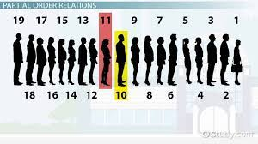
Building a Partial Order of Events
Assume system is composed of collection of processes
Each process is a sequence of events
Events within a single process have a natural total order
How about inter-process relationships?

Slide 53
The Happened Before Relation
x → y
Event x happened before event y
Event x could have had a causal influence on event y
Complete set of “happened before” relationships for a computation defines a partial order of its events

Slide 54
How Do We Define the Partial Order
1. If x and y are events in the same process, and x comes before y,
x → y
The natural ordering of events in a sequential process
2. If x is the sending of a message m and y is the receipt of message m
x → y
Means you can’t receive a message until after it is sent
3. If x → y, and y → z, then x → z
Transitivity applies
Also, x → x
An event cannot happen before itself

Slide 55
Concurrent events
Two events x and y are said to be concurrent if
x → y and y → x
Concurrent events cannot have a causal influence on each other

Slide 56
Examples of Partial Ordering
p1 → p2 q1 → q2 → q3
p2 → q2
p1 → q3 r3 → q3
q3
q2
r3
p2
q1
p1

Slide 57
Concurrent Event Examples
p2 and r3 are concurrent
q1 and p1 and r3 are concurrent
q3
q2
r3
p2
q1
p1

Slide 58
Causal Influence
Event x can have a causal influence on event y on if x → y
Which means, among other things, the events that are concurrent can be safely run in parallel

Slide 59
Logical Clocks
We can use event partial ordering to construct logical clocks that make the ordering explicit
Each event is assigned a timestamp
The timestamps reflect the “happened before relation”

Slide 60
Defining the System
System consists of set of processes P
Process P_{i} is the i^{th} of these processes
Each process has a clock C_{i}
Each event x of process P_{i} is assigned clock value C_{i}[x]
C[x] is global clock value of x
C[x] = C_{i}[x] if x happens at P_{i}

Slide 61
Correctness Condition for Logical Clocks
Clocks can be implemented as logical counters, rather than physical clocks
For any events x and y
If x → y, then C[x] < C[y]
Converse isn’t true, since that would imply concurrent events occur at the same time

Slide 62
How to Satisfy the Clock Condition
C1: If x and y are events in P_{i}, and x comes before y, C_{i}[x] < C_{i}[y]
C2: If x is the sending of a message by P_{i} and y is the receipt of that message by P_{j}, then C_{i}[x] < C_{j}[y]
These match the first two conditions in the definition of “happened before”

Slide 63
Example of Logical Clock Values
C_{p}[p1] → C_{p}[p2]
C_{p}[p2] → C_{q}[q2]
C_{p}[p1] → C_{q}[q3]
C_{q}[q1] → C_{q}[q2] → C_{q}[q3]
C_{r}[r3] → C_{q}[q3]
q3
q2
r3
p2
q1
p1

Slide 64
How Can We Make Logical Clocks Actually Work
Increment the local clock between any two successive events
Add timestamp T to message x
T = C_{i}[x]
On receipt y of a message at P_{j}, set C_{j}[y] = max(T, C_{j}) + 1

Slide 65
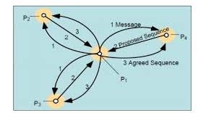
Obtaining a Total Ordering
Puts all events in system into some total order
Basic method is to provide ordering of processes
To break ties on local clock values

Slide 66
Using Causal Ordering in a Real System
Messages carry updates
All messages must be handled in the appropriate order to guarantee consistency
Absolute ordering
Causal ordering
Easy to provide synchronously
Hard to provide asynchronously

Slide 67
ISIS—A Causal Message Ordering Service
Isis is a library for guaranteeing message ordering
By multicast operations
Can provide either a reliable ordered atomic broadcast (ABCAST) or a causal and atomic group multicast (CBCAST)
Using low-overhead mechanisms

Slide 68
The ISIS Model
Set of processes P = {p₁, p₂, … p_{n}}
Process failure is detectable
Processes structured in process groups
G = {g₁, g₂, …}
Processes can belong to multiple groups
Multicasts only go to members in sender’s group

Slide 69
View in ISIS
The membership of a given group at a given moment is a view
A view sequence of a process group is a list of its views
Each view differs from last for each process
Processes learn of failures only by requesting view of a group

Slide 70
ISIS Message Transport
Isis is built on top of a transport mechanism
With the following characteristics
Lossless
Uncorrupted
Sequenced
Transport layer intercepts and discards messages from failed processes

Slide 71
ISIS Message Primitives
send_{p}(m)
Denotes sending of m by p; atomic
dests(m)
Set of processes receiving message m
rcv_{p}(m)
Event of process p receiving message m

Slide 72
Events in ISIS
The execution of a process is a partially ordered sequence of events
Events consist of things like sending a message, receiving a message
Acyclic event order reflects the dependence of events at p

Slide 73
Virtual Synchrony
Users program Isis as if it scheduled one distributed event at a time
How to achieve this?
Schedule one distributed event at a time
Enforce degree of synchrony actually needed for each case to give this appearance

Slide 74
Aspects of Virtual Synchrony
Address expansion
Ensure a given group multicast goes to all members of a given view
Delivery atomicity and order
Fault tolerant delivery
Multiple destinations receiving same messages get them in consistent order

Slide 75
Vector Clocks
Similar to version vectors, per process
For P processes, version clocks are of length P
VT(P_{i}) is the version clock of p_{i}
VT(P_{i})[i] is the i^{th} component
Assign a unique, increasing timestamp to each send event
Properly handled, version clocks encode causality

Slide 76
The CBCAST Protocol
Before multicasting message m, process p_{i} increments VT(P_{i})[i]
When p_{j} receives message m from p_{i}, delay delivery until
∀k, VT(m)[k] == VT(P_{j})[k] + 1 if k = i
VT(m)[k] <= VT(P_{j})[k] otherwise
On delivery of m, update j’s vector time

Slide 77
What Is Going on Here
Do not deliver a message to a process until
The process has received all earlier messages from the sending process
The process has received all earlier messages from third party processes received by the sending process

Slide 78
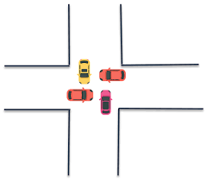
Can CBCAST Deadlock
Deadlocks are based on waiting
So when does CBCAST wait?
When a message has arrived at a process, but cannot yet be delivered
What is it waiting for?
Other messages to arrive

Slide 79
Is CBCAST’s Message Waiting Safe
The messages CBCAST waits for are messages that were delivered to (or originated with) the sender before the message m that’s waiting
So they are not waiting for message m
Reliable delivery guarantees that the messages being waited for will arrive

Slide 80
Other Issues in ISIS
Implementing ABCAST
Delivery atomicity
Handling group membership changes
Minimizing communications for overhead
Interactions of multiple overlapping groups
Performance, performance, performance

