Slide 1
Efficient Memory Management for Large Language Model Serving 2024.04.16
Xiaozhuang Song

Slide 2
Outline
Background
Long context learning
Bottlenecks for LLM/LM Servings
Problems
Proposed Methods
Results/Evaluation
Conclusions

Slide 3
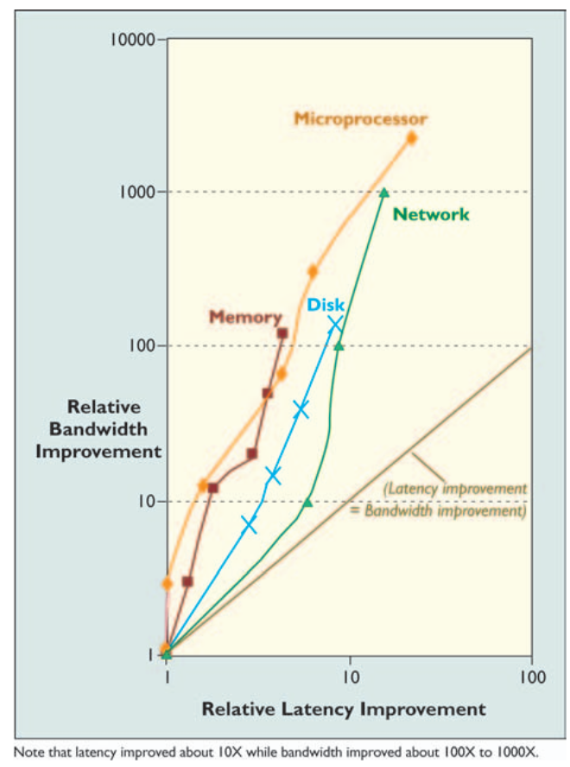
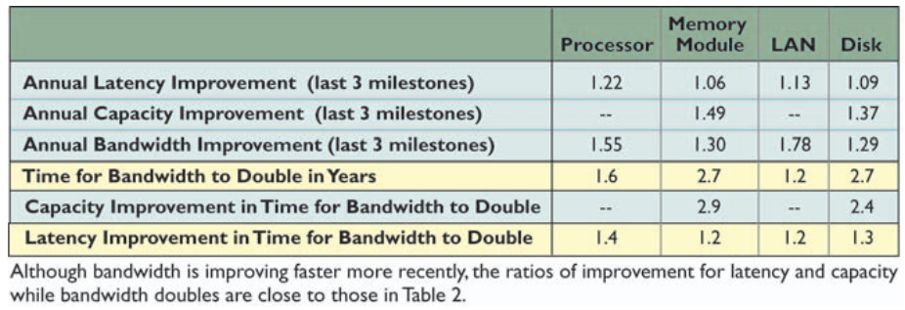
Background
Exacerbating the difficulty of maximizing compute utilization is the rate at which compute grows compared to memory bandwidth. Take this table on CPU FLOPS doubling times vs. memory bandwidth doubling times
Latency Lags Bandwith David Peterson, 2004

Slide 4
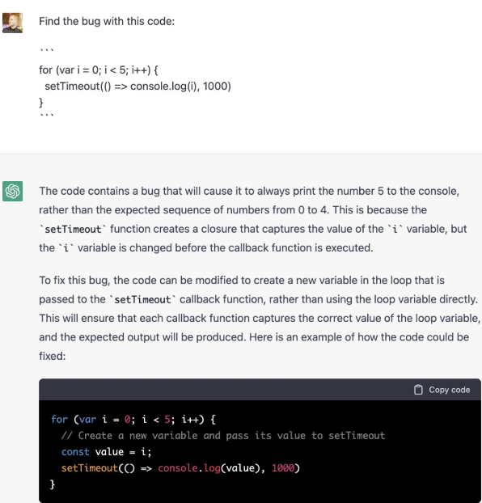
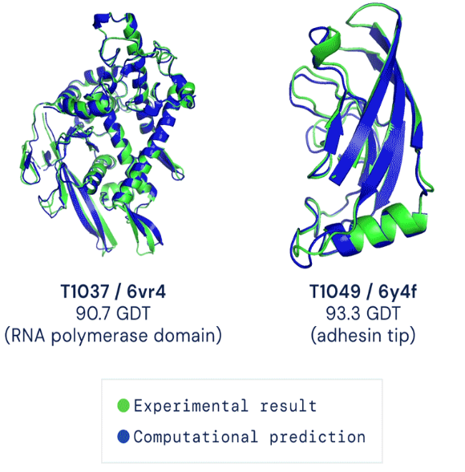
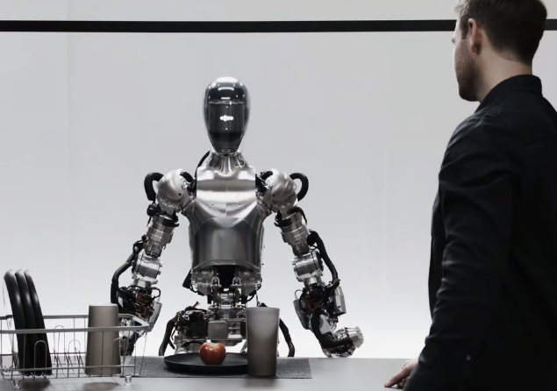
Background
Machine Learning Has Made Exciting Progress
Chatbot (ChatGPT/GPT4 - OpenAI)
Generate Art
(Stable Diffusion Stability.AI)
Design Drugs
(AlphaFold – DeepMind)
Robotics
(Figure)
What enabled these advances? What are outstanding problems? How do we approach them?

Slide 5
Background (Long context learning)
An Explanation of In-context Learning as Implicit Bayesian Inference, Sang M. Xie et al., arXiv.2111.02080
Effective Long-Context Scaling of Foundation Models, Meta, arXiv.2309.16039

Slide 6
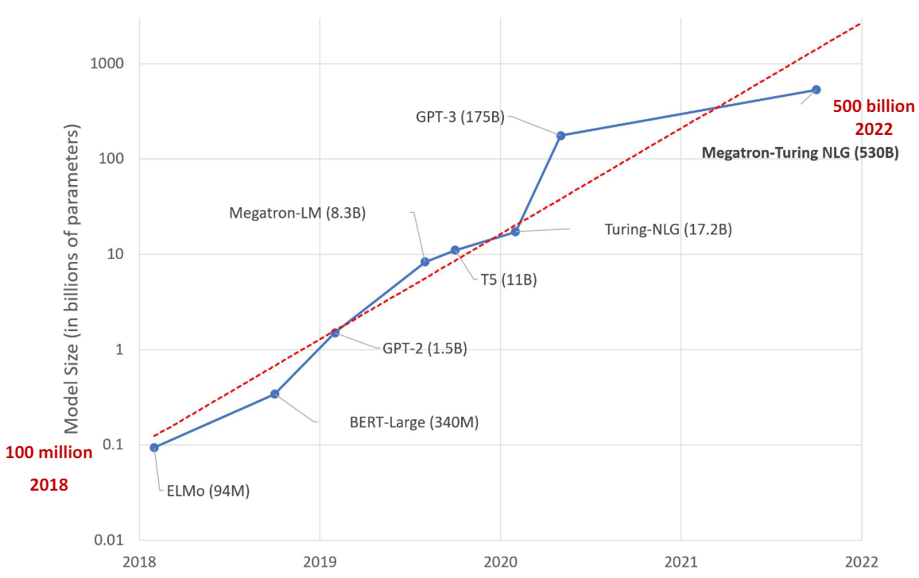
Background
Scale Brings Quality and Capabilities
Input: I tried 10000 random restarts of my neural network, but I was accused of overfitting. I guess no good seed goes unpunished.
1.3B model: The joke is that if you try 10000 different seed choices,you'll eventually find one that works, but you'll be accused of overfitting.
175B model: This joke is a play on words related to neural networks, a type of machine learning algorithm. The punchline, "I guess no good seed goes unpunished," is a play on the phrase "no good deed goes unpunished." In this case, "good seed" refers to a starting point for the random restarts and the joke implies that even when trying to improve the neural network’s performance, the person is still accused of overfitting.
Scale is more closely tied to advances in ML than ever before
The scaling hypothesis. Gwern Branwen 2022

Slide 7
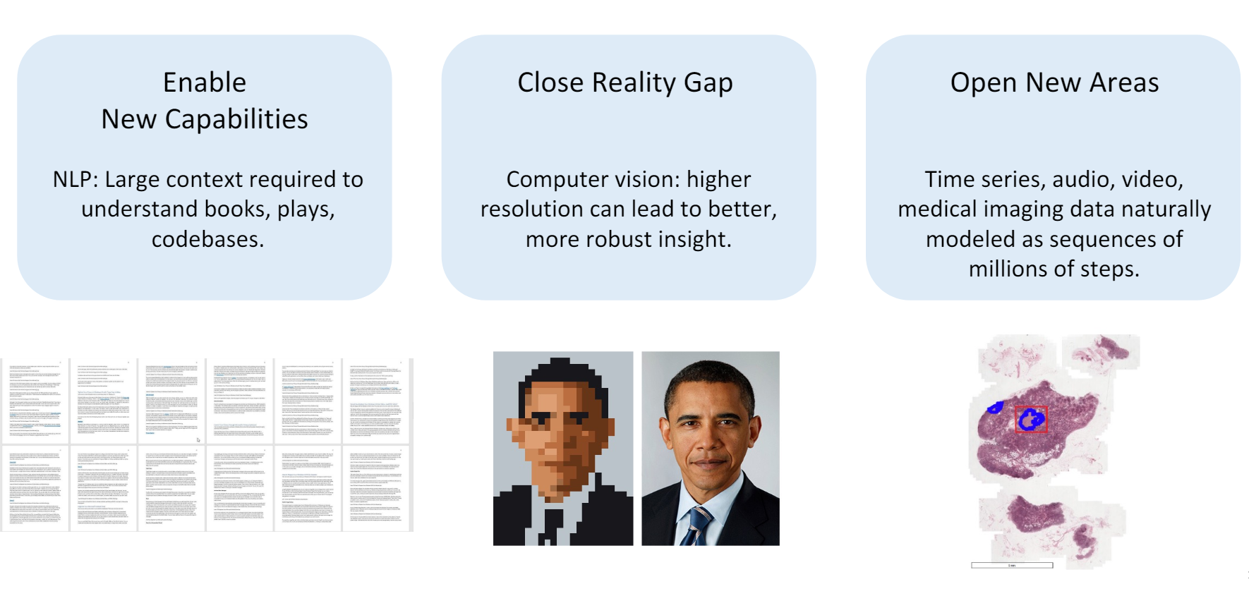
Background
Motivation: Modeling Long Sequences

Slide 8
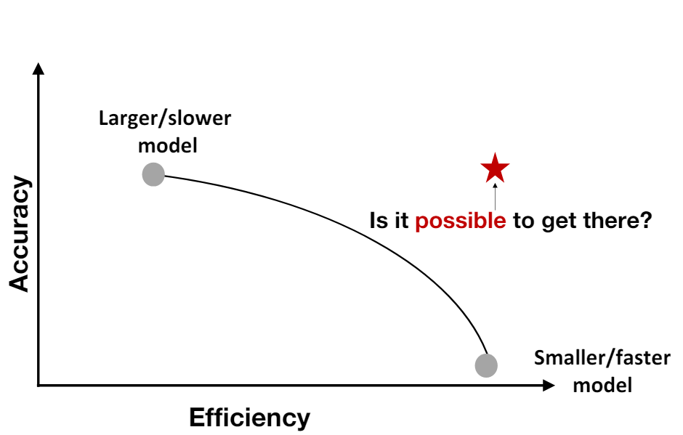
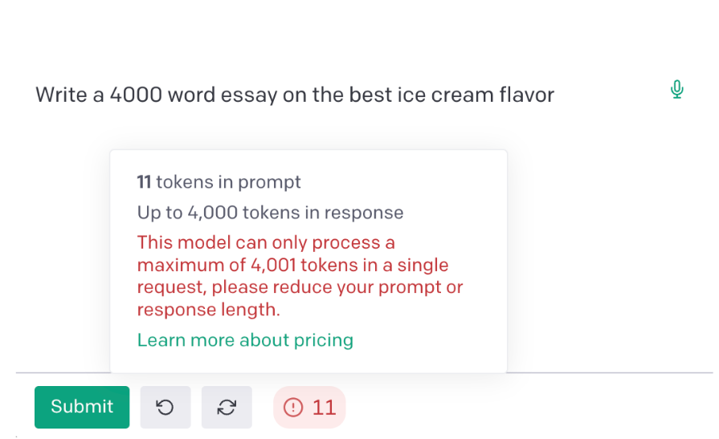
Problem
Core Challenge with Large Scale/Long Context/Long Sequence: Efficiency
Efficiency eases training, deployment, and facilitates research
Efficiency unlocks new capabilities (e.g., long context)

Slide 9
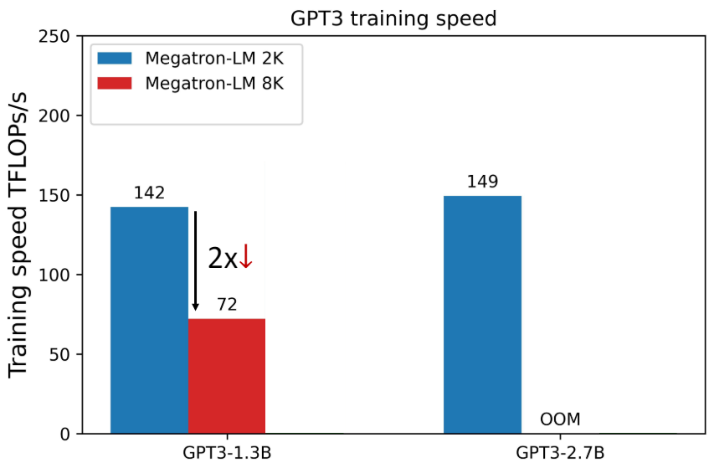
Problem
Efficiency is the Bottleneck for Modeling Long Sequences
Increasing context length slows down (or stops) training
Context length: how many other elements in the sequence does the current element interact with
How to efficiently scale models to longer sequences?

Slide 10
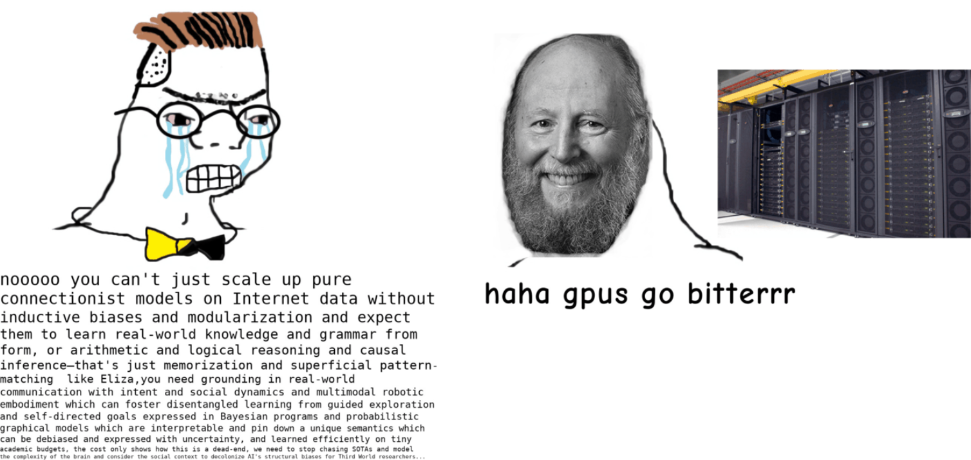
Problem
Core Challenge with Scale: Efficiency
Behind the bitter lesson is a legion of engineers keeping GPUs running efficiently. Image from The scaling hypothesis. Gwern Branwen 2022 blogs

Slide 11
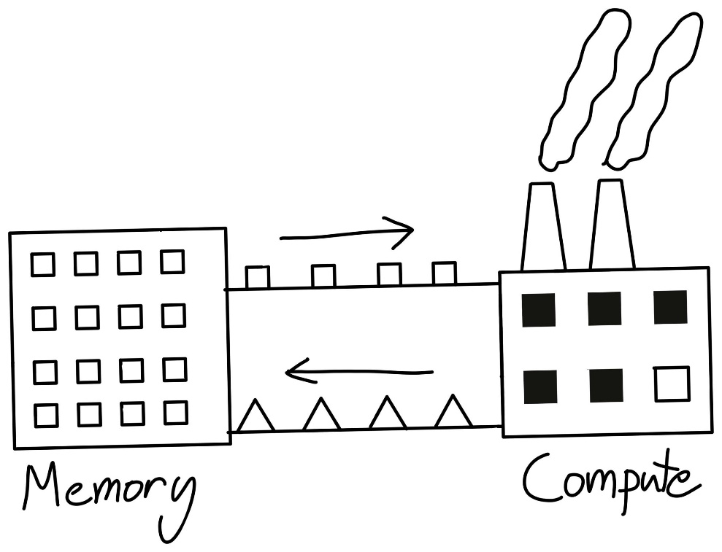
Problem
One way to think about compute is as a factory. We send instructions to our factory (overhead), send it materials (memory-bandwidth), all to keep our factory running efficiently (compute).
Making Deep Learning Go Brrrr From First Principles, Horace He

Slide 12
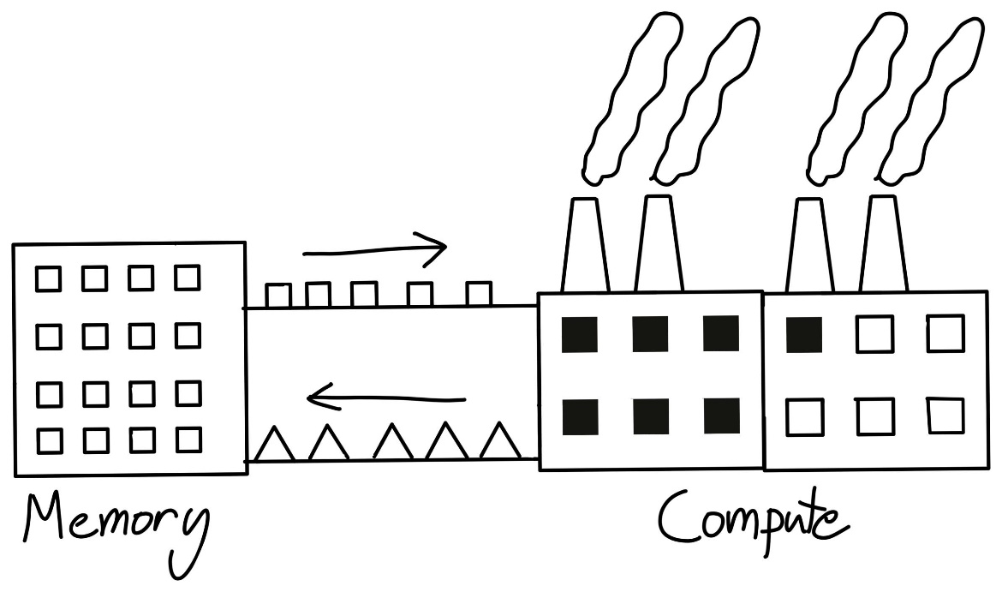
Problem
So, if our factory increases efficiency faster than the rate at which we can supply it materials, it becomes harder for our factory to achieve its peak efficiency.
Even though our factory's size (FLOPS) doubled - if our bandwidth can't keep up then our performance isn't also going to double
Making Deep Learning Go Brrrr From First Principles, Horace He

Slide 13
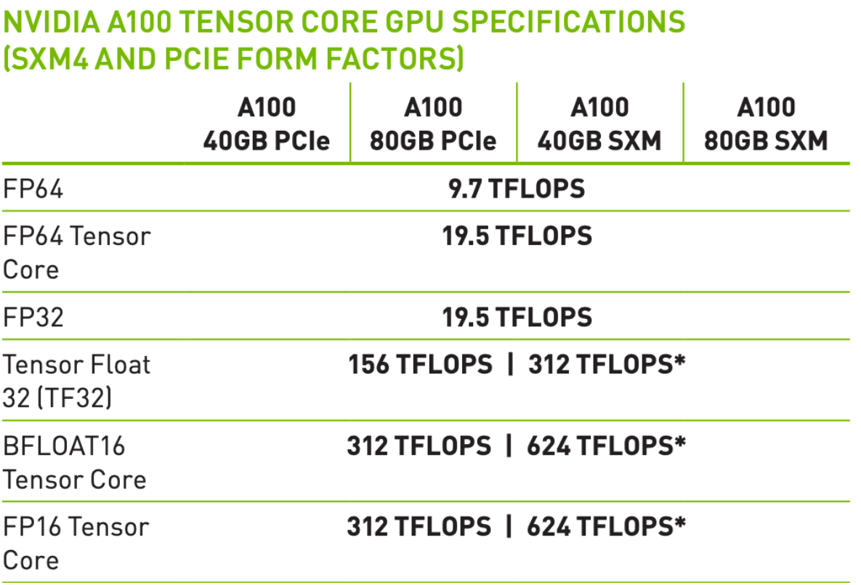
Problem
This growing difficulty in utilizing our compute also makes understanding our bottlenecks even more important.
One more addendum about FLOPS. Modern machine learning accelerators all have hardware specialized for matrix-multiplication, such as Nvidia's "Tensor Cores". So, if you aren't doing matrix multiplication, you'll only be able to achieve 19.5 teraflops instead of the stated 312. Note that this isn't unique to GPUs - in fact, TPUs are even less general than GPUs.

Slide 14
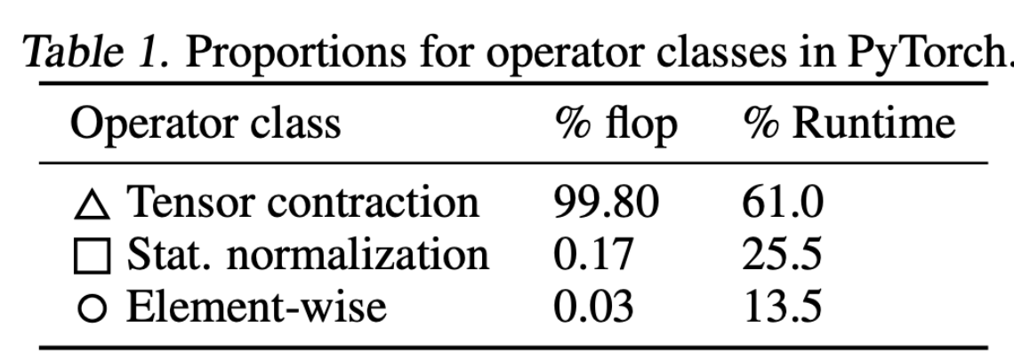
Problem
Altogether, the non-matmul ops only make up 0.2% of our FLOPS.
But, in this case, the normalization and pointwise ops actually achieve 250x less FLOPS and 700x less FLOPS than our matmuls respectively.
Data Movement Is All You Need: A Case Study on Optimizing Transformers, 2020, Andrei Ivanov et al.

Slide 15
Problem
Altogether, the non-matmul ops only make up 0.2% of our FLOPS.
But, in this case, the normalization and pointwise ops actually achieve 250x less FLOPS and 700x less FLOPS than our matmuls respectively.
So why do non-matmul ops take so much more stime than they should?
Data Movement Is All You Need: A Case Study on Optimizing Transformers, 2020, Andrei Ivanov et al.

Slide 16
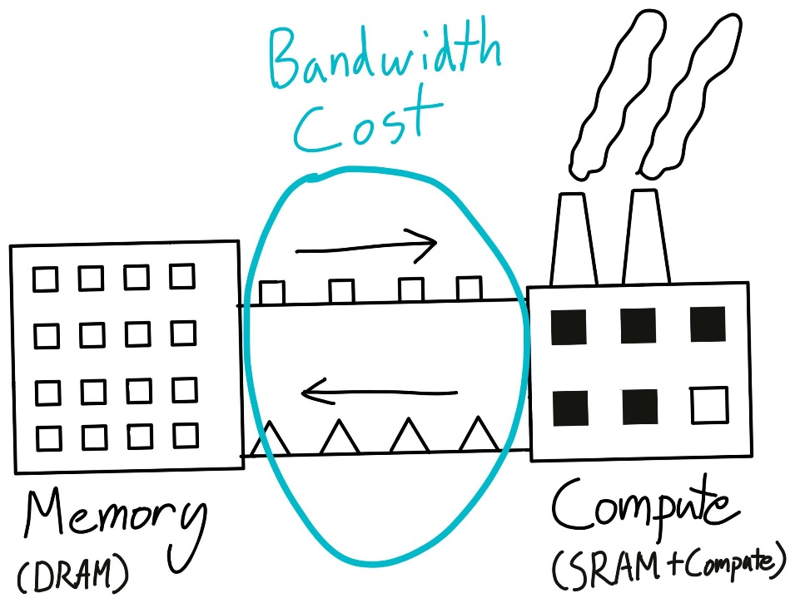
Memory Bandwidth Efficiency
The problem is with memory bandwidth.

Slide 17
Memory Bandwidth Efficiency
The problem is with memory bandwidth.
Although our factory is where we do the actual work, it's not suitable as a bulk storage unit. A large part of this is that since we're doing actual work here, all the storage is optimized for being fast to actually use (SRAM), instead of having a lot of it.
So, where do we store the actual results and materials? The typical approach is to have a warehouse, probably somewhere where land is cheap and we have a lot of space (DRAM). Then, we can ship supplies to and from our factories (memory bandwidth).

Slide 18
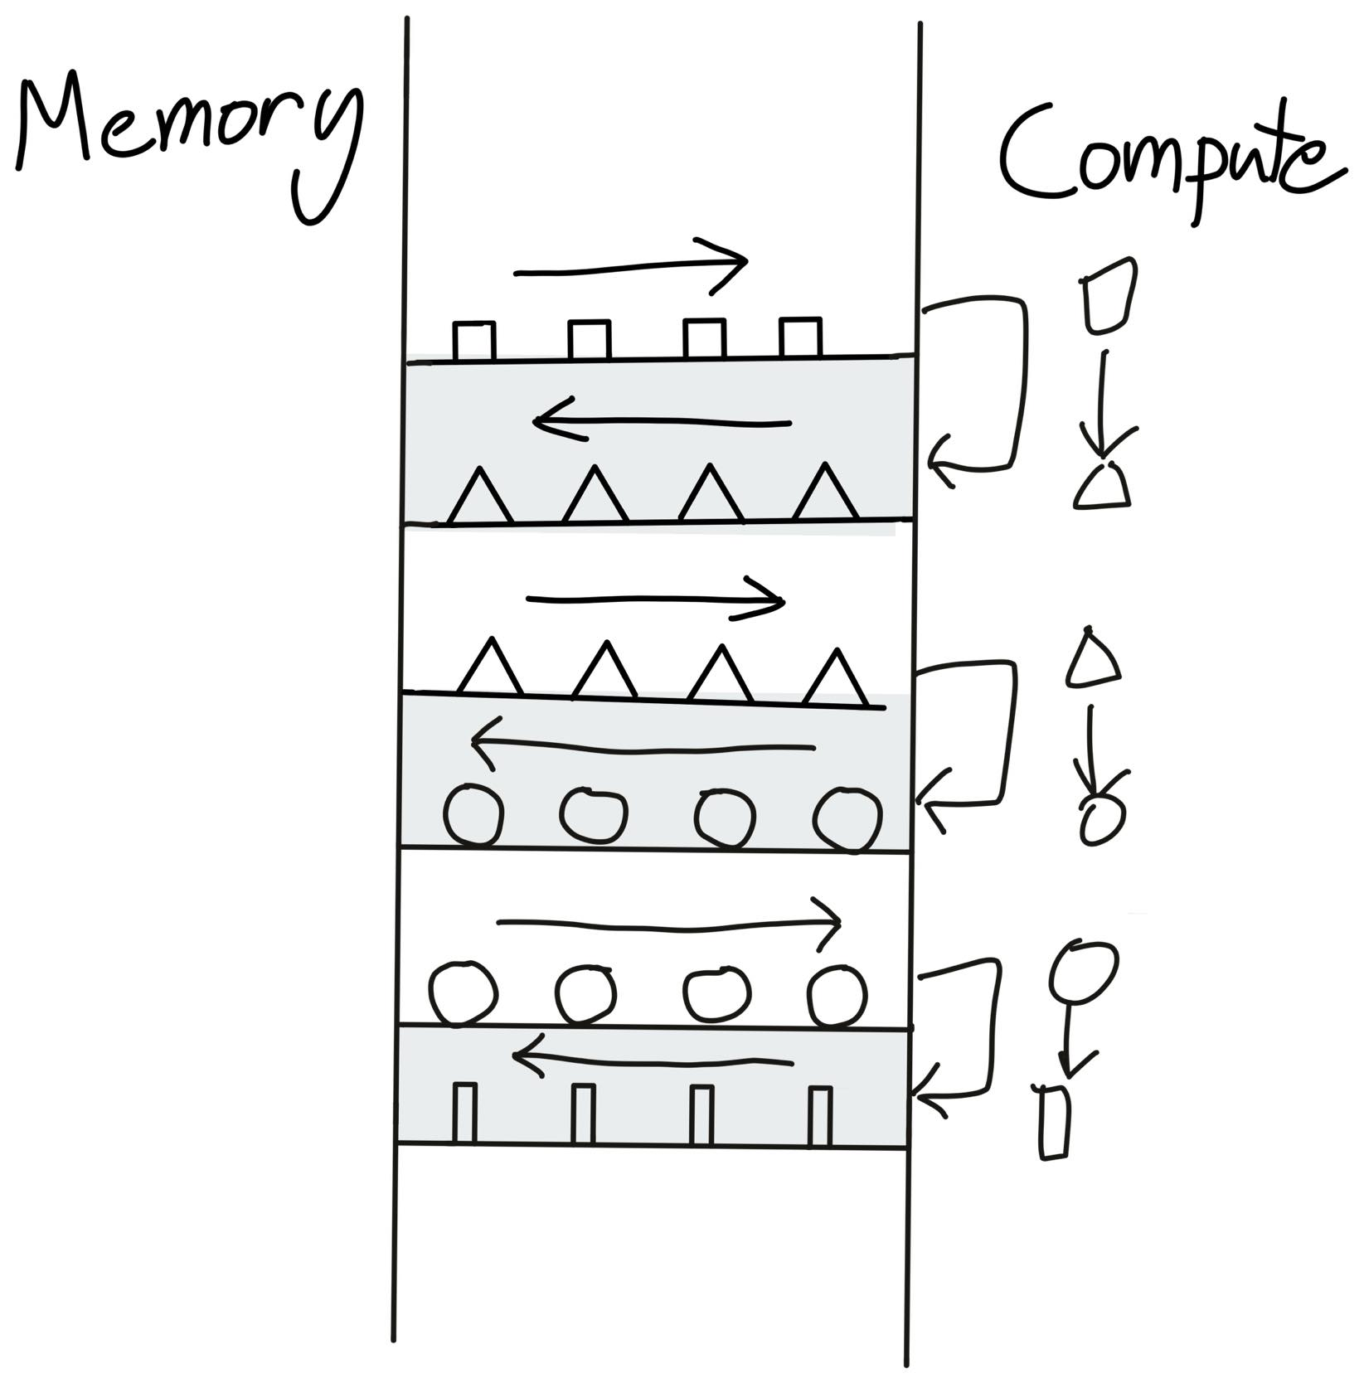
Memory Bandwidth Efficiency
Imagine what happens when we perform an unary operation like torch.cos. We need to ship our data from our storage to the warehouse, then perform a tiny bit of computation for each piece of data, and then ship that storage back. Shipping things around is quite expensive.
As a result, nearly all of our time here is spent shipping data around, and not on the actual computation itself.
Since we're spending all of our time on memory-bandwidth, such an operation is called a memory-bound operation, and it means that we're not spending a lot of time on compute.

Slide 19
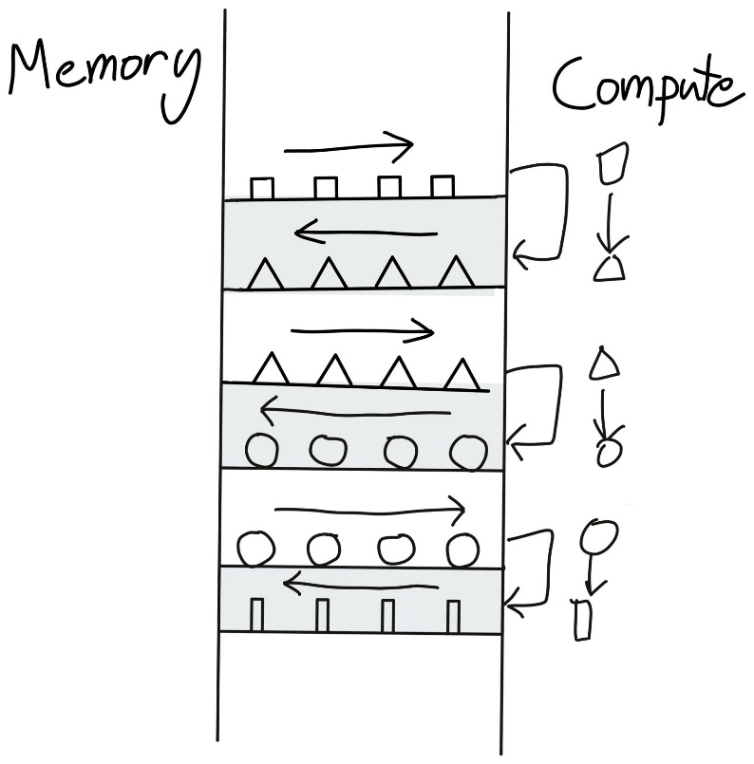
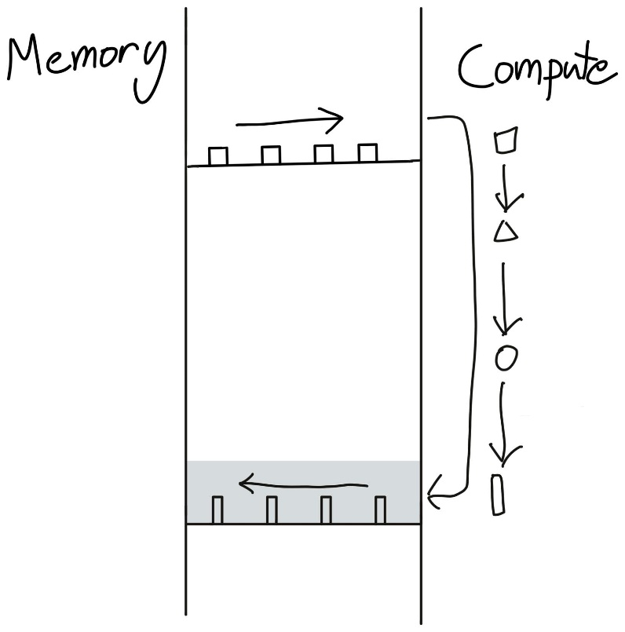
Memory Bandwidth Efficiency
Instead of sending our triangle back to global memory just to read it back again.
What if we instead just do all of our operations in one go?

Slide 20
Memory Bandwidth Efficiency
Instead of sending our triangle back to global memory just to read it back again.
What if we instead just do all of our operations in one go?
This is operator fusion - the most important optimization in deep learning compilers.
Simply put, instead of writing our data to global memory just to read it again, we elide the extra memory accesses by performing several computations at once.

Slide 21
Operator fusion
There are a couple of caveats that make this a bit tricky.
First of all, the GPU needs to know what's going to happen next when performing the current operation. So, you can't do this optimization in eager-mode, where PyTorch runs operators one at a time.
Second, we actually need to generate CUDA code for this, which opens up a whole new can of worms.

Slide 22
Operator fusion
For one, a fused x.cos().cos() will take nearly the exact same time as calling x.cos() by itself. This is why activation functions are nearly all the same cost, despite gelu obviously consisting of many more operations than relu.
Not all operator fusion is as simple as pointwise operators. One can fuse pointwise operators onto reductions, or pointwise operators onto matrix multiplication.
Even matrix multiplication itself can be thought of as fusing a broadcasting multiply followed by a reduction.

Slide 23
Operator fusion
For one, a fused x.cos().cos() will take nearly the exact same time as calling x.cos() by itself. This is why activation functions are nearly all the same cost, despite gelu obviously consisting of many more operations than relu.
Not all operator fusion is as simple as pointwise operators. One can fuse pointwise operators onto reductions, or pointwise operators onto matrix multiplication.
Even matrix multiplication itself can be thought of as fusing a broadcasting multiply followed by a reduction.
Moreover, this fact leads to some interesting consequences for rematerialization/activation checkpointing. Essentially, doing extra recomputation might lead to less memory-bandwidth, and thus less runtime.

Slide 24
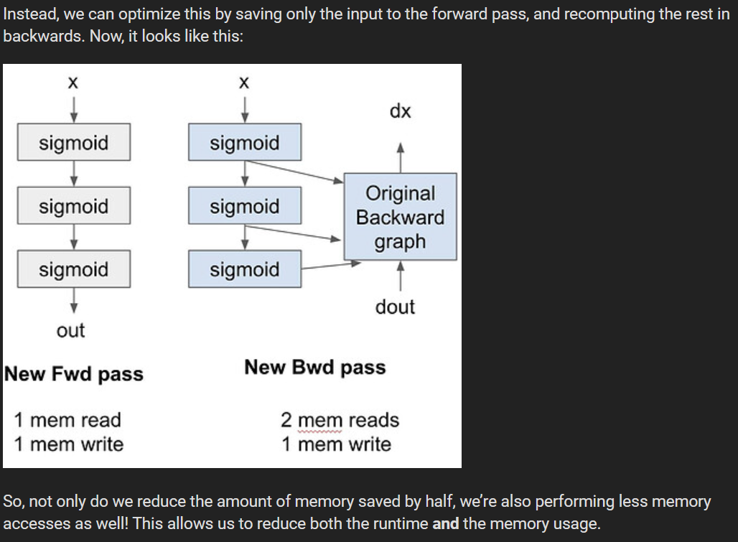
Recomputation make efficiency?
This fact leads to some interesting consequences for rematerialization/activation checkpointing. Essentially, doing extra recomputation might lead to less memory-bandwidth, and thus less runtime.

Slide 25
Problem
How can we optimize the memory efficiency for the transformer models?
Efficiency eases training, deployment, and facilitates research
Efficiency unlocks new capabilities (e.g., long context)

Slide 26
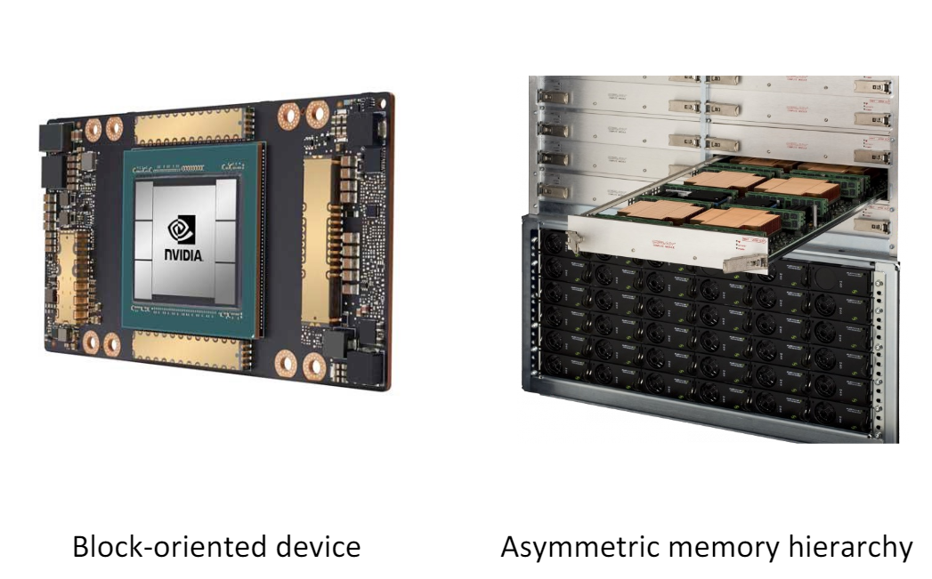
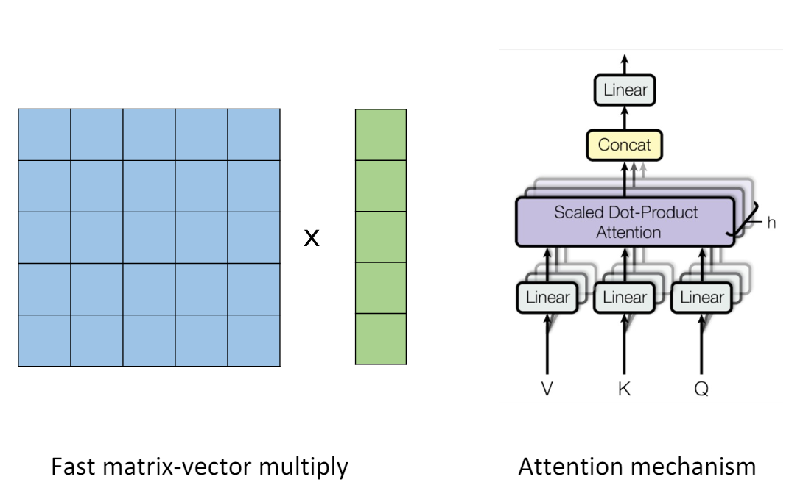
Problem
Approach to Efficiency: Understanding Algorithms & Systems
Hardware accelerators & distributed systems
Fundamental algorithms

Slide 27
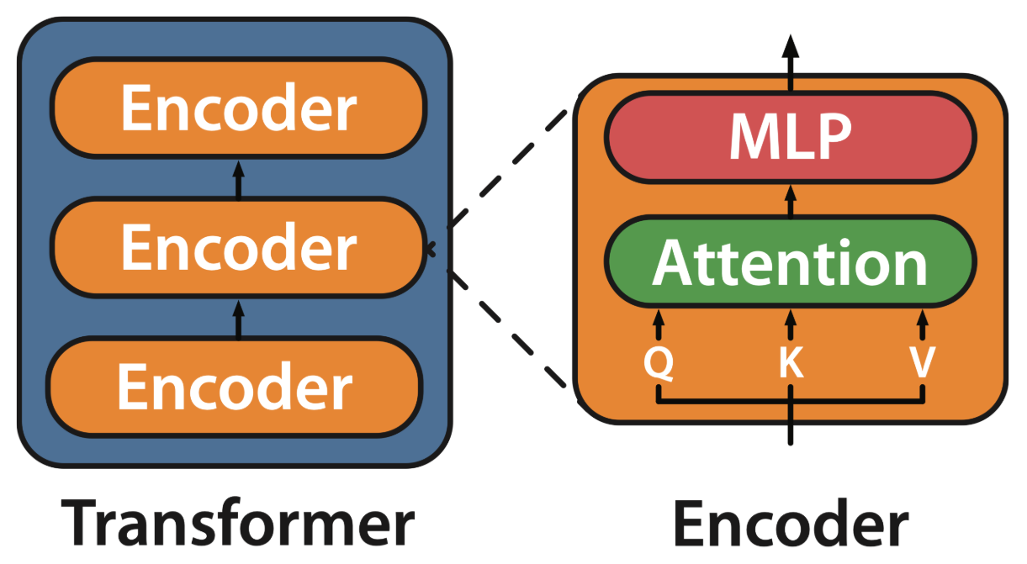
Problem
How to efficiently scale models to longer sequences with transformers?
Attention is the Heart of Transformers

Slide 28
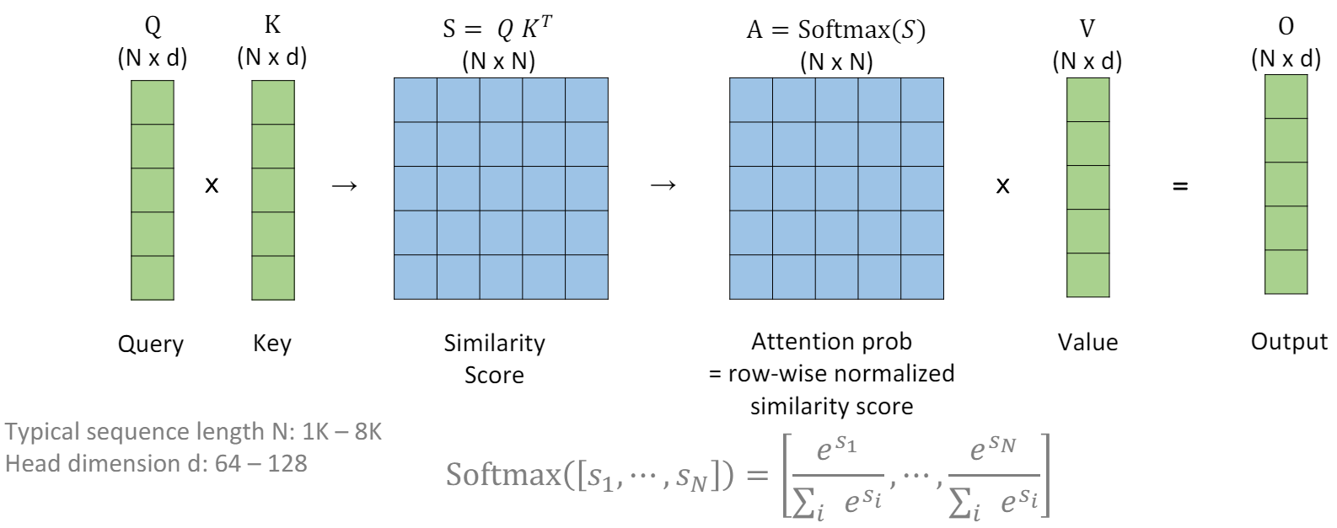
Problem
Attention scales quadratically in sequence length N

Slide 29
Problem
Algorithm-level Method: Approximate Attention
Approximate attention: tradeoff quality for speed fewer FLOPs
Survey: Tay et al. Long Range Arena : A Benchmark for Efficient Transformers. ICLR 2020

Slide 30
Problem
Algorithm-level Method: Approximate Attention
Approximate attention: tradeoff quality for speed fewer FLOPs
But is the compute overhead really bottleneck?
Survey: Tay et al. Long Range Arena : A Benchmark for Efficient Transformers. ICLR 2020

Slide 31
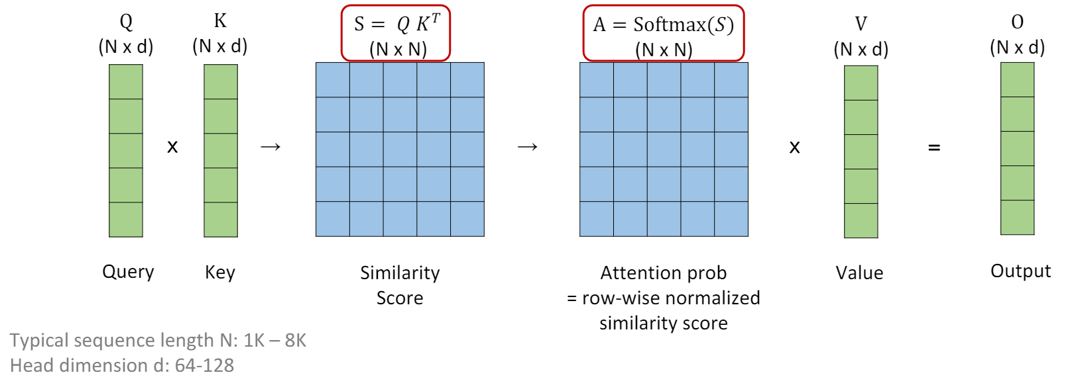
Problem
Observation: Attention is Bottlenecked by Memory Reads/Writes
The biggest cost is in moving the bits! Standard implementation requires repeated R/W from slow GPU maemory

Slide 32
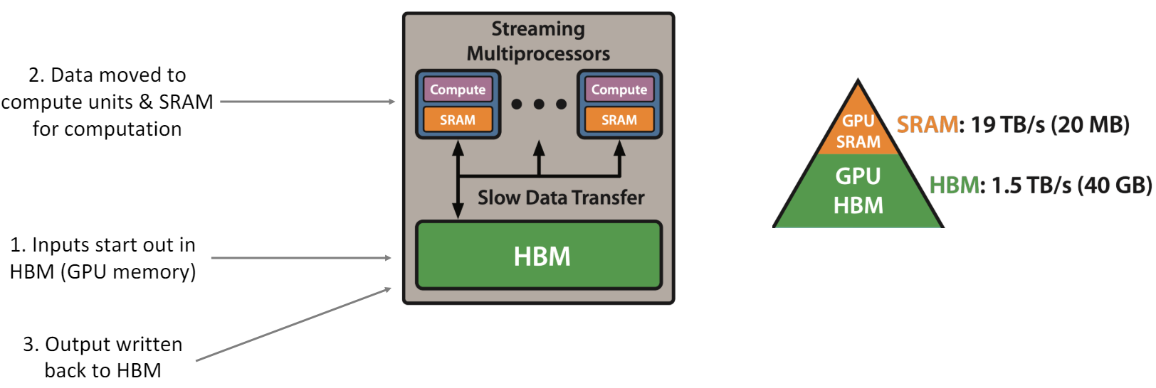
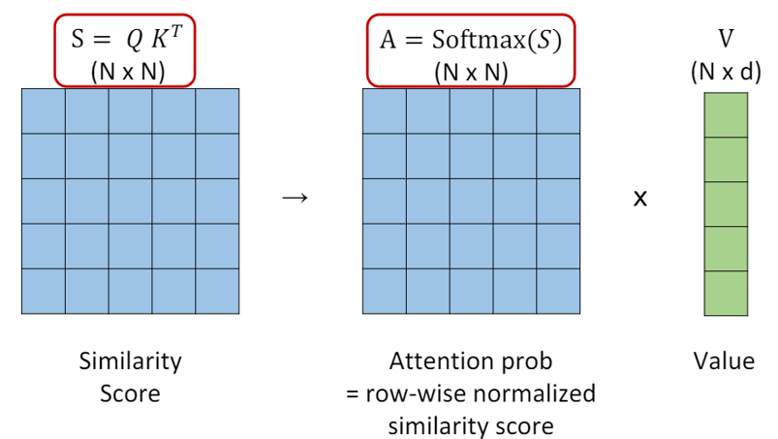
Proposed Method
Can we exploit the memory asymmetry to get speed up? With IO-awareness/hardware-awareness (accounting for Read/Write to different levels of memory)
Making Deep Learning Go Brrrr From First Principles, Horace He

Slide 33
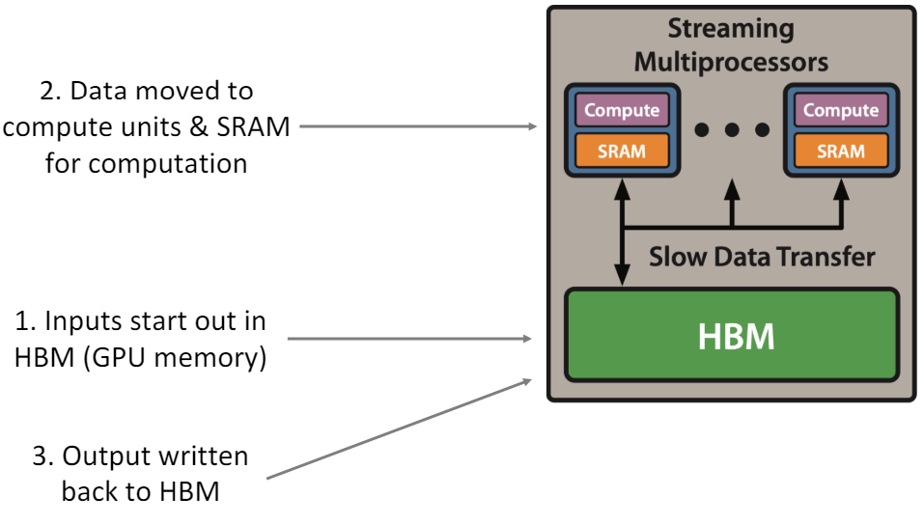
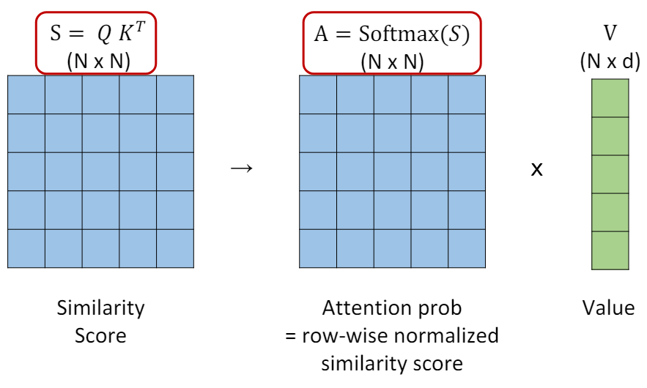
Proposed Method
Challenge:
Compute softmax normalization without access to full input.
Backward without reading the large attention matrix from forward (Recomputation)
Approaches:
(1) Tiling: Restructure algorithm to load block by block from HBM to SRAM to compute attention.
(2) Recomputation: Don’t store attn. matrix from forward, recompute it in the backward

Slide 34
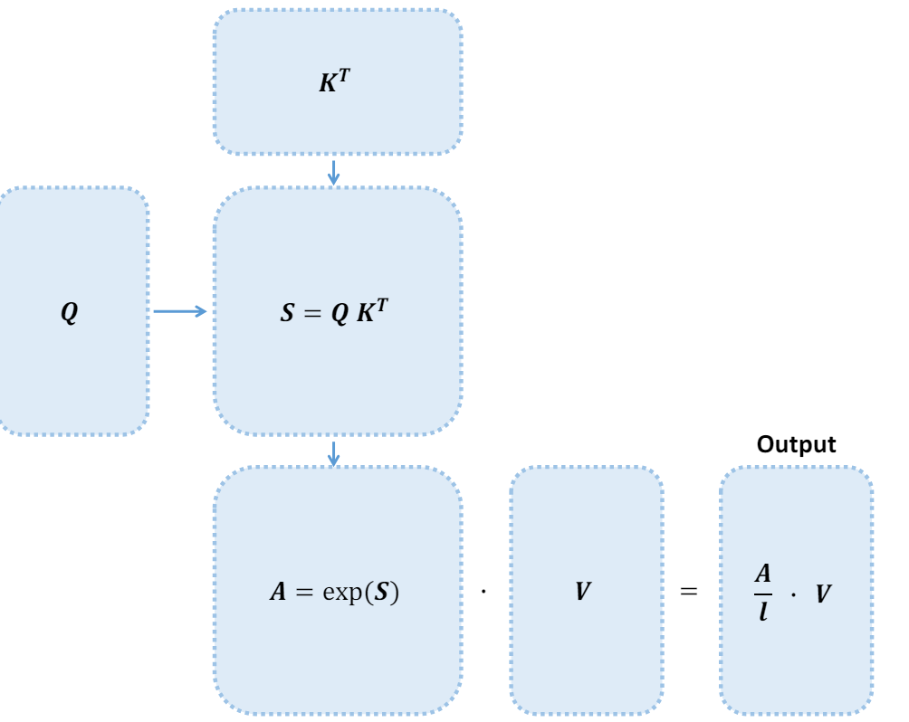
Proposed Method
Recap: Attention Computation Pipeline
Softmax row-wise normalization constant
Compute by blocks: easy to split Q

Slide 35
Proposed Method
Recap: Attention Computation Pipeline
Softmax row-wise normalization constant
Compute by blocks: easy to split Q,
but how do we split K & V?

Slide 36
Flash-attention

Slide 37
Flash-attention

Slide 38
Flash-attention

Slide 39
Recomputation (Backward Pass)
Essentially, doing extra recomputation might lead to less memory-bandwidth, and thus less runtime.

Slide 40
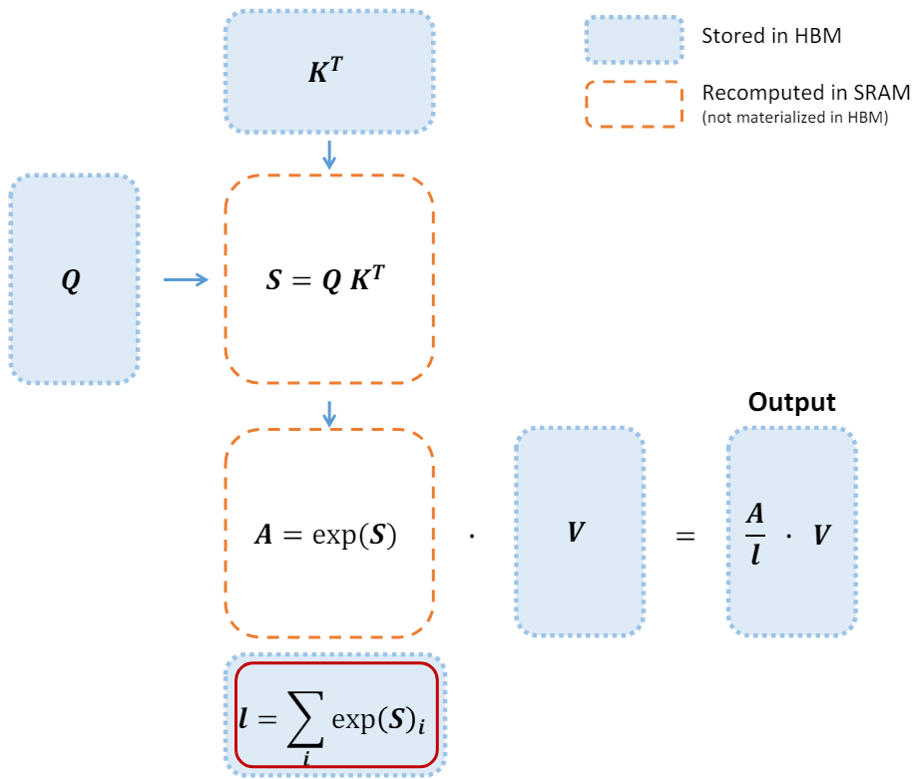
Recomputation (Backward Pass)
By storing softmax normalization from forward (size N), quickly recompute attention in the backward from inputs in SRAM.

Slide 41
Recomputation (Backward Pass)
By storing softmax normalization from forward (size N), quickly recompute attention in the backward from inputs in SRAM.
FlashAttention speeds up backward pass even with increased FLOPs

Slide 42
Results: 2-4x speedup, 10-20x memory reduction

Slide 43
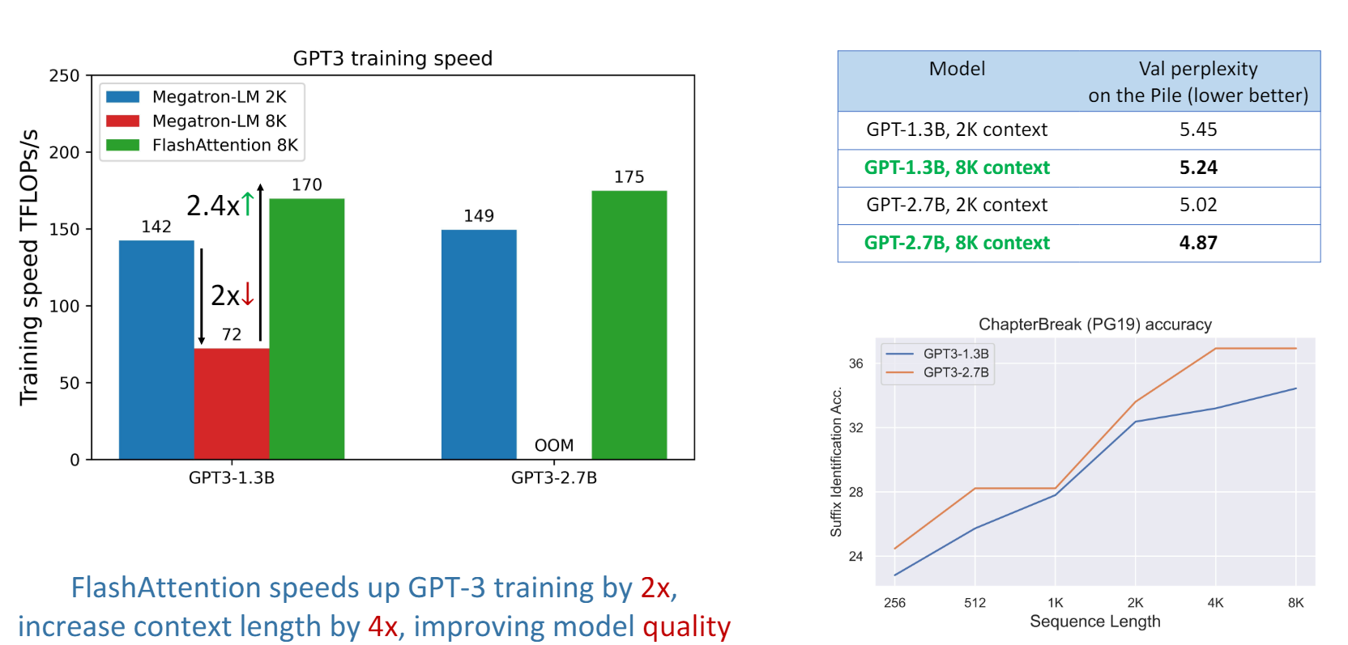
GPT3: Faster Training, Longer Context, Better Model

Slide 44
Follow-up studies

Slide 45
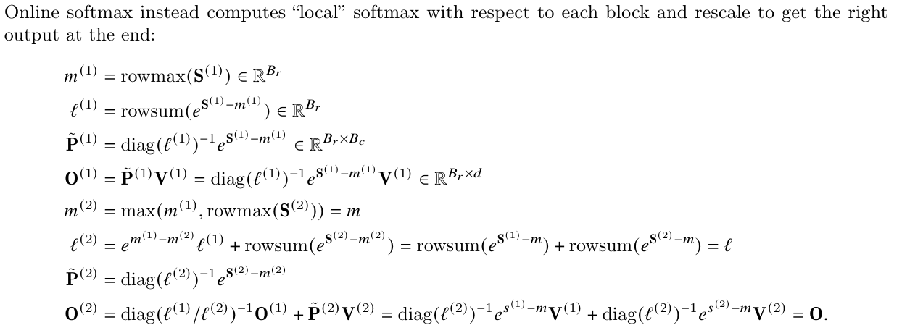
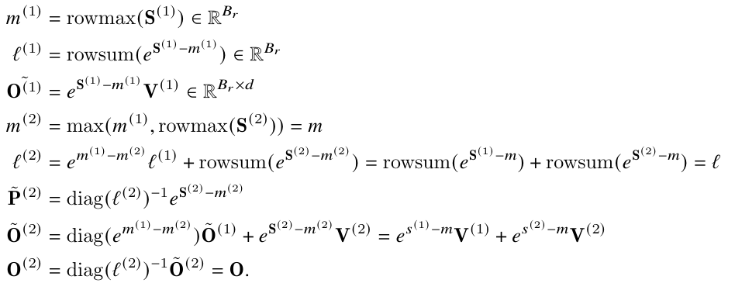
Flash-Attention-2
Reduce non-matmul FLOPs (operator fusion)

Slide 46
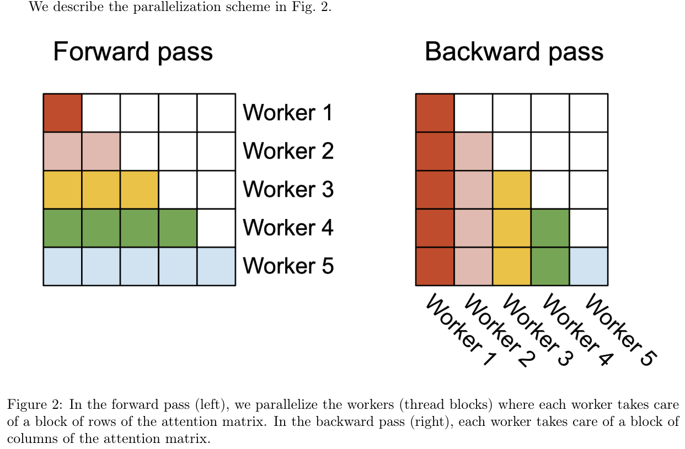
Flash-Attention-2
Parallelism/work partition
Better Work Partitioning Between Warps/No need for communication between warps
Parallelism

Slide 47
Optimizing FlashAttention for H100 GPU
Ganesh Bikshandi and Jay Shah, A Case Study in CUDA Kernel Fusion: Implementing FlashAttention-2 on NVIDIA Hopper Architecture using the CUTLASS Library
Ganesh Bikshandi and Jay Shah, Delivering 1 PFLOP/s of Performance with FP8 FlashAttention-2

Slide 48
Flash-Decoding for long context inference

Slide 49
Conclusion
Fast and memory-efficient algorithm for exact attention
Key ideas: enable fast and memory-efficient algorithm for exact attention computation by maximizing the memory bandwidth cost.
Methods:
Tiling & backward recomputation
Upshot: faster training, better models with longer sequences/contexts

Slide 50
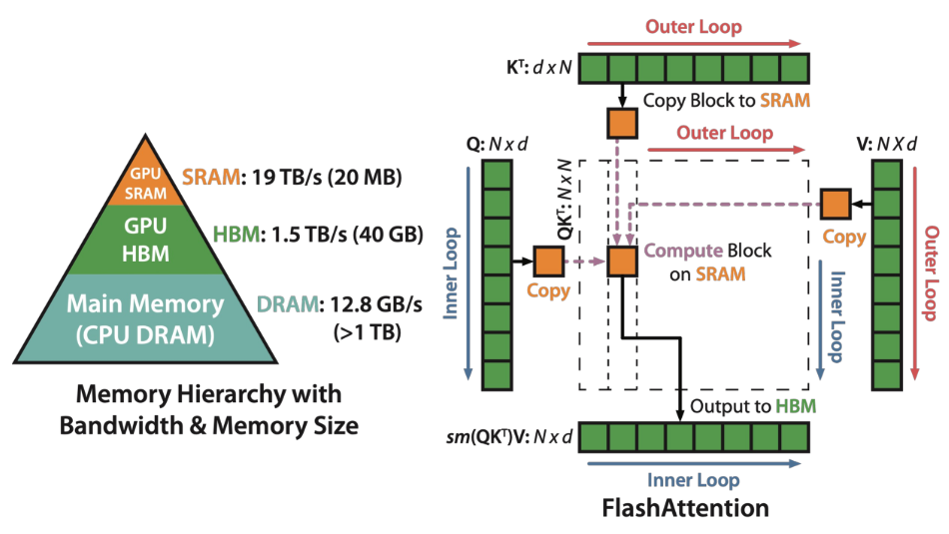
Introduction
Flash-attention: fast and memory-efficient attention algorithm, with no approximation
IO-awareness: reducing reads/writes to GPU memory yields significant speedup

