Slide 1
LLM4Ops Benchmark System 2024.04.07
Junjielong Xu
School of Data Science
Chinese University of Hong Kong, Shenzhen
Notes:
An introduction, a review, a discussion, and an implementation

Slide 2
Outline
Introduction
Related Work
Preliminaries
Proposed Methods
Performance Evaluation
Conclusions

Slide 3
LLM4Ops Benchmark System
Introduction
Related Work
Preliminaries
Proposed Methods
Performance Evaluation
Conclusions

Slide 4
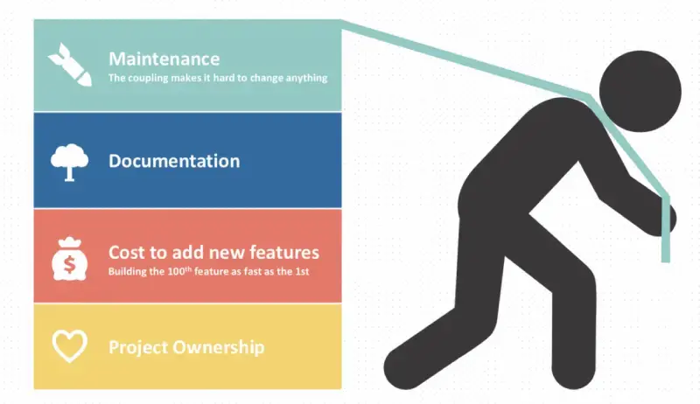
Introduction-it operation
Monolithic Software System
Code functions are coupled with each other
High software volume, high build and deployment costs.
Only capable for waterfall development model

Slide 5
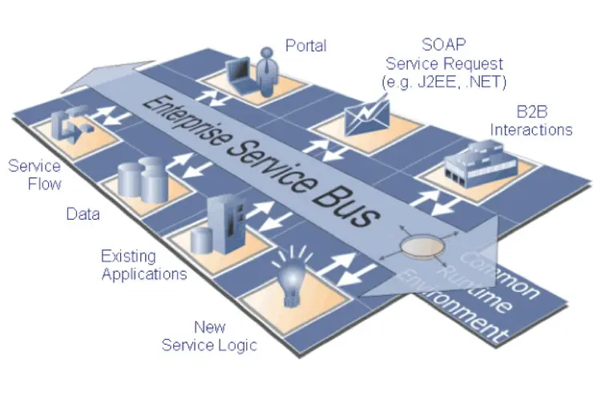
Introduction-it operation
Service-Oriented Architecture
Good scalability, can easily add machines and features to withstand high loads.
Each service runs independently, simplifying the architecture and improving reliability.
One service, one server (machine).

Slide 6
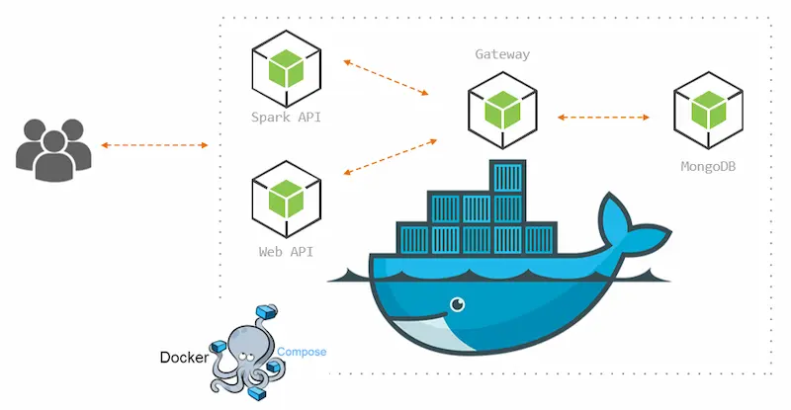
Introduction-it operation
Microservice System
Microservices are service-oriented architectures that use container technology. It still uses the "service" as a functional unit, which only require only new containers (a process).

Slide 7
Introduction-it operation
Case study: BILIBILI. 2021.07.13
https://www.bilibili.com/read/cv17521097/

Slide 8
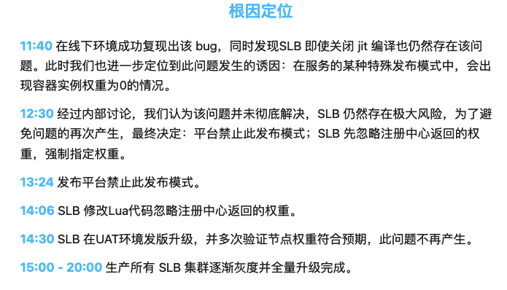
Introduction-it operation
Case study: BILIBILI. 2021.07.13
https://www.bilibili.com/read/cv17521097/
Notes:
Server load balancer

Slide 9
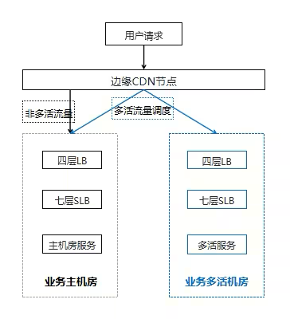
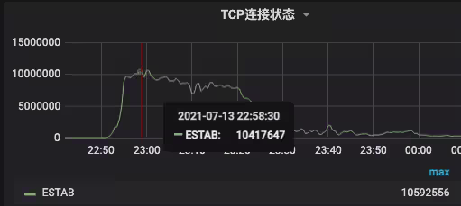
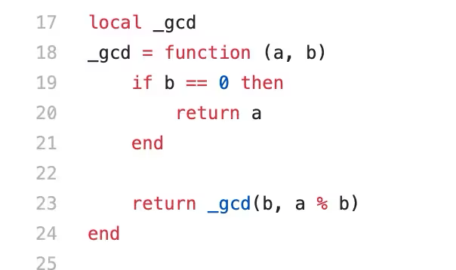
Introduction-it operation
Case study: BILIBILI. 2021.07.13
Metric
Architecture
Root cause
https://www.bilibili.com/read/cv17521097/
Notes:
The root cause is a lua function（code-level function）

Slide 10
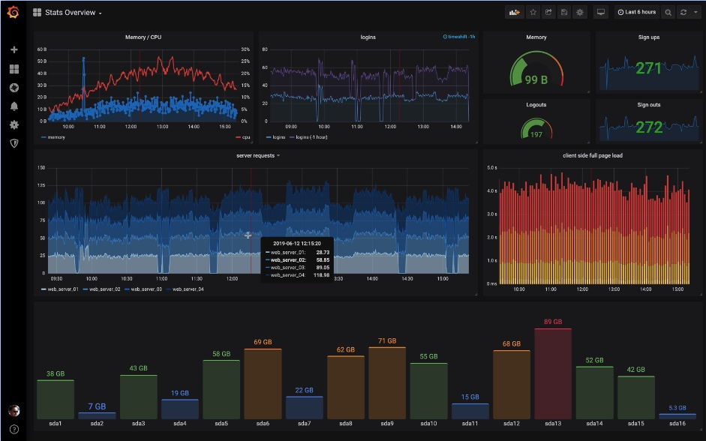
Introduction-it operation
A simplified IT operation case: (Metric Panel)
Notes:
Prometheus+Grafana

Slide 11
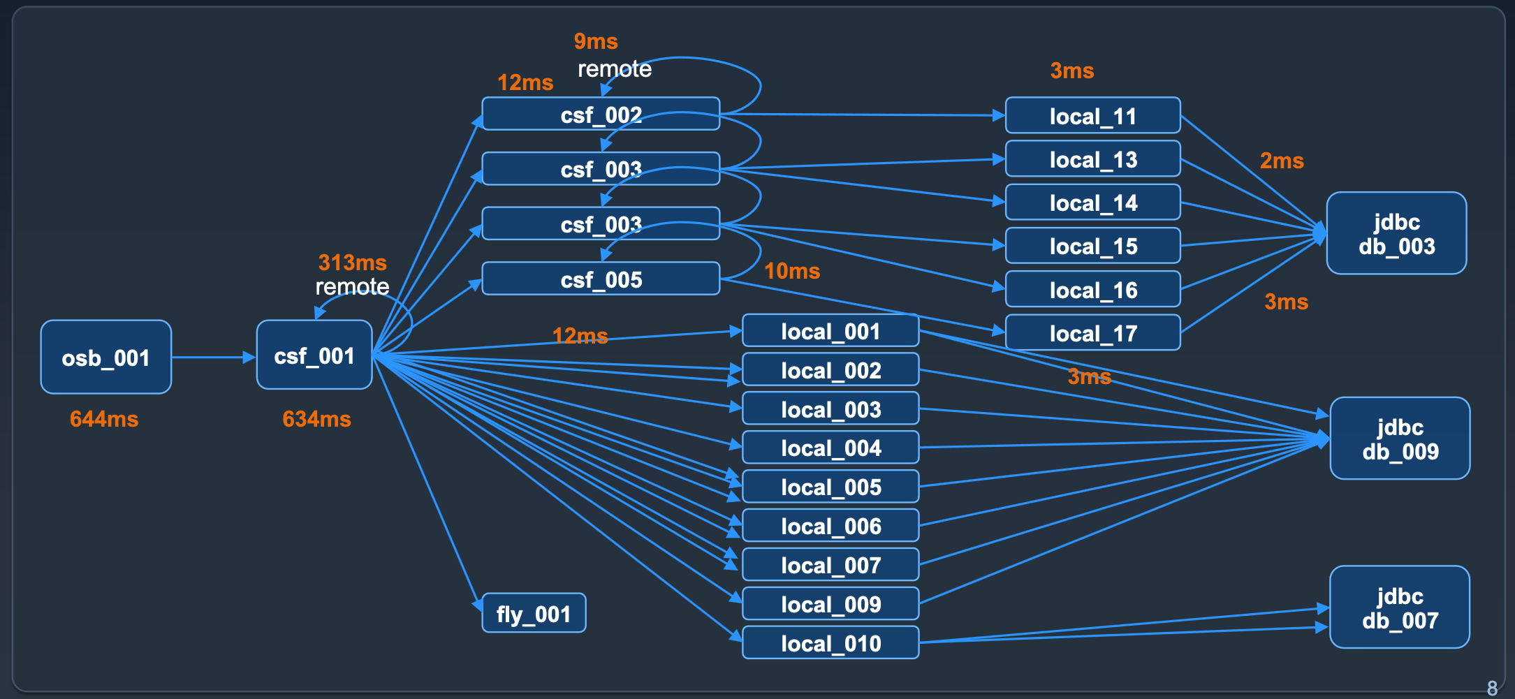
Introduction-it operation
A simplified IT operation case: (Trace Topology)

Slide 12
Introduction-AIOps
AIOps (Artificial Intelligent for IT Operation) is a growing field that integrates artificial intelligence, machine learning, and data science techniques into the traditional IT operations process. It aims to enhance the efficiency and effectiveness of IT operations teams by automating complex tasks, improving service quality, and enabling faster and more accurate decision-making.

Slide 13
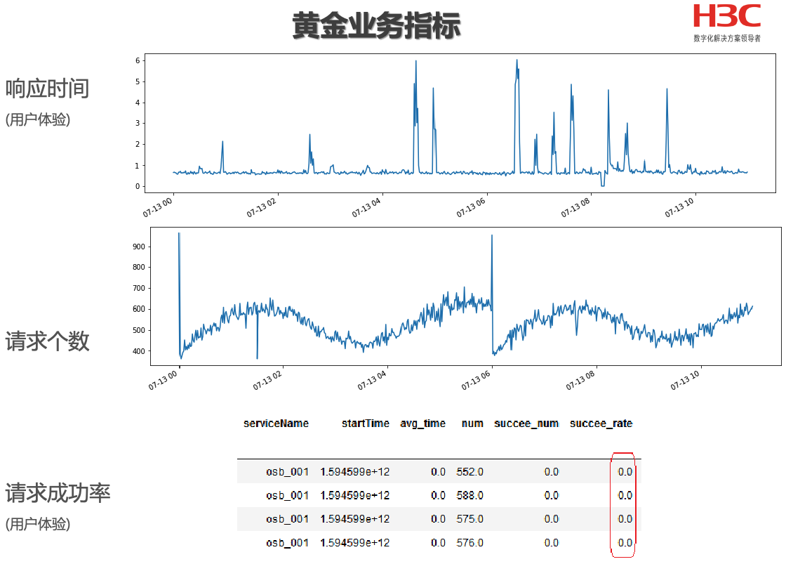
Introduction-AIOps
“Golden Metrics”

Slide 14
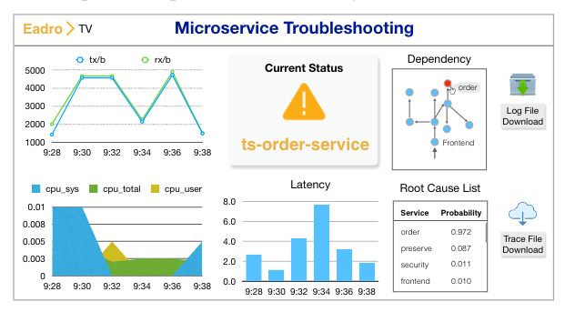
Introduction-aiops
Root Cause Analysis (RCA)
In microservice architectures, due to the distributed nature of services, problems may involve multiple services and components, which makes diagnosing and resolving problems more complex. An effective microservices RCA system should be able to help teams quickly pinpoint the root cause of a problem and provide a solution to avoid recurrence.

Slide 15
Introduction-aiops
Traditional RCA system architecture
Use traditional ML&DL model that trained from scratch on a large amount of labeled offline data
ICSE’23 - Eadro: An end-to-end troubleshooting framework for microservices on multi-source data

Slide 16
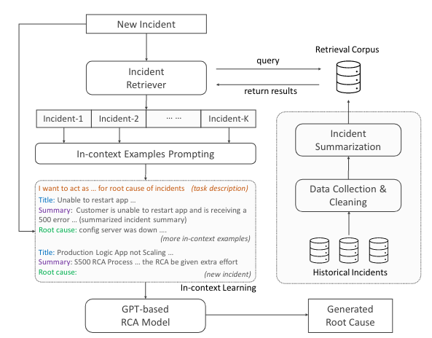
Introduction-llm4ops
Large Language Model (LLM) based RCA system
The core is a LLM, but the system contains multiple component to retrieval, prompting, summarization, and collection.
Rather than use various component to mine the anomaly pattern in different data types, LLM-based system treat the model as a human-like agent. It can analyze, explicitly reasoning for the potential root cause of the microservice system.
We call it LLM4Ops, where LLMs are treated as agent
EuroSys’24 - Automatic Root Cause Analysis via Large Language Models for Cloud Incidents

Slide 17
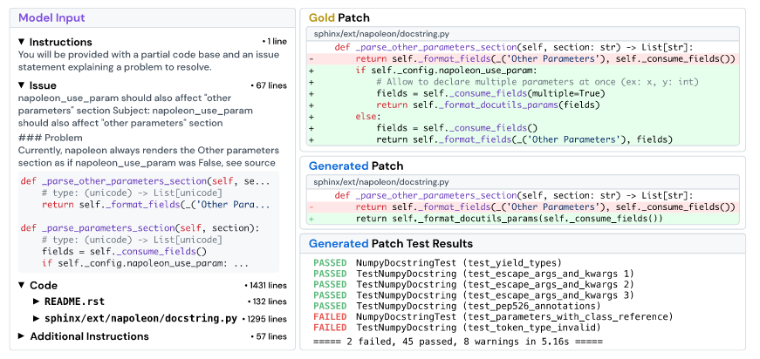
Introduction-llm4ops
LLM-based automated program repair (APR) system
Recent study show that LLMs agents can be used for solving real-world bugs via referring to the GitHub Issues, and generate patches to fix it like a developer.
It inspired us that LLM agents may be capable to remediate service fault by referring to the incident report.
Both of Issue and Incident are the reports of unexpected errors.
ICLR’24 - SWE-bench: Can Language Models Resolve Real-World GitHub Issues?

Slide 18
Introduction-llm4ops
How to evaluate LLM4Ops system？
Use the labeled offline run-time data from the real-world microservices system.
- Labor intensive for labeling and privacy ensuring (if the data from the company).
- Can only be used for diagnosis, not repair.
+ Real service fault, which means real error pattern.
+ Large scaled.
Develop another open-sourced microservice system and perform fault injection.
- The faults are manually injected, which means the unreal fault pattern.
- Relatively smaller scale.
+ Easy to obtain the fault labels.
+ Can provide all access to the model for troubleshooting and remediation

Slide 19
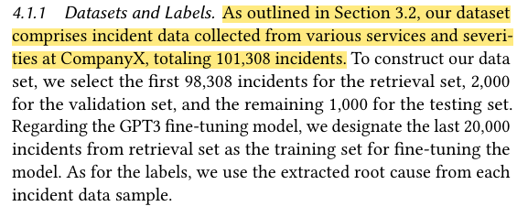
Introduction-llm4ops
How to evaluate LLM4Ops system？
Use the labeled offline run-time data from the real-world microservices system.
- Labor intensive for labeling and privacy ensuring (if the data from the company).
EuroSys’24 - Automatic Root Cause Analysis via Large Language Models for Cloud Incidents

Slide 20
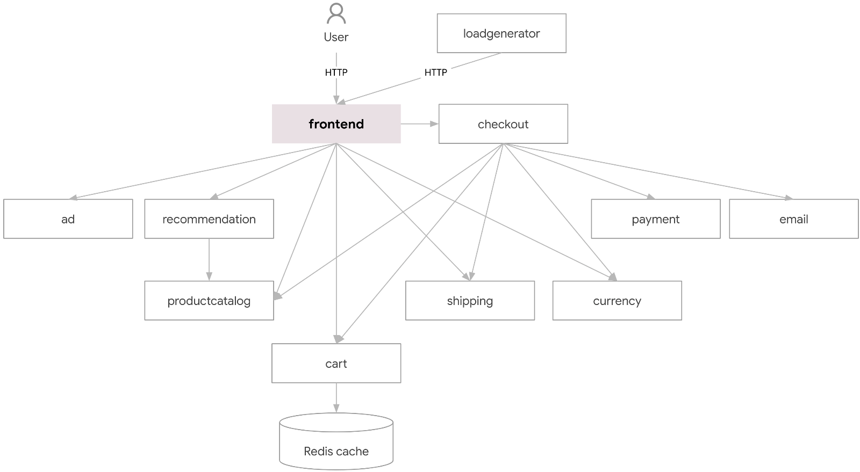
Introduction-llm4ops
fault
How to evaluate LLM4Ops system？
Develop another open-sourced microservice system and perform fault injection.
EuroSys’24 - Automatic Root Cause Analysis via Large Language Models for Cloud Incidents

Slide 21
LLM4Ops Benchmark System
Introduction
Related Work
Preliminaries
Proposed Methods
Performance Evaluation
Conclusions

Slide 22
Related works
Existing open-sourced microservice system testbed
Name | Service# | Interaction | Language# | Reference
Acme Air | 5 | Sync | 4 | https://github.com/acmeair/acmeair
Music Store | 6 | Sync + Async | 5 | https://github.com/aspnet/MusicStore
Spring Cloud | 6 | Sync | 1 | https://github.com/kbastani/spring-cloud-microservice-example
Bifrost App | 5 | Sync + Async | 3 | https: //github.com/sealuzh/bifrost-microservices-sample-application
Socks Shop | 8 | Sync + Queue | 3 | https://github.com/microservices-demo/microservices-demo
Staffjoy | 9 | Sync + Queue | 4 | https://github.com/Staffjoy/v2
NServiceBus | 8 | Queue | 3 | https://github.com/dotnet/eShop
Online Boutique | 11 | Sync + Async | 3 | https://github.com/GoogleCloudPlatform/microservices-demo
Social Network | 21 | Sync + Async | 6 | ASPLOS’19 [DeathStarBench]
Train Ticket | 41 | Sync+Async+Queue | 6 | ICSE’18 [TrainTicket]
ASPLOS’19 - An Open-Source Benchmark Suite for Microservices and Their Hardware-Software Implications for Cloud & Edge Systems
ICSE’18 - Benchmarking Microservice Systems for Software Engineering Research

Slide 23
Related works
Online Boutique
Features:
Kubernetes/GKE: The app is designed to run on Kubernetes
gRPC: Microservices use a high volume of gRPC calls to communicate to each other.
Istio: Application works on Istio service mesh.
Cloud Operations (Stackdriver): Many services are instrumented with Profiling and Tracing. In addition to these, using Istio enables features like Request/Response Metrics and Context Graph out of the box. When it is running out of Google Cloud, this code path remains inactive.
Skaffold: Application is deployed to Kubernetes with a single command using Skaffold.
Synthetic Load Generation: The application demo comes with a background job that creates realistic usage patterns on the website using Locust load generator.
https://github.com/GoogleCloudPlatform/microservices-demo

Slide 24
Related works
Online Boutique
+ The most commonly used microservices benchmark in the past.
+ Comes with Monitoring suites (StackDriver for Log, Istio for Metrics).
- Service dependency relationship is simple.
- Lack of common middleware (gateway, mq, etc).
https://github.com/GoogleCloudPlatform/microservices-demo

Slide 25
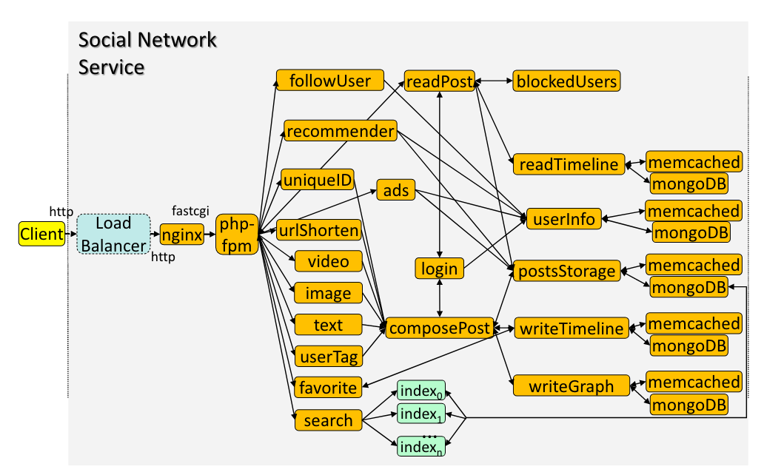
Related works
Social Network
Features:
Docker Swarm: The app is designed to run on Docker Swarm.
gRPC: Microservices use a high volume of gRPC calls to communicate to each other.
High Heterogeneity: The suite uses applications in low and high-level, managed and unmanaged languages including C/C++, Java, Javascript, node.js, Python, html, Ruby, Go, and Scala.
Representativeness: The suite is built using popular open-source applications deployed by cloud providers, such as NGINX, Memcached, MongoDB.
ASPLOS’19 - An Open-Source Benchmark Suite for Microservices and Their Hardware-Software Implications for Cloud & Edge Systems

Slide 26
Related works
Social Network
+ Microservice dependencies are much more complex.
+ Highly heterogeneous and contains common middleware.
- No existing tracing system or log collection & analysis component.
- Unknown fault injection methodology.
ASPLOS’19 - An Open-Source Benchmark Suite for Microservices and Their Hardware-Software Implications for Cloud & Edge Systems

Slide 27
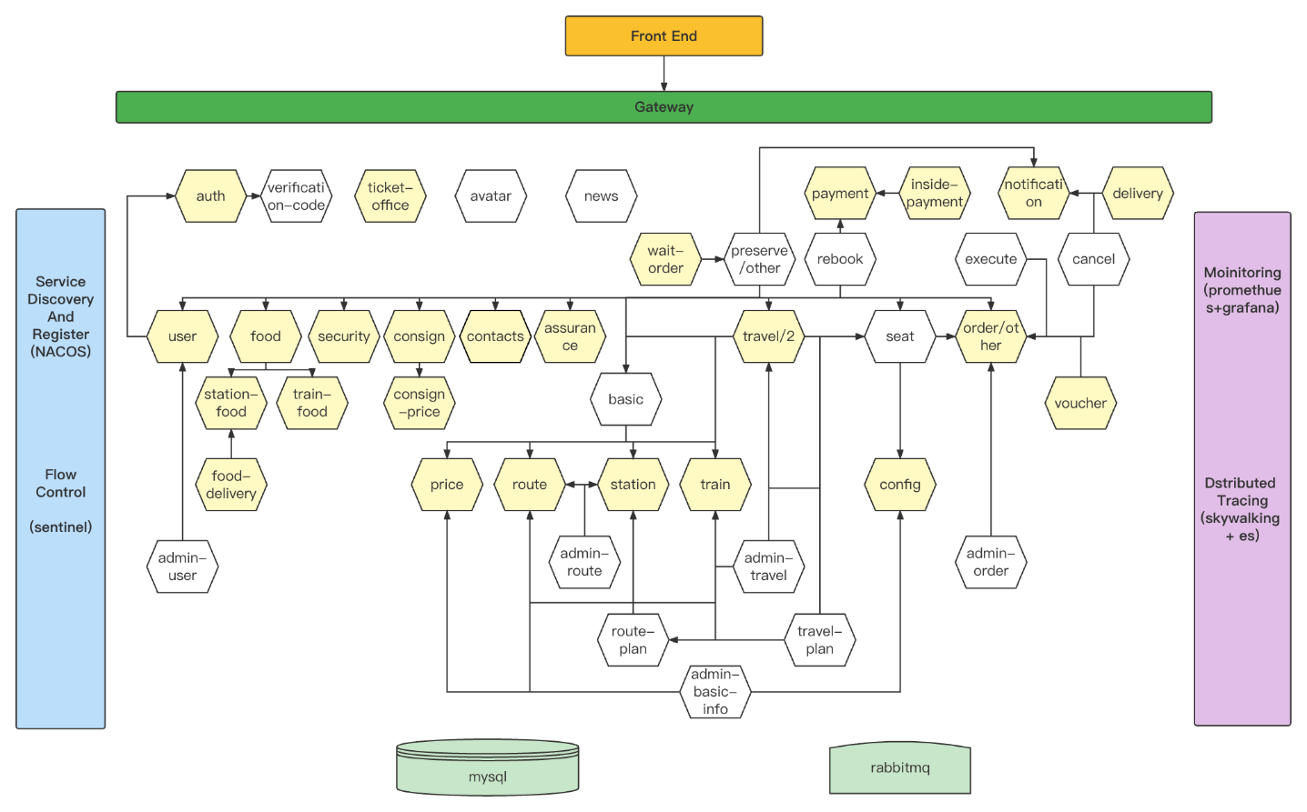
Related works
Train Ticket
Features:
Kubernetes: The system is designed to run on Kubernetes
High Complexity: The system contains multiple microservices and many common middlewares like MySQL and MongoDB, and it also adopts different web framework like Django, Spring Cloud, Spring Boot, Webgo, etc.
NACOS: The system adopts NACOS for service register & discover.
Sentinel: The system adopts Sentinel for flow control and fusion.
Promethues+Grafana: The system has embedded a monitoring system.
Skywalking+ES: The system has embedded a tracing system.
Skaffold: The system is deployed with a single command using Skaffold.
Test Suite: In total, the system contains 37 unit test cases and 14 integration test cases with 5,218 lines of test code. Which can be used for the repair of the microservices when injecting the functional bugs to the specific services.
ICSE’18 - Benchmarking Microservice Systems for Software Engineering Research

Slide 28
Related works
Train Ticket
+ Microservice dependencies are very complex.
+ Embedded with strong tracing and monitoring system.
- Incomplete log statement design.
- No existing fault injection suites.
ICSE’18 - Benchmarking Microservice Systems for Software Engineering Research

Slide 29
LLM4Ops Benchmark System
Introduction
Related Work
Preliminaries
Proposed Methods
Performance Evaluation
Conclusions

Slide 30
Preliminary
Recall the LLM4Ops Agent System: What can an LLM agent system do?
Root Cause Analysis
Automated Program Repair
EuroSys’24 - Automatic Root Cause Analysis via Large Language Models for Cloud Incidents
ICLR’24 - SWE-bench: Can Language Models Resolve Real-World GitHub Issues?

Slide 31
Preliminary
Recall the LLM4Ops Agent System: What do we expect an LLM agent system to do in the future?
Online Troubleshooting:
24h monitoring and tracing
Automated detect anomaly
Automated generate incident report
Automated diagnosis root cause
Online Remediation
24h on-call
Automated retrieve ticket
Automated plan remediation method
Automated execute fault remediation

Slide 32
Preliminary
General Methodology of current LLM4Ops agent system: An champion case in AIOps Competition:
ReAct (Reasoning&Action Framework)
Reasoning existing data and then execute specific actions (including call APIs, provide solutions, etc.)
CoT (Chain-of-Thought Prompting)
Serialized decoupling of a complex task into several simple tasks for LLMs prompting and reasoning.
Multi-Agent Scheduling
Parallel decoupling of a complex task into several atomized tasks and provide them to different specific agents for handling.
https://www.aiops.cn/aiopschallenge/

Slide 33
Preliminary
General Methodology of current LLM4Ops agent system: An champion case in AIOps Competition:
RAG (Retrieva Augmented Generation)
Searching for relevant documents or data to gain domain-specific knowledge in various specific scenarios
ICL (In-Context Learning)
Providing input-output example pairs in the prompt to enable LLMs to analogy them and handling new query in a similar way
Self-Reflection
When the answer of LLMs is incorrect, LLMs can re-thinking its reasoning path and refine the answer without feedback
https://www.aiops.cn/aiopschallenge/

Slide 34
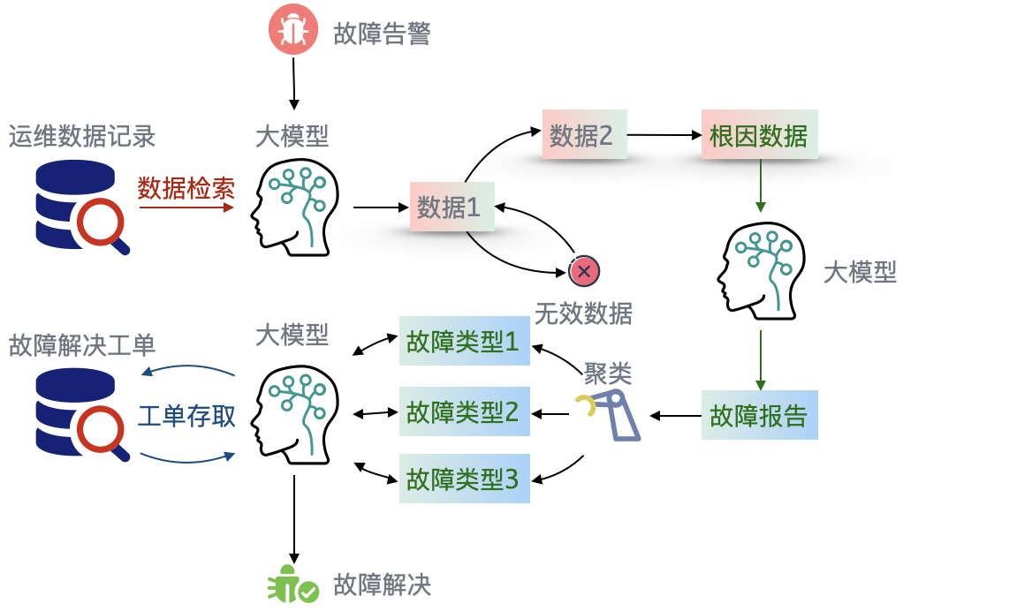
Preliminary
How can we design and implement a playground to adapt to LLM4Ops Agent Systems?
Can read
Can write
Fault Injected
Provide all APIs to Agents

Slide 35
LLM4Ops Benchmark System
Introduction
Related Work
Preliminaries
Proposed Methods
Performance Evaluation
Conclusions

Slide 36
method
Recall the Related Work: The best microservice system testbed might be Train Ticket

Slide 37
method
Incomplete log statement design.
Current system log statements do not contain trace IDs. They are not helpful to diagnosis system faults or repair system faults.

Slide 38
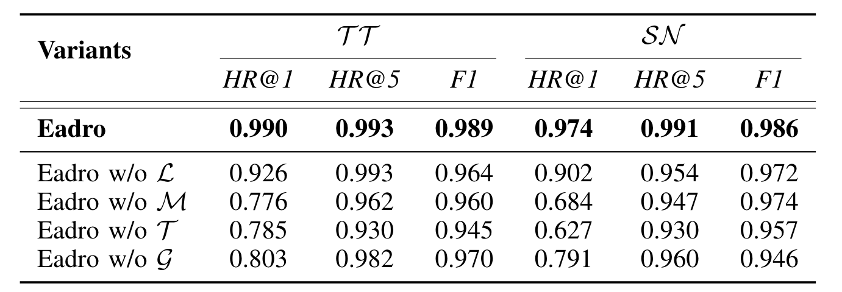
method
Why does the quality of logging matter?
Logs and traces capture information about inner-service and inter-service status. Traces specifically monitor service-to-service calls and dependencies, following set standards from tracing systems. In contrast, logs are hand-crafted by developers and lack a universal standard.
As shown in the diagram on the left, traditional RCA methods suffer little accuracy loss when logs are ignored. However, the absence of traces and metrics greatly affects the analysis.
ASPLOS’10 - Sherlog: error diagnosis by connecting clues from run-time logs
ASPLOS’11 - Improving Software Diagnosability via Log Enhancement
OSDI’12 - Be Conservative: Enhancing Failure Diagnosis with Proactive Logging
SOSP’17 - Log20: Fully Automated Optimal Placement of Log Printing Statements under Specified Overhead Threshold

Slide 39
method
Enrich the information in logs
We enhance the service logs by adding the OpenTelemetry TraceIDs and SpanIDs to the log statement and obtain compelted logs

Slide 40
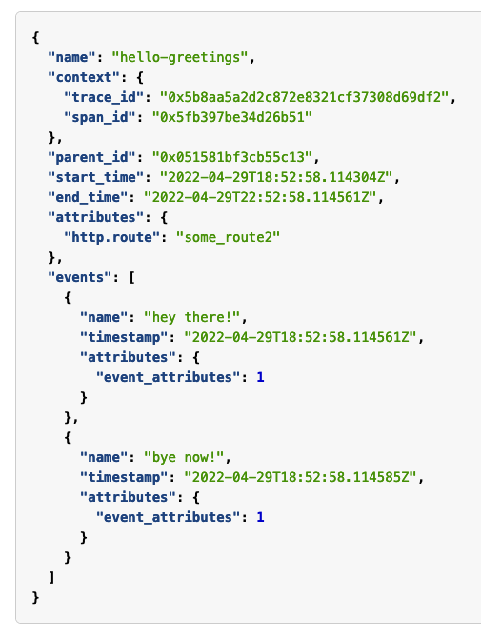
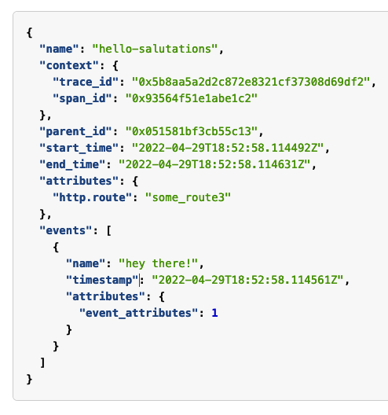
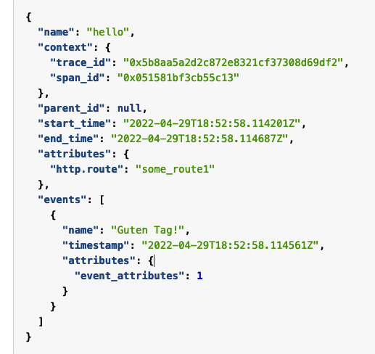
method
OpenTelemetry Trace Example
Span leaf 1
Span root
Span leaf 2

Slide 41
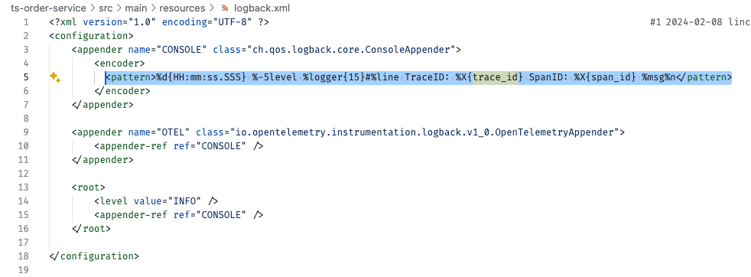
method
Implementation: Logger Config
Implementation: Log Statement

Slide 42
method
Implementation: Fine-Grained Data Collection
Traces are collected by Opentelemetry Collector and store them in Grafana Tempo.
Logs are collected by Grafana Promtail and stored in Grafana Loki.
System-level metrics are collected by cAdvisor. (e.g., CPU, MEM)
Application-level metrics are collected by Istio. (e.g., request latency)

Slide 43
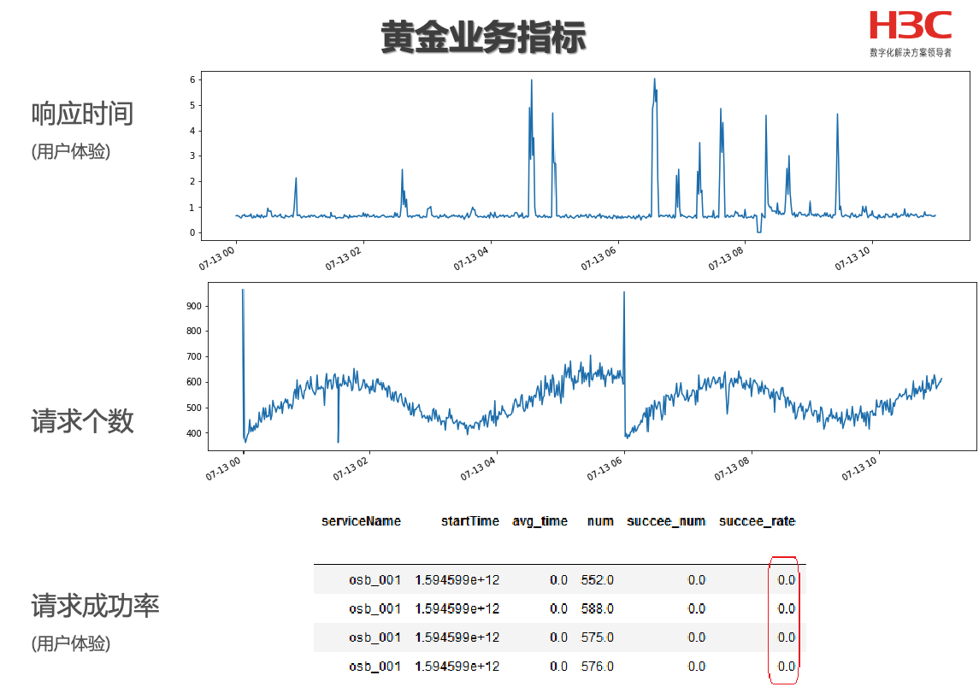
method
Methodology: Fault Injection, from user’s view
https://www.aiops.cn/aiopschallenge/

Slide 44
method
Implementation: Fault Injection
Referring to Eadro, we inject three typical types of faults via Chaosblade.
We simulate CPU exhaustion by putting a hog to consume CPU resource heavily.
To simulate a network jam, we delay the network packets of a microservice instance.
To simulate stochastic packet loss that frequently occurs when excessive data packets flood a network, we randomly drop network packets .
Easy to use. An command can be used to inject:
blade create dubbo delay --consumer --time 3000 --Service means a delay 3s
https://github.com/chaosblade-io/chaosblade

Slide 45
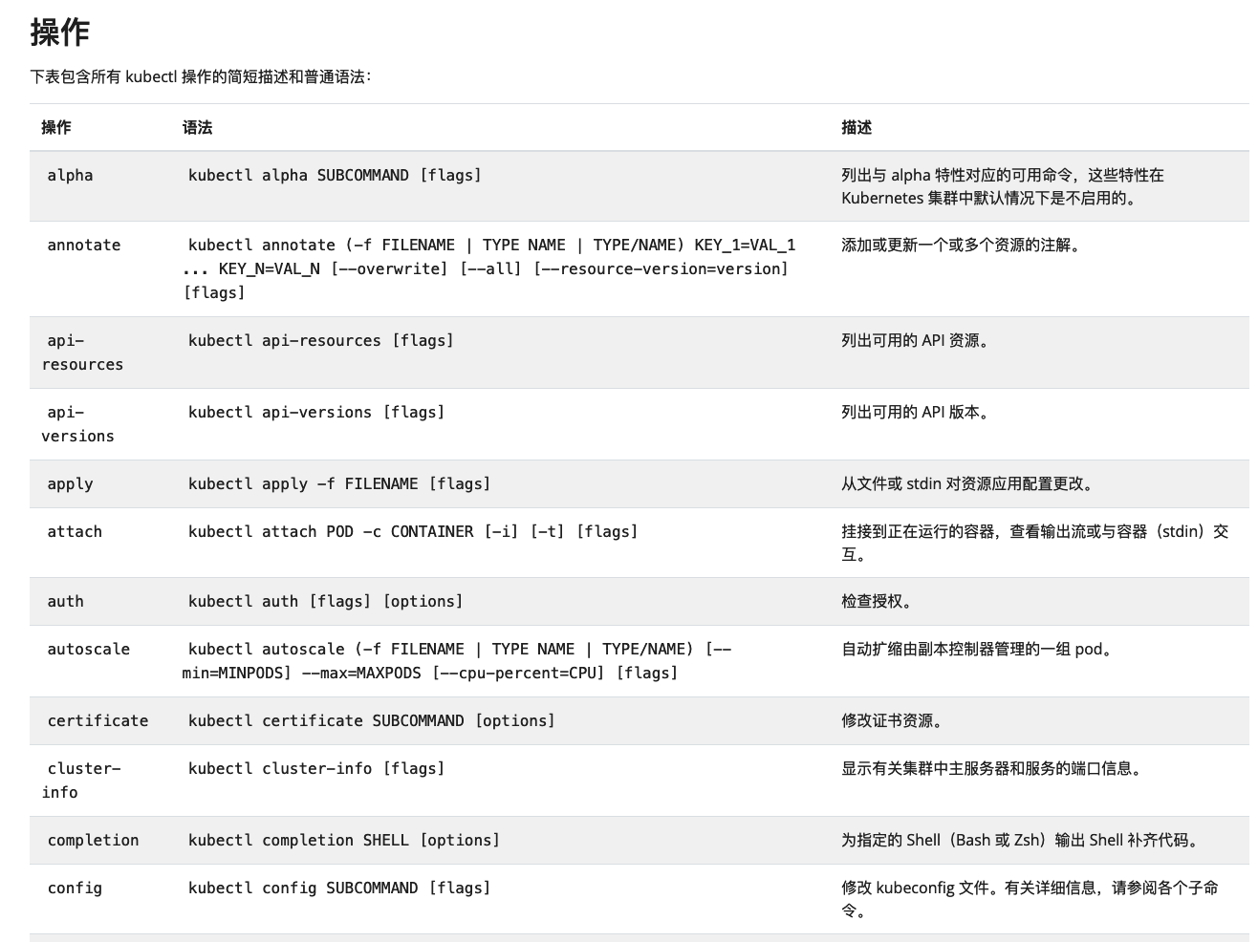
method
Provided APIs (sudo)
We provide command tables of k8s and basic bash command to all agents with sudo authority.
kubectl exec <pod-name> -- <command>
kubectl edit deployment
kubectl edit service
https://github.com/chaosblade-io/chaosblade

Slide 46
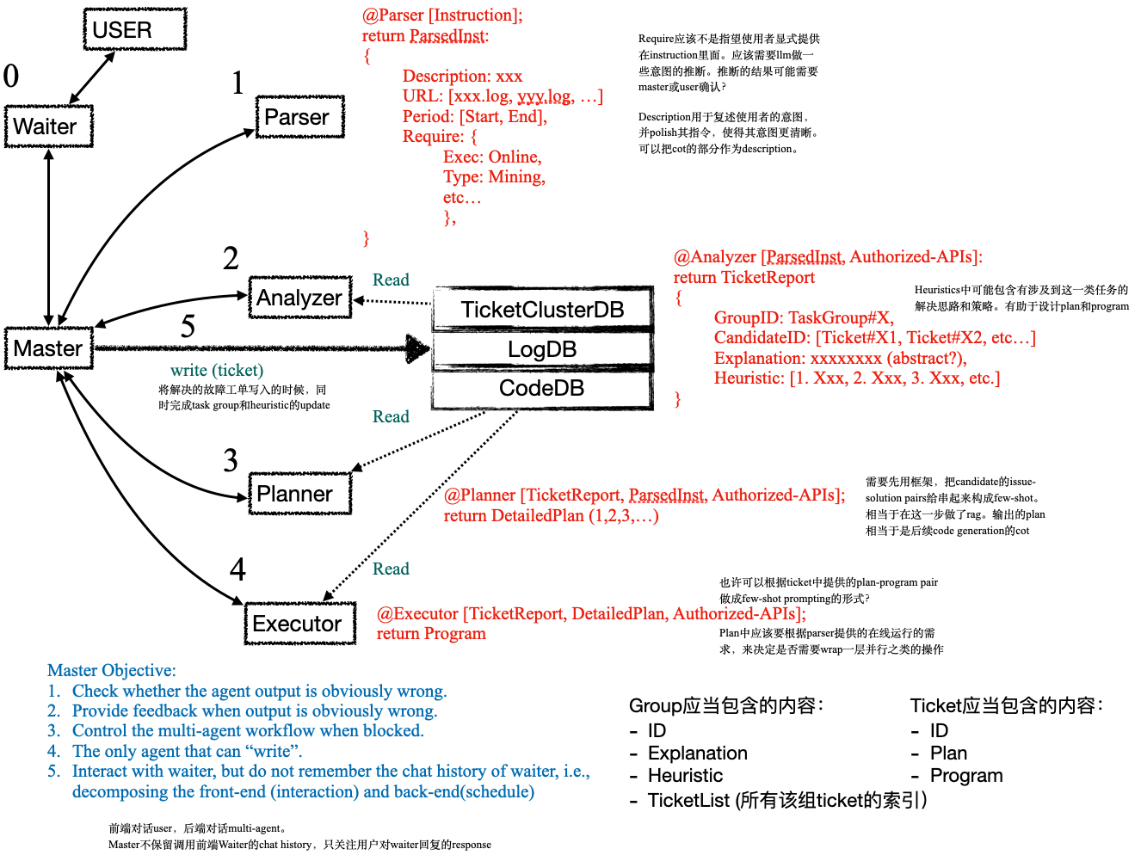
method
Provided APIs (sudo)
We provide all APIs of code and log, trace, metric files to all agents and allow read and write
Ticket (.json, .yaml, etc)
Code (.java, .go, etc)
Log/Trace/Metric

Slide 47
method
Overall Implementation
Deployed Train Ticket.
Enhanced logging.
Fault injection.
API tables.

Slide 48
LLM4Ops Benchmark System
Introduction
Related Work
Preliminaries
Proposed Methods
Performance Evaluation
Conclusions

Slide 49
Evaluation
Fault Injection Setting
20 Inter-service communication fault (request latency, package lost)
25 Inner-service code defects (infinite loop, infinite recursion)

Slide 50
Evaluation
AIOps Comparison
Name | AS@1 | AS@5 | AC@1 | AC@5 | Reference
MicroScope | 17.78 | 35.56 | N/A | N/A | ICSOC’18 - Microscope: Pinpoint Performance Issues with Causal Graphs in Micro-service Environments
MicroRCA | 20.00 | 44.44 | N/A | N/A | NOMS’20 - MicroRCA: Root Cause Localization of Performance Issues in Microservices.
SBLD | 15.56 | 24.44 | 15.56 | 24.44 | ESEM’20 - Spectrum-Based Log Diagnosis.
LogFaultFlagger | 17.78 | 24.44 | 15.56 | 24.44 | ICSE’19 - Mining historical test logs to predict bugs and localize faults in the test logs.
MicroRank | 15.56 | 35.56 | N/A | N/A | WWW’21 - MicroRank: End-to-End Latency Issue Localization with Extended Spectrum Analysis in Microservice Environments.
TraceAnomaly | 13.33 | 33.33 | N/A | N/A | ISSRE’20 - Unsupervised detection of microservice trace anomalies through service-level deep bayesian networks.
PDiagnose | 8.89 | 22.22 | 8.89 | 15.56 | ISPA’21 - Diagnosing Performance Issues in Microservices with Heterogeneous Data Source.
Eadro | 42.22 | 44.44 | 42.22 | 44.44 | ICSE’23 - Eadro: An End-to-End Troubleshooting Framework for Microservices on Multi-source Data
Nezha | 55.56 | 68.89 | 55.56 | 68.89 | ESEC/FSE’23 - Nezha: Interpretable Fine-Grained Root Causes Analysis for Microservices on Multi-modal Observability Data

Slide 51
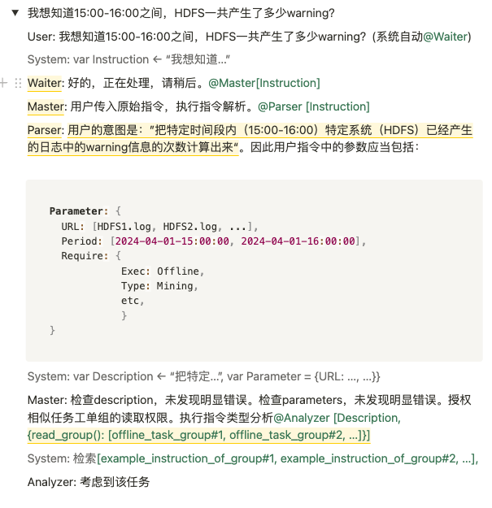
Evaluation
LLM4Ops Agent System Comparision: In progress
Ours (developing)
RCAcopilot (reproducing)
EuroSys’24 - Automatic Root Cause Analysis via Large Language Models for Cloud Incidents

Slide 52
LLM4Ops Benchmark System
Introduction
Related Work
Preliminaries
Proposed Methods
Performance Evaluation
Conclusions

Slide 53
conclusion
Conclusion
Deployed Train Ticket.
Enhanced logging.
Fault injection.
API tables.
Evaluate AIOps baselines

Slide 54
conclusion
Thanks

