Slide 1
Review on Distributed File System
2024.04.30
Jiawei Xu
School of Data Science
Chinese University of Hong Kong, Shenzhen

Slide 2
Outline
Background
Taxonomy
Evolution
Case Study
Conclusion

Slide 3
Outline
Background
Taxonomy
Evolution
Case Study
Conclusion

Slide 4
Background

Slide 5
Background
How should we store and process massive amount of data?
Datacenters!

Slide 6
Background
Distributed File System

Slide 7
Outline
Background
Taxonomy
Evolution
Case Study
Conclusion

Slide 8
Taxonomy
Architecture
Client-Server Architecture
Cluster-Based Distributed System
Symmetric Architecture
Asymmetric Architecture
Parallel Architecture

Slide 9
Taxonomy
Service
Stateless service
  clients can fail and resume without disturbing the system as a whole,
  but locking a file cannot be done easily.
Stateful service

Slide 10
Taxonomy
Communication
TCP
UDP
Network Independence
  Lustre can be used over a wide variety of networks as using Network Abstraction Layer.

Slide 11
Taxonomy
Naming
Central metadata server
Metadata distributed in all nodes

Slide 12
Taxonomy
Synchronization
Semantics for File Sharing
  session semantics, immutable semantics…
File Locking System
  write-once-read-many access, give locks on objects to clients…

Slide 13
Taxonomy
Consistency
Client-side caching
Server-side replication

Slide 14
Taxonomy
Fault Tolerance
Failure as exception
  Isolate the failure node or recover the system from last normal running state.
Failure as norm
  Employ replication of all kind of data and execute re-replication whenever replication ratio becomes unsafe.

Slide 15
Taxonomy
Security
Certification
  Encryption, Firewalls, Kerberos…
No dedicated security mechanism
  Trust among all nodes and clients.

Slide 16
Outline
Background
Taxonomy
Evolution
Case Study
Conclusion

Slide 17
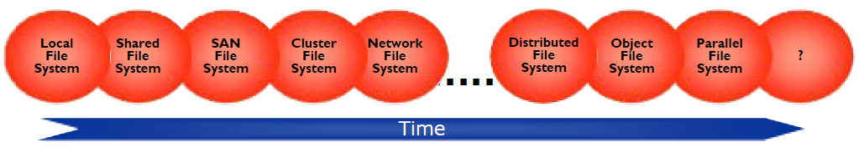
Evolution
Not a strict timeline.

Slide 18
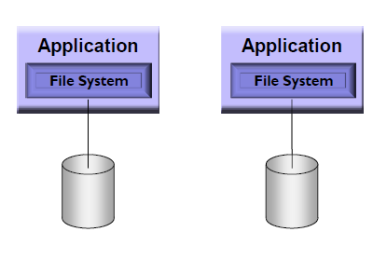
Evolution
Local File System
No data sharing.

Slide 19
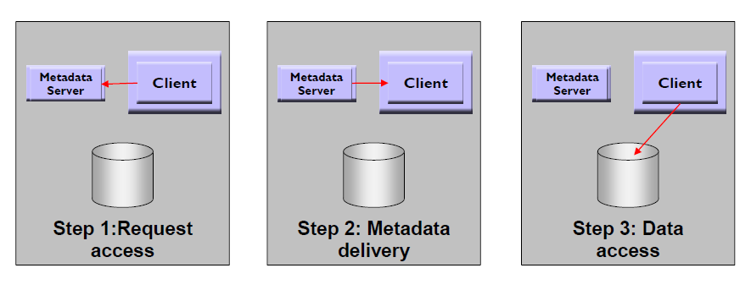
Evolution
Shared File System
File access in a three-step transaction.

Slide 20
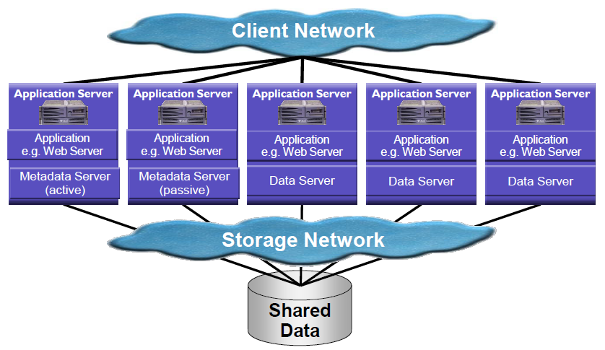
Evolution
SAN File System
One active metadata server, limited by metadata server capacity.

Slide 21
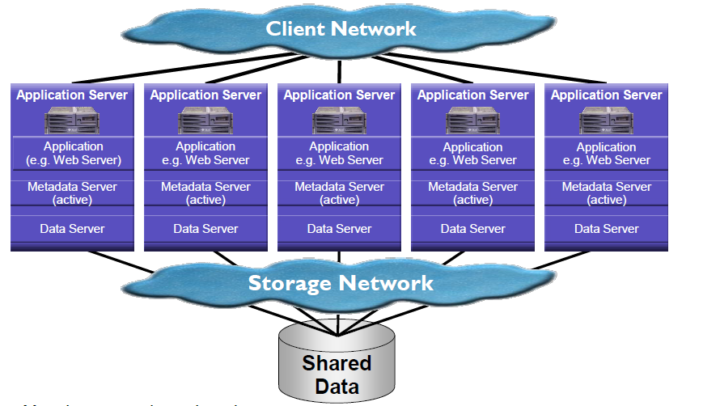
Evolution
Cluster File System
Metadata server in each node, limited by internal communication.

Slide 22
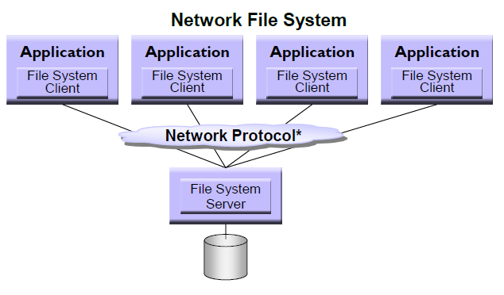
Evolution
Network File System
Clients access to the file server using a network protocol.

Slide 23
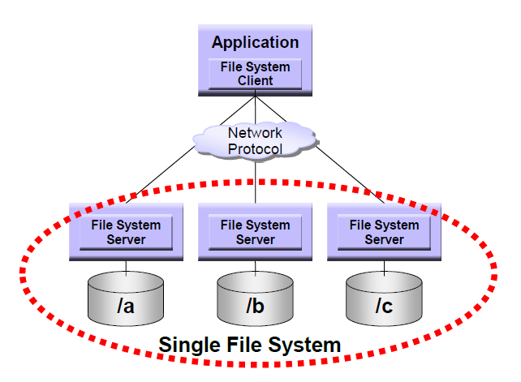
Evolution
Distributed File System
Files distribute among multiple file servers.

Slide 24
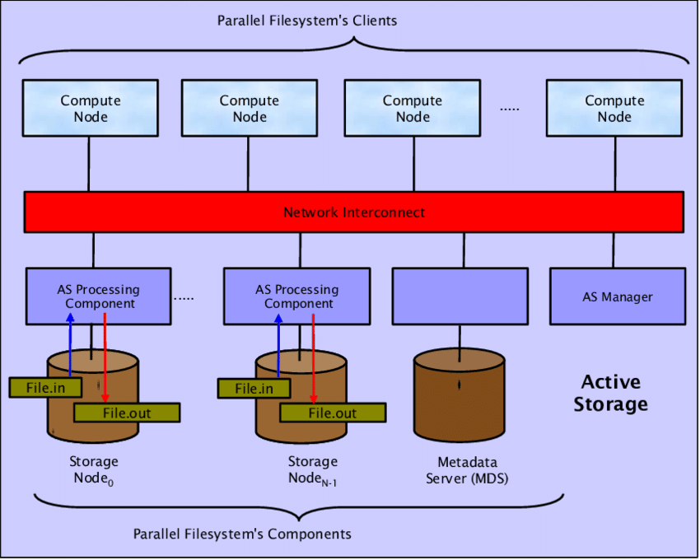
Evolution
Parallel File System
Enable parallel I/O to individual files.

Slide 25
Outline
Background
Taxonomy
Evolution
Case Study
Conclusion

Slide 26
Case Study
The Sun Network File System (NFS)
VFS: Virtual File System interface defines the operations that can be done on a filesystem.
V-node: Virtual node interface defines the operations that can be done on a file within that filesystem.
XDR: External Data Representation specification describes protocols in a machine and system independent way.
RPC: Remote Procedure Call package helps simplify protocol definition, implementation, and maintenance.

Slide 27
Case Study
The Sun Network File System (NFS)
NFS is stateless whereby all its client requests must be self-contained.
NFS uses VFS and V-node operations on its virtual file system interface.
NFS accounts for fast recovery (the reason behind the stateless design).
NFS uses UNIX semantics at the client side as a way to achieve transparency.

Slide 28
Case Study
Andrew File System (AFS)
Vice: The server side process that resides on top of the UNIX kernel, providing shared file services to each client.
Venus: The client side cache manager which acts as an interface between the application program and the Vice

Slide 29
Case Study
Andrew File System (AFS)
The entire file is transferred to the client computers in one go, limited only by the maximum size UDP/IP supports.
The entire file is cached in the local machine cache, reducing file open latency, and frequent read/write requests to the server.
AFS provides location independence and location transparency.
AFS has stateful servers and allows the server to inform all clients with open files about any updates (callback).

Slide 30
Case Study
Comparison between NFS and AFS
 | NFS | AFS
Security | N/A | Kerberos + Encryption
File Access | Remote Service + Cache | File Cache Orient (in Disk)
Cache | Write-Through (metadata) | Write-Through (directory)
Replication | N/A | Supported
Consistency | N/A | Server-Initiated (callback)
Service | Stateless | Stateful

Slide 31
Case Study
Google File System (GFS)
Large Chunk size: minimize the cost of disk seek to push up file transfer rate to the disk transfer rate.
Reliability through replication: each chunk replicated across 3+ chunkserver.
Single master to coordinate access: keep metadata.
Add record append operations: support concurrent appends.

Slide 32
Case Study
Google File System (GFS)

Slide 33
Case Study
Google File System (GFS)

Slide 34
Case Study
Google File System (GFS)
Issue on single master
What if master goes offline?
  Add a shadow master.
What if master is overloaded?
  Minimize master involvement to address the scalability issue.

Slide 35
Case Study
Google File System (GFS)
Master
Metadata storage.
Namespace management/locking.
Periodic communication with chunkservers.
  give instructions, collect state, track cluster health.
Chunk creation, re-replication, rebalancing.
  spread replicas across racks to reduce correlated failures.
  re-replicate data if redundancy falls below a threshold.

Slide 36
Case Study
Google File System (GFS)
Master
Garbage collection.
  simpler, more reliable than traditional file delete
  master logs the deletion, renames the file to a hidden name
  lazily garbage collects hidden files
Stale replica deletion.
  detect “stale” replicas using chunk version numbers

Slide 37
Case Study
Google File System (GFS)
Chunkserver
Stores 64 MB file chunks on local disk, each with version number and checksum.
Read/write requests specify chunk handle and byte range.
Chunks replicated on configurable number of chunkservers (default: 3-way replication).
No file data caching

Slide 38
Case Study
Google File System (GFS)
Client
Issues control (metadata) requests to master.
Issues data requests directly to chunkservers.
Caches no file data but metadata.

Slide 39
Case Study
Google File System (GFS)
Summary
Tolerates frequent component failures (failures as the norm rather than the exception).
Optimizes for huge files that are mostly appended and then read sequentially.
Delivers high aggregate throughput to many concurrent readers and writers.

Slide 40
Case Study
Google File System (GFS)
Limitations:
Assumes write-once, read-many workloads.
Assumes a modest number of large files.

Slide 41
Case Study
The Hadoop Distributed File System (HDFS)
An open-source implementation of GFS
NameNode: single master.
SecondaryNameNode: shadow master.
DataNode: chunkserver.

Slide 42
Case Study
The Hadoop Distributed File System (HDFS)
NameNode
Manages filesystem namespace.
  Maps a filename to a set of blocks
  Maps a block to the DataNodes where it resides
Cluster configuration management.
Replication engine for blocks.

Slide 43
Case Study
The Hadoop Distributed File System (HDFS)
DataNode
Stores data in the local file system.
Stores metadata of a block
Serves data and metadata to clients
Communicates with NameNode through periodic “heartbeat” (once per 3 secs)
Block report
Facilitates pipelining of data

Slide 44
Case Study
The Hadoop Distributed File System (HDFS)
Client
Client can find locations of blocks.
Client accesses data directly from DataNodes.

Slide 45
Case Study
The Hadoop Distributed File System (HDFS)
Summary:
Handling very large files, often spanning gigabytes or terabytes in size, which can be complex for traditional data processing software to manage.
Streaming data access pattern benefits large scale data processing tasks, making Hadoop ideal for batch processing jobs
Compatibility with commodity hardware, which are low-cost systems available en masse.

Slide 46
Case Study
The Hadoop Distributed File System (HDFS)
Limitations:
Low-latency data access.
Assumes a modest number of large files.

Slide 47
Case Study
Alluxio: Reliable In-memory Distributed Storage System
Why use in-memory storage?
Data sharing is the bottleneck in analytics pipeline.
Cache loss when process crashes.
Data duplication and Garbage Collection.

Slide 48

Case Study
Alluxio: Reliable In-memory Distributed Storage System
Accelerate I/O to/from Remote Storage
Low latency
Memory throughout
Spark
Spark
Keeping data in Alluxio accelerates data access
Alluxio
High latency
Network throughout

Slide 49
Case Study
Alluxio: Reliable In-memory Distributed Storage System
Share Data Across Jobs at Memory Speed
Spark
MapReduce
Spark
Spark
MapReduce
Spark
Alluxio
Network/Disk I/O slows down sharing
Sharing data with Alluxio via memory

Slide 50
Case Study
Alluxio: Reliable In-memory Distributed Storage System
Transparently Manage Data Across Storage Systems
Spark
MapReduce
Spark
Flexible and simple
No application changes
Alluxio
Sharing data with Alluxio via memory

Slide 51
Case Study
Alluxio: Reliable In-memory Distributed Storage System

Slide 52
Outline
Background
Taxonomy
Evolution
Case Study
Conclusion

Slide 53
Conclusion
Definition:
  A Distributed File System (DFS) is a file system that allows access to files from multiple servers sharing via a network. It allows applications to read and write data to and from the distributed system and enables multiple users to access and process data in parallel.
Requirement:
  Communication, Naming, Synchronization, Consistency, Security…
Application:
  NFS, AFS, GFS, HDFS…

Slide 54
Reference
Satyanarayanan M. A survey of distributed file systems[J]. Annual Review of Computer Science, 1990, 4(1): 73-104.
Thanh T D, Mohan S, Choi E, et al. A taxonomy and survey on distributed file systems[C]//2008 Fourth international conference on networked computing and advanced information management. IEEE, 2008, 1: 144-149.
Macko P, Hennessey J. Survey of distributed file system design choices[J]. ACM Transactions on Storage (TOS), 2022, 18(1): 1-34.
Ghemawat S, Gobioff H, Leung S T. The Google file system[C]//Proceedings of the nineteenth ACM symposium on Operating systems principles. 2003: 29-43.
Borthakur D. The hadoop distributed file system: Architecture and design[J]. 2008.
Li H. Alluxio: A virtual distributed file system[M]. University of California, Berkeley, 2018.

Slide 55
Thank You
2024.04.30
Jiawei Xu
School of Data Science
Chinese University of Hong Kong, Shenzhen

