Slide 1
General External Memory System for Graph Processing 2024.04.09
Ma Haotian
Supervised by Prof. Yeh-Ching Chung
School of Data Science
Chinese University of Hong Kong, Shenzhen

Slide 2
Outline
Introduction
Related Work
Preliminaries
Proposed Methods
Performance Evaluation
Conclusions

Slide 3
Graph External Memory System
Introduction
Related Work
Preliminaries
Proposed Methods
Performance Evaluation
Conclusions

Slide 4
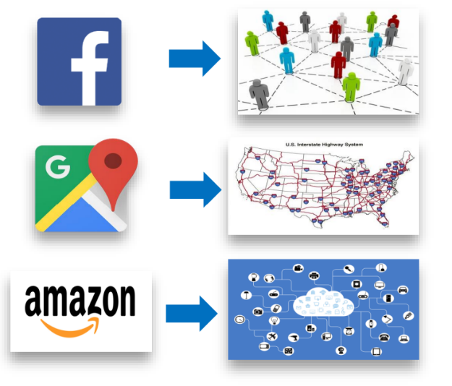
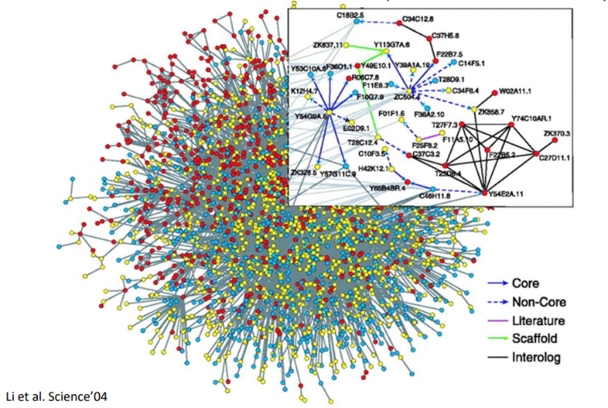
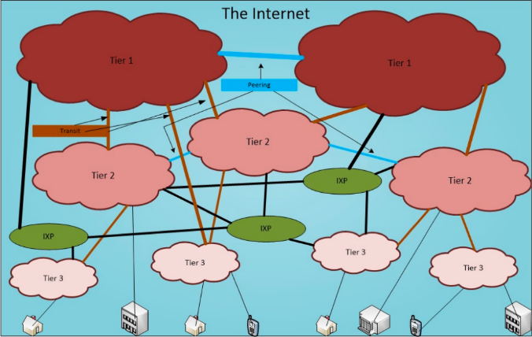
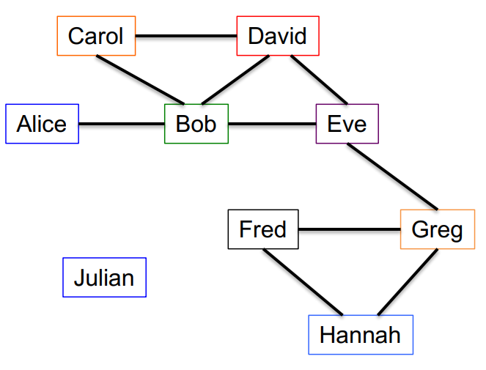
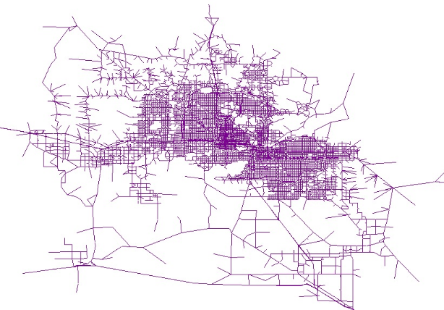
Introduction
Why Graph？
Many useful applications are based on graph
Different types of graphs
Different types of application
Protein-Protein Interaction
Computer Network
Social Network
Transportation Network

Slide 5
Introduction
Graph Algorithm
Different graph algorithms serve different applications
BFS
DFS
Random Walk
Subgraph isomorphism
Strongly Connected Component (SCC)
Shortest Path (SP)
PageRank (PR)
Dominating Set (DS)
Graph Decomposition (Take K-core as an example)
Graph Diameter (Diam)

Slide 6
Introduction
Graph Algorithm Feature
Most common access pattern:
Random access of vData causes low locality
Each time, only a subset of data is randomly (unpredictable) fetched for processing
For most of graph algorithm, data access has low spatial locality

Slide 7
Introduction
Graph Algorithm Feature
Algorithm with high complexity
Graph algorithm might take several iterations of whole graph to complete
PageRank, Shortest Path, K-core Decomposition…
Some graph algorithms are NP-hardness
Subgraph isomorphism

Slide 8
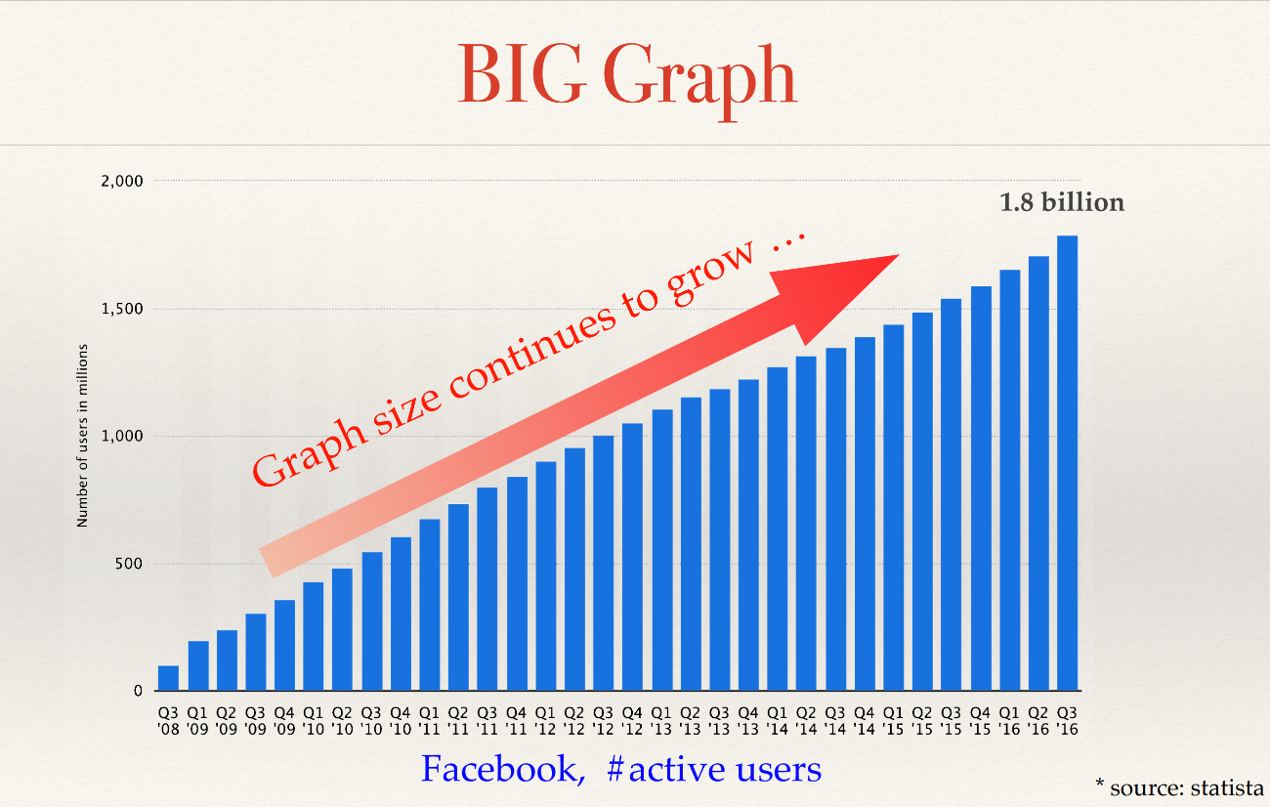
Introduction
Challenges of Current Graph Processing (view of system)
Insufficient Memory for processing
Graph sizes grows fast
Facebook graph has reached terabytes on 2016
Probably grows faster because big data analytics
Memory is not sufficient for obtaining the
whole graph and process.

Slide 9
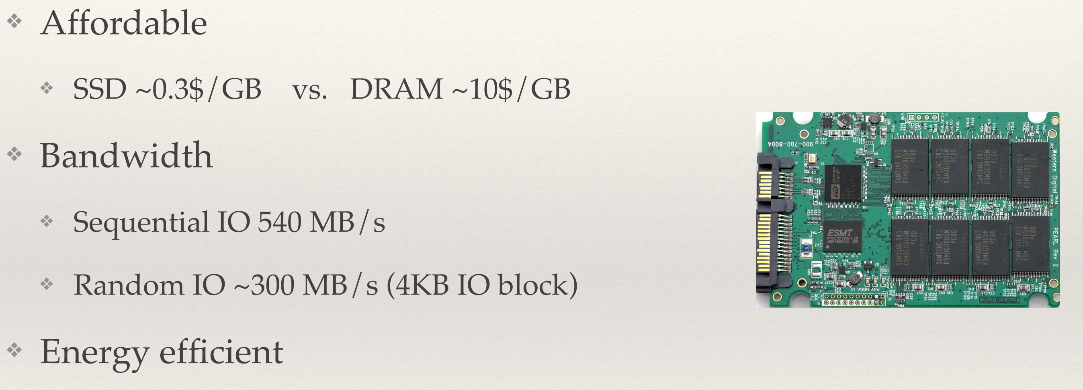
Introduction
Solutions to Insufficient Memory
Distributed Graph processing system
Pros:
Fast processing; Large distributed memory;
Cons:
Bottleneck by network; Higher price; Scalability issues; Implementation difficulties
Then it comes to external memory solution
Pros:
Lower cost; Easy for implementing and further development; Comparable speed to distributed system
Cons:
High overhead on I/O loading and page-fault interruption
need to be overcome

Slide 10
Graph External Memory System
Introduction
Related Work
Preliminaries
Proposed Methods
Performance Evaluation
Conclusions

Slide 11
Related work
Title | Conference | Year
Practicably Boosting the Processing Performance of BFS-like Algorithms on Semi-External Graph System via I/O-Efficient Graph Ordering | FAST | 2022
GraphOne: A Data Store for Real-time Analytics on Evolving Graphs | FAST | 2019
Large-Scale Graph Processing on Emerging Storage Devices | FAST | 2019
Graphene: Fine-Grained IO Management for Graph Computing | FAST | 2017
FlashGraph: Processing Billion-Node Graphs on an Array of Commodity SSDs | FAST | 2015
SOWalker: An I/O-Optimized Out-of-Core Graph Processing System for Second-Order Random Walks | ATC | 2023
GraphWalker: An I/O-Efficient and Resource-Friendly Graph Analytic System for Fast and Scalable Random Walks | ATC | 2020
Optimizing memory-mapped I/O for fast storage devices | ATC | 2020
Lumos: Dependency-Driven Disk-based Graph Processing | ATC | 2019
Pre-Select Static Caching and Neighborhood Ordering for BFS-like Algorithms on Disk-based Graph Engines | ATC | 2019
CGraph: A Correlations-aware Approach for Efficient Concurrent Iterative Graph Processing | ATC | 2018
Squeezing out All the Value of Loaded Data: An Out-of-core Graph Processing System with Reduced Disk I/O | ATC | 2017
Load the Edges You Need: A Generic I/O Optimization for Disk-based Graph Processing | ATC | 2016
GridGraph: Large-Scale Graph Processing on a Single Machine Using 2-Level Hierarchical Partitioning | ATC | 2015
GraphChi: Large-Scale Graph Computation on Just a PC | OSDI | 2012
Mosaic: Processing a Trillion-Edge Graph on a Single Machine | EuroSys | 2017
Phases, Modalities, Spatial and Temporal Locality: Domain Specific ML Prefetcher for Accelerating Graph Analytics | SC | 2023
MBFGraph: An SSD-based External Graph System for Evolving Graphs | SC | 2023
Blaze: fast graph processing on fast SSDs | SC | 2022
Wonderland: A Novel Abstraction-Based Out-Of-Core Graph Processing System | ASPLOS | 2018
Graspan: A Single-machine Disk-based Graph System for Interprocedural Static Analyses of Large-scale Systems Code | ASPLOS | 2017
GraphSSD: graph semantics aware SSD | ISCA | 2019
GraFBoost: Using Accelerated Flash Storage for External Graph Analytics | ISCA | 2018
Ligra: a lightweight graph processing framework for shared memory | PPoPP | 2013
RealGraph: A Graph Engine Leveraging the Power-Law Distribution of Real-World Graphs | WWW | 2019
TurboGraph++: A Scalable and Fast Graph Analytics System | SIGMOD | 2018
Hybrid Pulling/Pushing for I/O-Efficient Distributed and Iterative Graph Computing | SIGMOD | 2016
TurboGraph: a fast parallel graph engine handling billion-scale graphs in a single PC | SIGKDD | 2013
Chaos: scale-out graph processing from secondary storage | SOSP | 2015
NXgraph: An efficient graph processing system on a single machine | ICDE | 2016
PrefEdge: SSD Prefetcher for Large-Scale Graph Traversal | SYSTOR | 2014
MMap: Fast billion-scale graph computation on a PC via memory mapping | BigData | 2014

Slide 12
Related work
Classification of existing External-Memory Graph processing system
Type of external-memory approach
Partitioned Graph and executing graph analytics by partition
Utilizing sequential read speed
Using Asynchronous I/O in page-grained (4KB in usual)
Minimizing the number of useless page loaded
Overlapping I/O overhead by computation
Algorithm specific
BFS-like Algorithm
Each time, only a subset of edge lists will be fetched for visiting, and it is hard to predict the access pattern
All-active Algorithms (PageRank, Collaborative Filtering)
All vertices and their adjacent lists are processed in each iteration
A vertex accesses multiple edge lists
Triangle Counting; Scan statistic
External-Memory Graph system are in various types

Slide 13
Related work
State-of-the-art System picked in this seminar
Graphchi (OSDI’ 12)
FlashGraph (FAST’ 15)
Graphene (FAST’ 17)
IOE-order (FAST’ 22)
CLIP (ATC’ 17)
GraphSSD (ISCA’ 19)
Blaze (SC’ 22)

Slide 14
Graph External Memory System
Introduction
Related Work
Preliminaries
Proposed Methods
Performance Evaluation
Conclusions

Slide 15
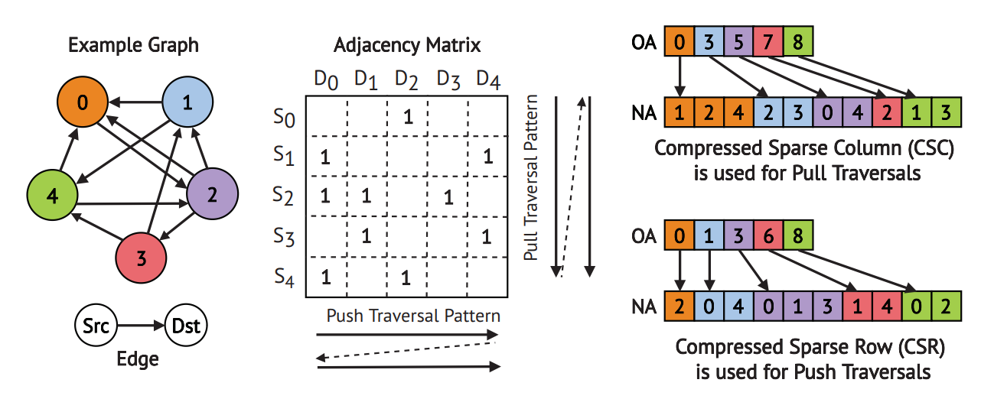
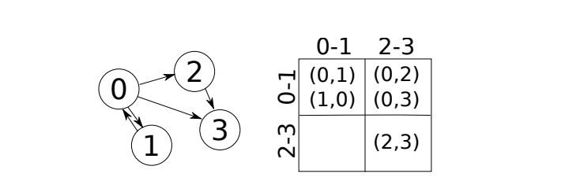
Graph Layout
Compressed Format
Compress Sparse Row (CSR)
Compress Sparse Column (CSC)
Edge Array
Grid

Slide 16
Preliminaries
Different type of general solutions
Partition; Asyc I/O; Merge I/O
Disk-based; SSD-based

Slide 17
Preliminaries
Different type of general solutions
Partition; Asyc I/O; Merge I/O
Disk-based; SSD-based

Slide 18
Preliminaries
SSD challenges:
From FlashGraph (FAST’ 15)

Slide 19
Graph External Memory System
Introduction
Related Work
Preliminaries
Proposed Methods
Performance Evaluation
Conclusions

Slide 20
Proposed Methods
GraphChi OSDI’ 12
GraphChi: Large-Scale Graph Computation on Just a PC

Slide 21
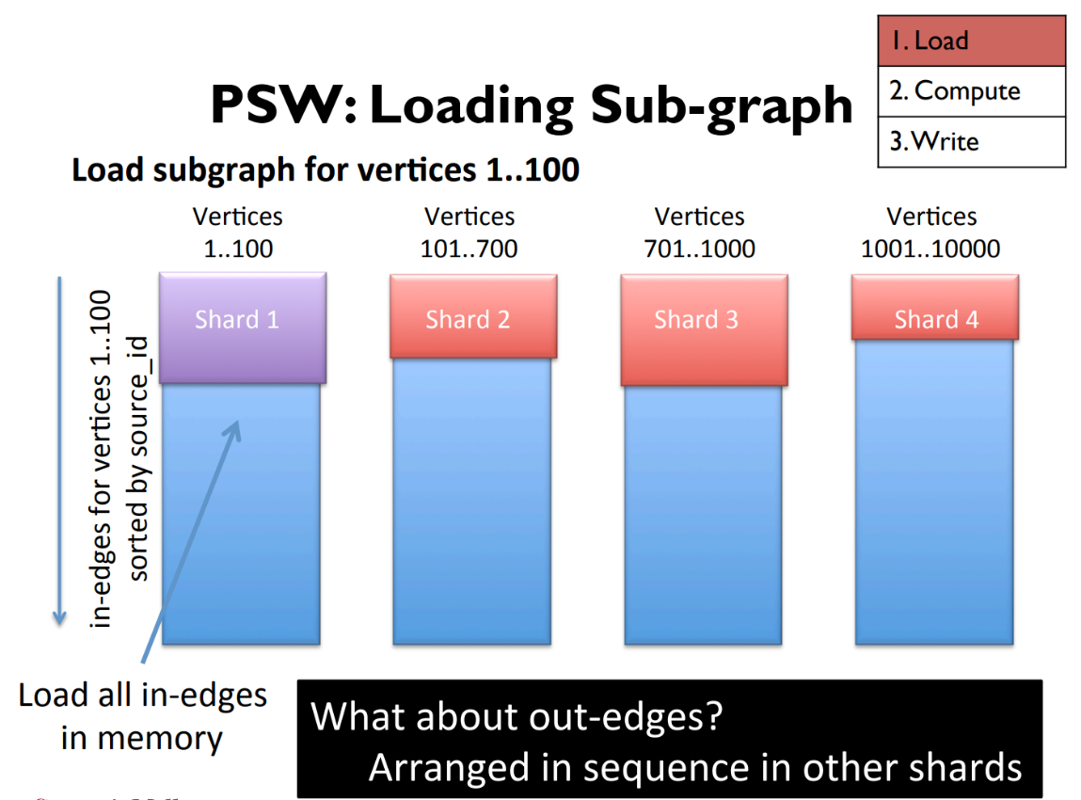
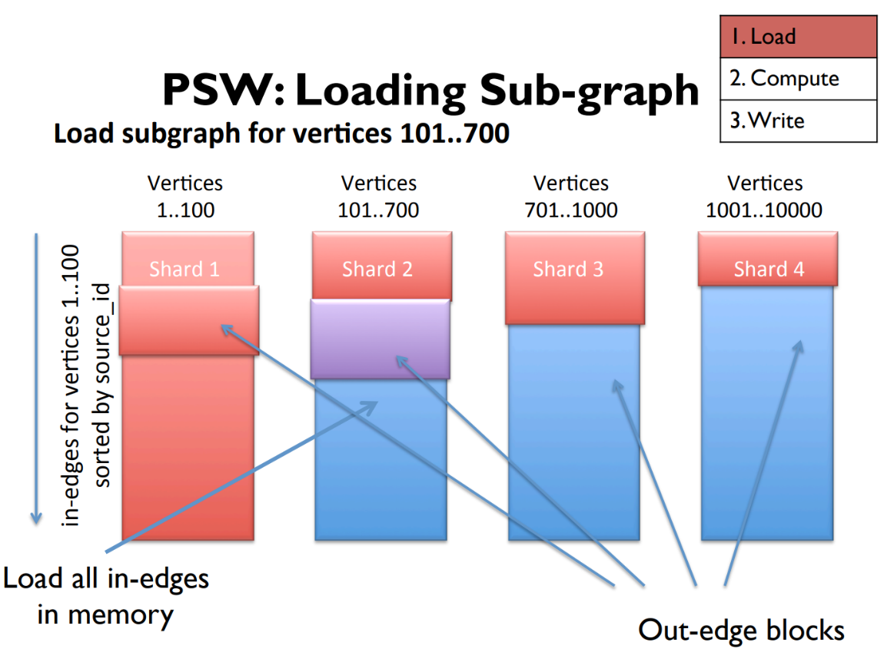
Proposed Methods
GraphChi OSDI’ 12
GraphChi: Large-Scale Graph Computation on Just a PC

Slide 22
Proposed Methods
GraphChi OSDI’ 12
GraphChi: Large-Scale Graph Computation on Just a PC

Slide 23
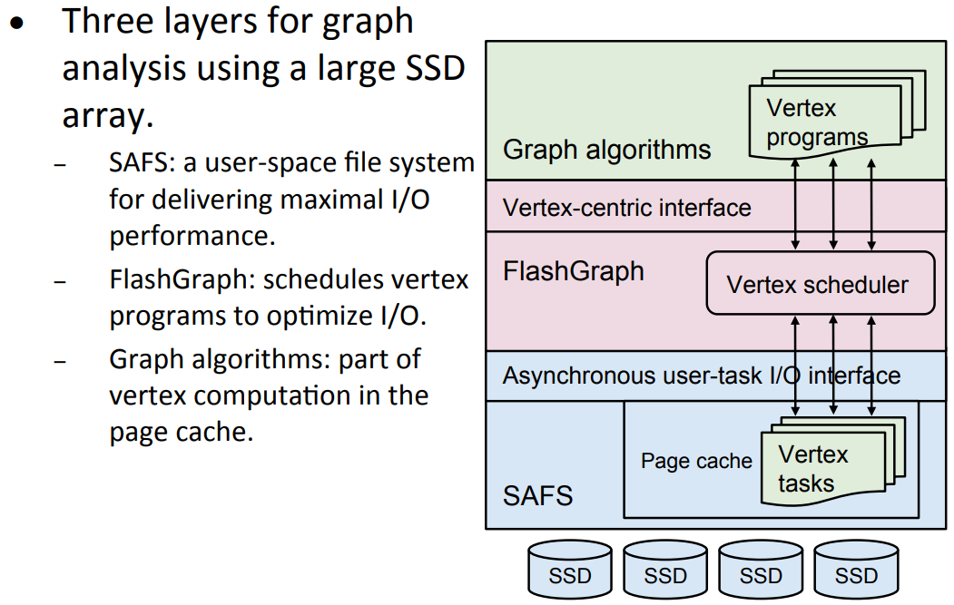
Proposed Methods
FalshGraph FAST’ 15
FlashGraph: Processing Billion-Node Graphs on an Array of Commodity SSDs

Slide 24
Proposed Methods
FalshGraph FAST’ 15
FlashGraph: Processing Billion-Node Graphs on an Array of Commodity SSDs

Slide 25
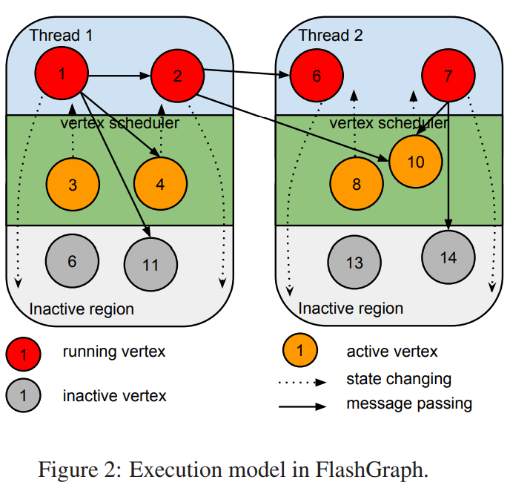
Proposed Methods
FalshGraph FAST’ 15
FlashGraph: Processing Billion-Node Graphs on an Array of Commodity SSDs

Slide 26
Proposed Methods
Graphene FAST’ 17
Graphene: Fine-Grained IO Management for Graph Computing

Slide 27
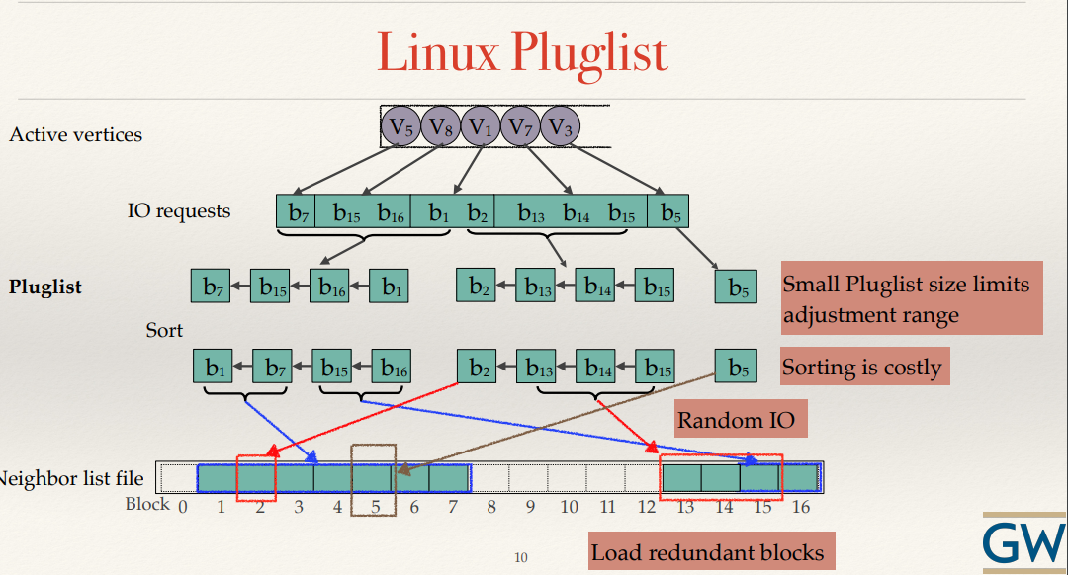
Proposed Methods
Graphene FAST’ 17
Graphene: Fine-Grained IO Management for Graph Computing

Slide 28
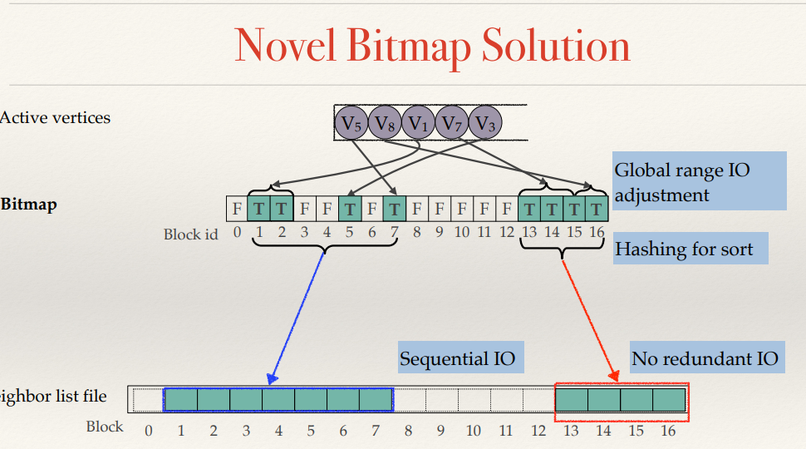
Proposed Methods
Graphene FAST’ 17
Graphene: Fine-Grained IO Management for Graph Computing

Slide 29
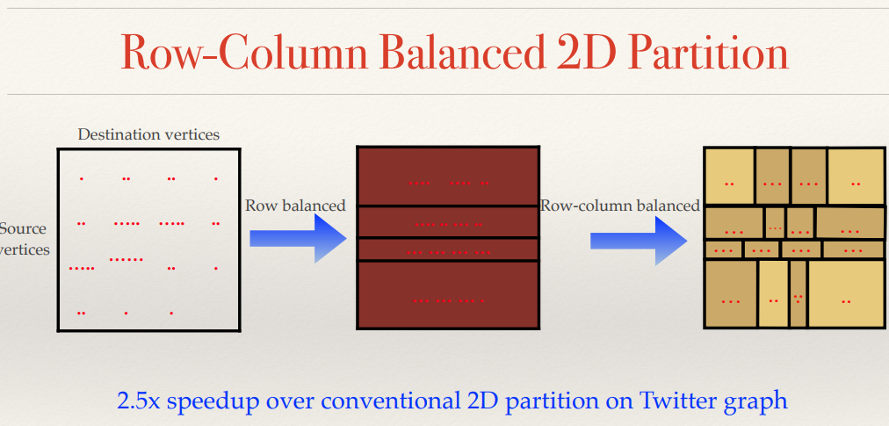
Proposed Methods
Graphene FAST’ 17
Graphene: Fine-Grained IO Management for Graph Computing

Slide 30
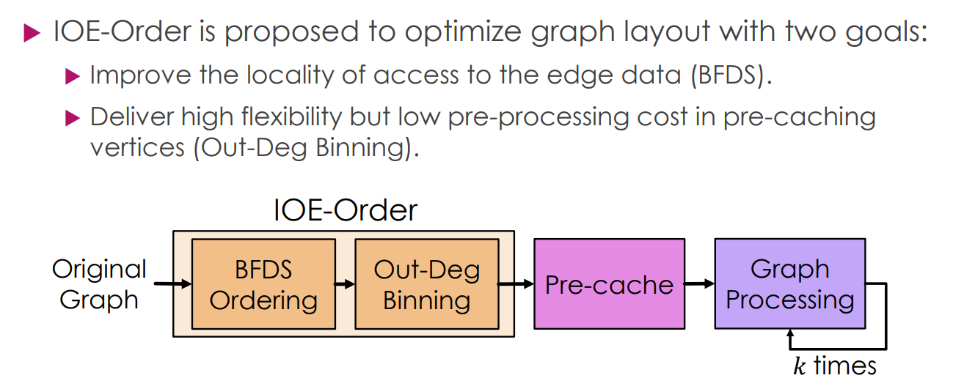
Proposed Methods
IOE-order FAST’ 22
(Note: Build base on principle of Graphene FAST’ 15)
Practicably Boosting the Processing Performance of BFS-like Algorithms on Semi-External Graph System via I/O-Efficient Graph Ordering

Slide 31
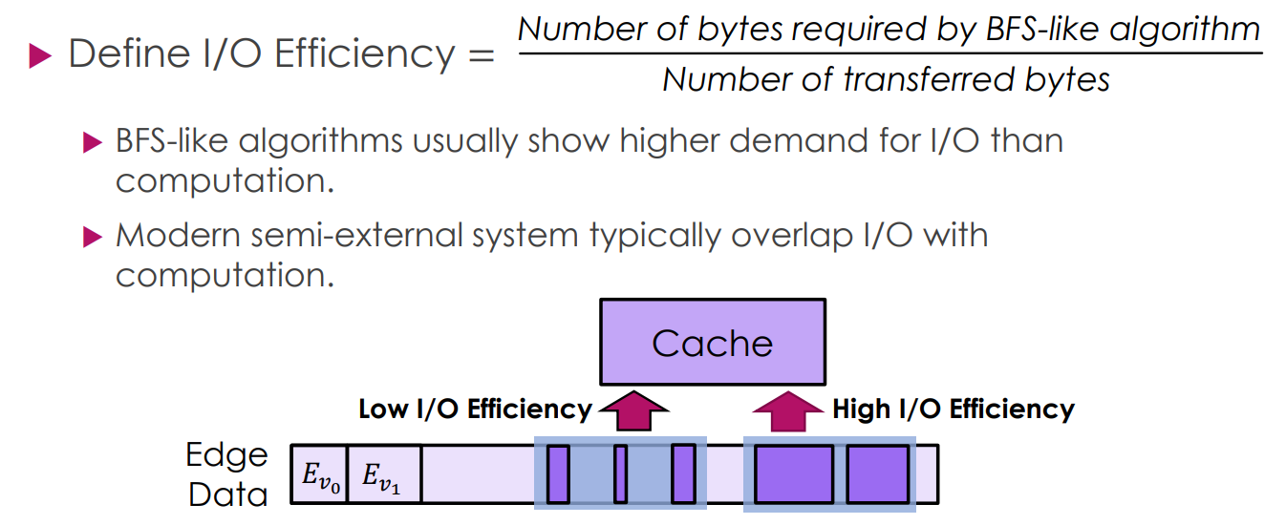
Proposed Methods
IOE-order FAST’ 22
Practicably Boosting the Processing Performance of BFS-like Algorithms on Semi-External Graph System via I/O-Efficient Graph Ordering

Slide 32
Proposed Methods
IOE-order FAST’ 22
Practicably Boosting the Processing Performance of BFS-like Algorithms on Semi-External Graph System via I/O-Efficient Graph Ordering

Slide 33
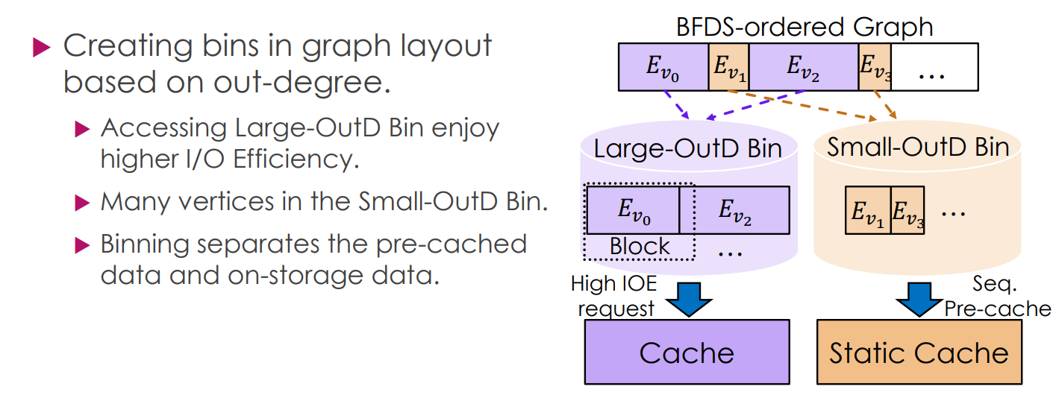
Proposed Methods
IOE-order FAST’ 22
Practicably Boosting the Processing Performance of BFS-like Algorithms on Semi-External Graph System via I/O-Efficient Graph Ordering

Slide 34
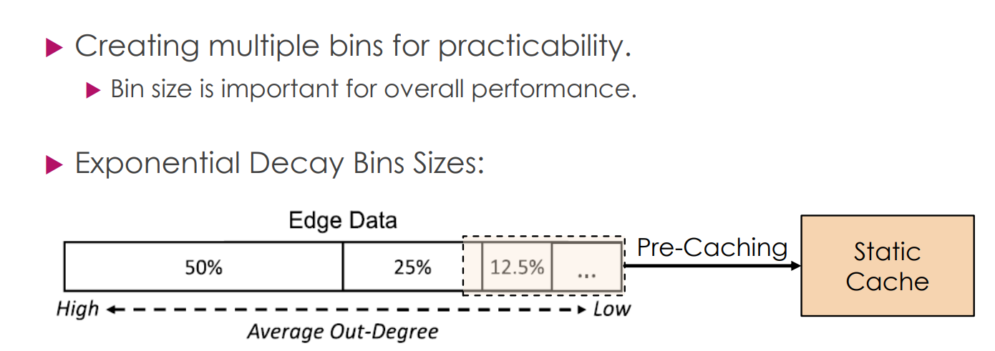
Proposed Methods
IOE-order FAST’ 22
Practicably Boosting the Processing Performance of BFS-like Algorithms on Semi-External Graph System via I/O-Efficient Graph Ordering

Slide 35
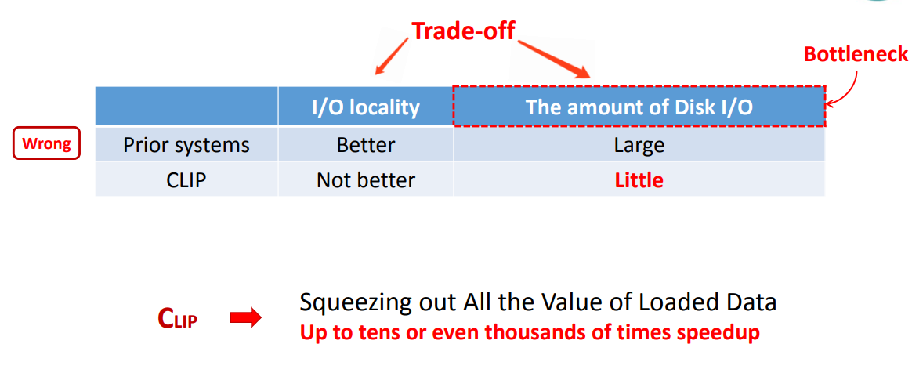
Proposed Methods
CLIP ATC’ 17
Squeezing out All the Value of Loaded Data: An Out-of-core Graph Processing System with Reduced Disk I/O

Slide 36
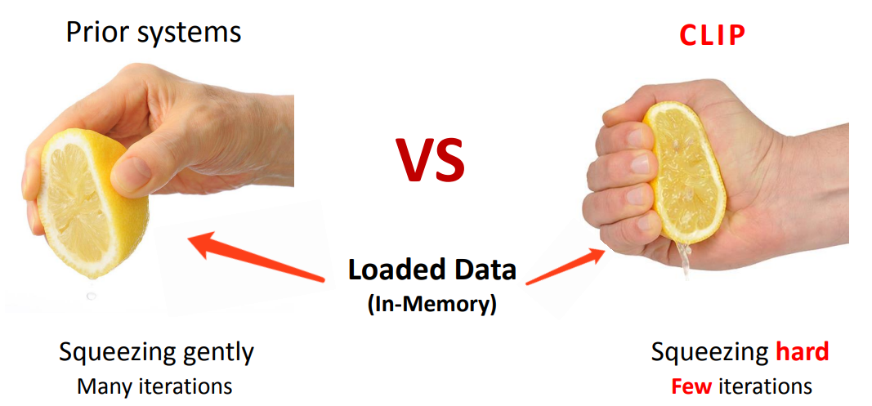
Proposed Methods
CLIP ATC’ 17
Squeezing out All the Value of Loaded Data: An Out-of-core Graph Processing System with Reduced Disk I/O

Slide 37
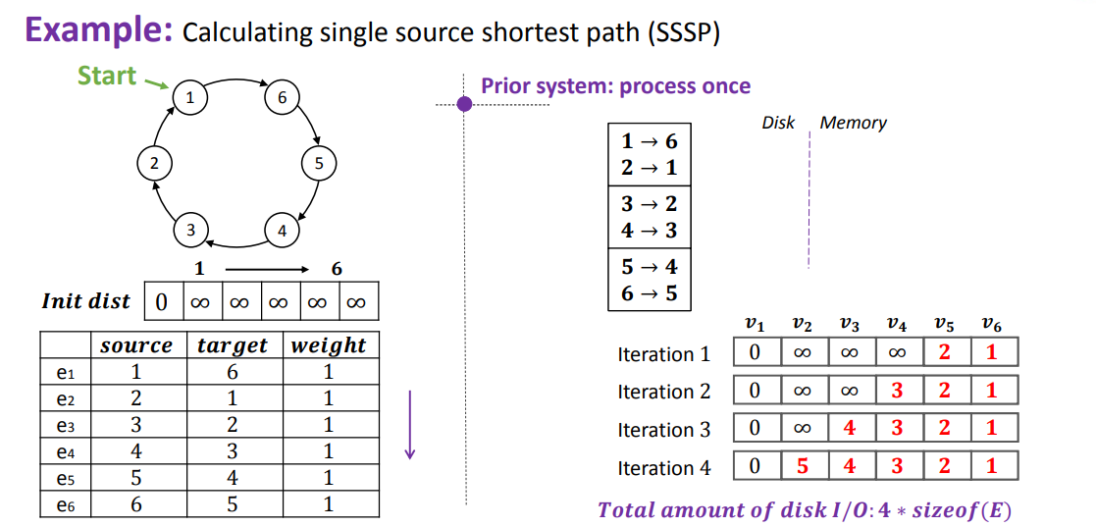
Proposed Methods
CLIP ATC’ 17
Squeezing out All the Value of Loaded Data: An Out-of-core Graph Processing System with Reduced Disk I/O

Slide 38
Proposed Methods
CLIP ATC’ 17
Squeezing out All the Value of Loaded Data: An Out-of-core Graph Processing System with Reduced Disk I/O

Slide 39
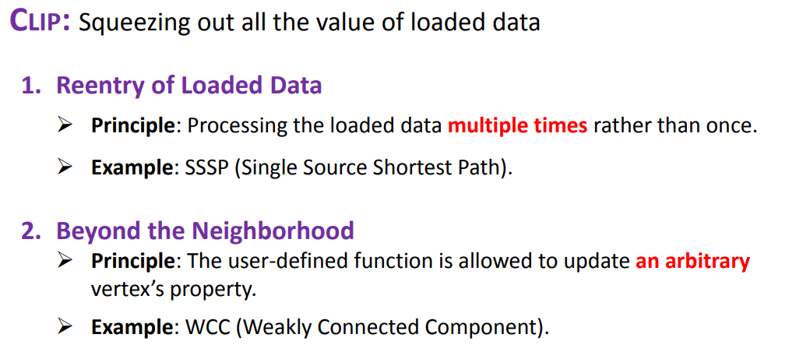
Proposed Methods
CLIP ATC’ 17
Squeezing out All the Value of Loaded Data: An Out-of-core Graph Processing System with Reduced Disk I/O

Slide 40
Proposed Methods
Blaze SC’ 22
Blaze: fast graph processing on fast SSDs
Transferring page id that needs to be load
Sending I/O request to SSD
Preparing(free/ malloc) buffer space for loading data
Fill the buffers with $mod$ principle
Once there is a full buffer, then copy it into bin space for gather thread to process
As useful data is copied into bin, then release the buffer
Generally using MPMC model

Slide 41
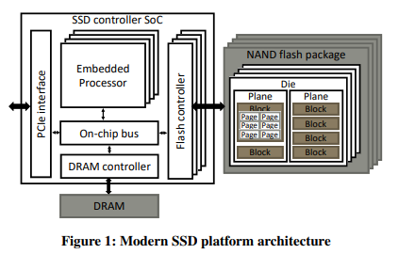
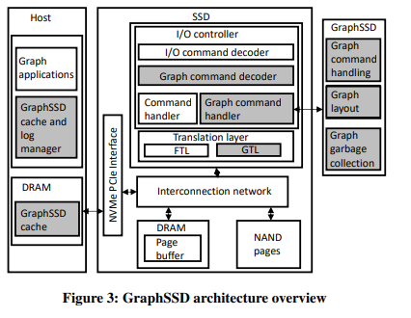
Proposed Methods
GraphSSD ISCA’ 19
GraphSSD: graph semantics aware SSD
Each block of SSD has some buffer which is flexible for update.
The adjacent list trying to avoid across blocks except the adjacent list is too long.
It manage pointers, and indicators such that it is flexible to note if there is extension block for inserting, or dirty blocks for updating

Slide 42
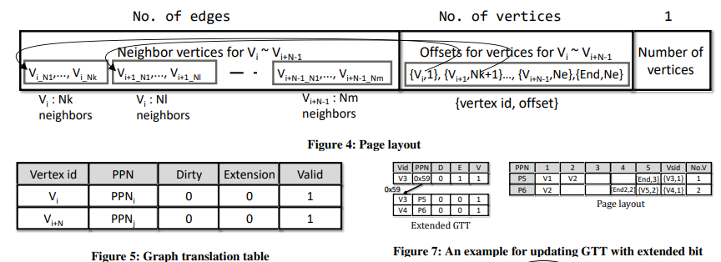
Proposed Methods
GraphSSD ISCA’ 19
GraphSSD: graph semantics aware SSD

Slide 43
Graph External Memory System
Introduction
Related Work
Preliminaries
Proposed Methods
Performance Evaluation
Conclusions

Slide 44
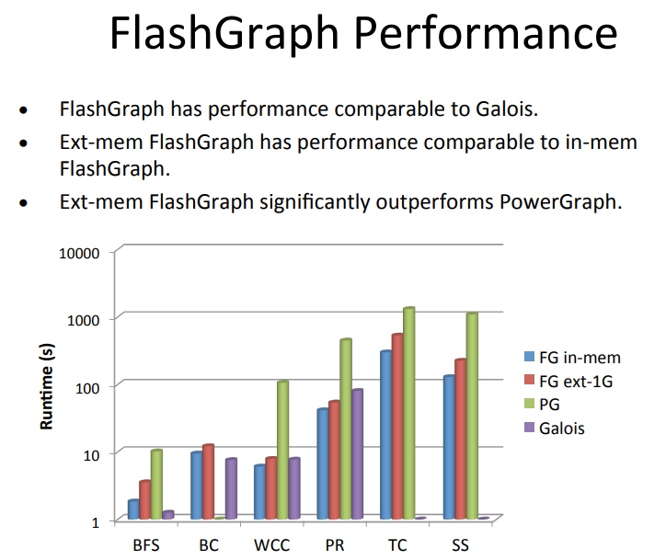
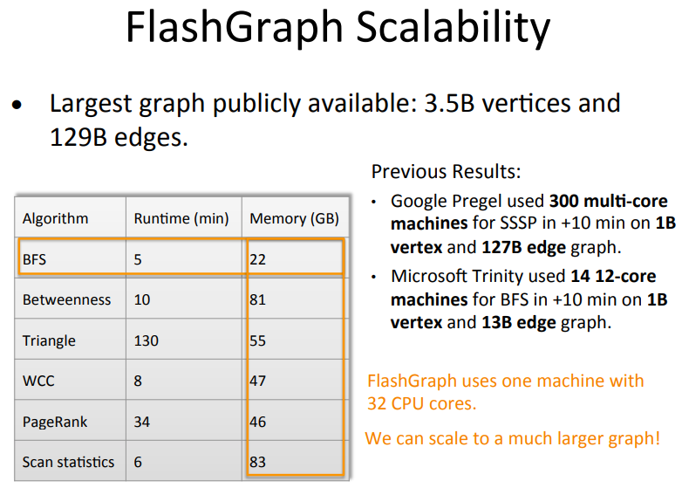
Performance Evaluation
FlashGraph’s evaluation

Slide 45
Performance Evaluation
Graphene’s evaluation

Slide 46
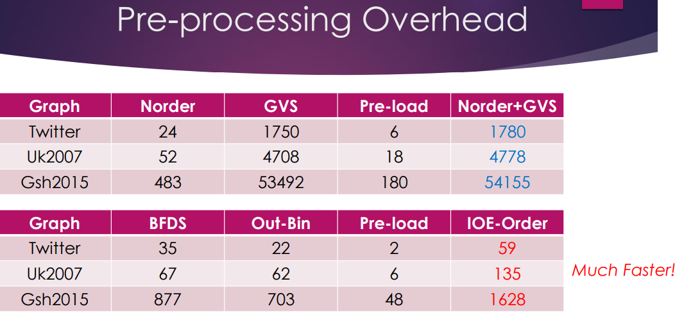
Performance Evaluation
IOE-Order’s evaluation

Slide 47
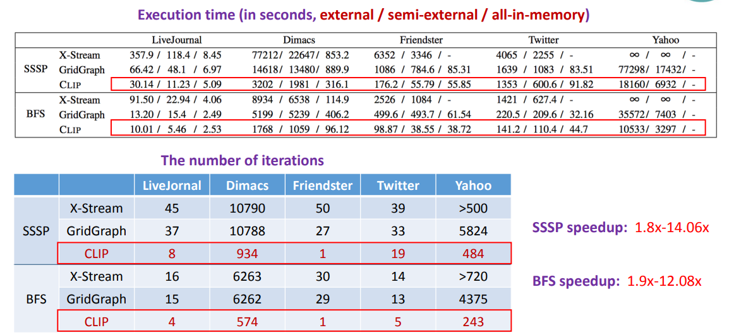
Performance Evaluation
CLIP’s evaluation

Slide 48
Graph External Memory System
Introduction
Related Work
Preliminaries
Proposed Methods
Performance Evaluation
Conclusions

Slide 49
Conclusion
In conclusion, the Graph External Memory system has been proposed with various solutions tailored for different algorithms and device configurations.
It would be beneficial to flexibly choose the corresponding external memory strategy for the optimal solution.

