Slide 1
A Survey of Virtualization techniques on Mobile Cloud Computing
2024.04.25
Bohan Zhuang
School of Data Science
Chinese University of Hong Kong, Shenzhen

Slide 2
Outline
Introduction
Preliminaries
Proposed Methods
Conclusions

Slide 3
Virtualization Techniques on MCC
Introduction
Preliminaries
Proposed Methods
Conclusions

Slide 4
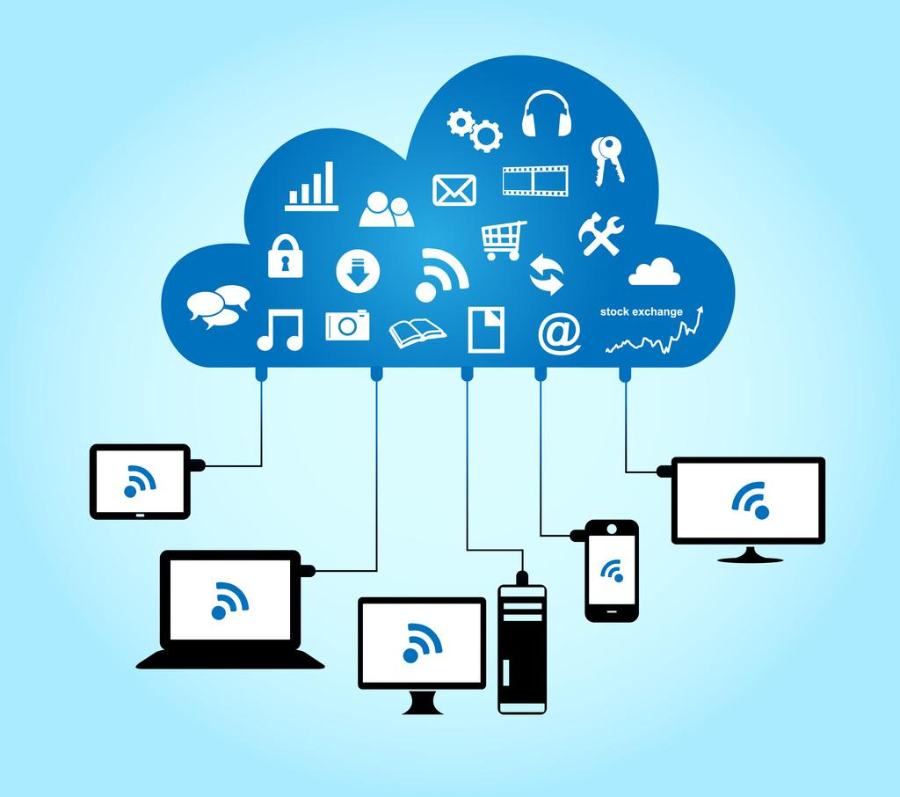
What is Cloud Computing
Cloud computing provides access through the web to computing resources and products, including development tools, business applications, compute services, data storage, and networking solutions. These cloud services are hosted at a software vendor’s data center and managed by the cloud services provider or onsite at a customer's data center.

Slide 5
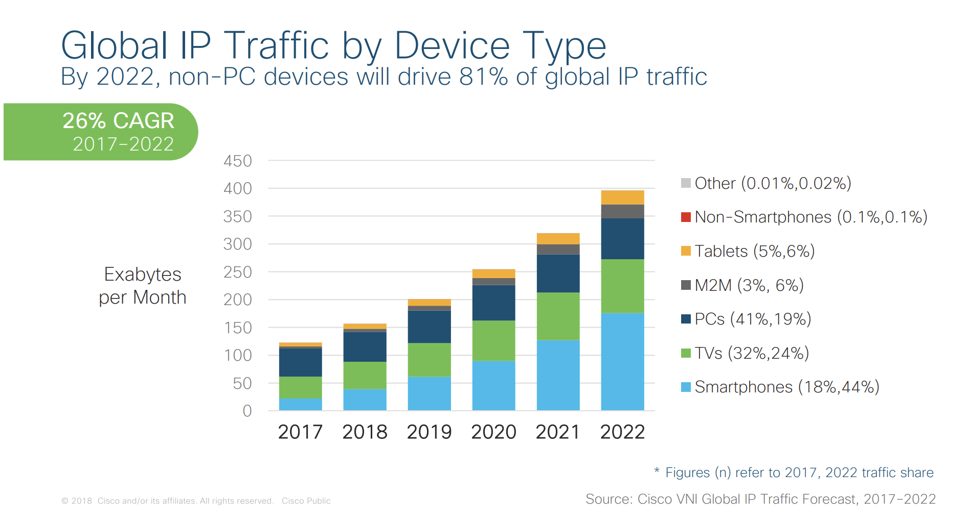
Why Mobile Cloud Computing
The use of smartphones and mobile devices is increasing

Slide 6
Why Mobile Cloud Computing(2)
Mobile devices face many resource challenges.
They are battery operated so they suffer from limitations in storage, processing power, energy, communication, and security.
Cloud computing offers advantages to users by allowing them to use infrastructure, platforms and software by cloud providers at low cost and elastically in an on-demand fashion.
Mobile cloud computing provides mobile users with data storage and processing services in clouds, obviating the need to have a powerful device configuration (e.g. CPU speed, memory capacity), as all resource-intensive computing can be performed in the cloud.

Slide 7
Virtualization Techniques on MCC
Introduction
Preliminaries
Proposed Methods
Conclusions

Slide 8
Service models for CC
Infrastructure as a service (IaaS)
Provides access to main resources such as VMs, virtual storage, virtual infrastructure. All these resources are available to the end-users through server virtualization, while the cloud service provider manages the infrastructure.
Platform as a service (PaaS)
Provides a runtime environment and tools for developing applications. In this model, clients are responsible for the services and applications that they develop, and the cloud service provider manages the rest of the operations.

Slide 9
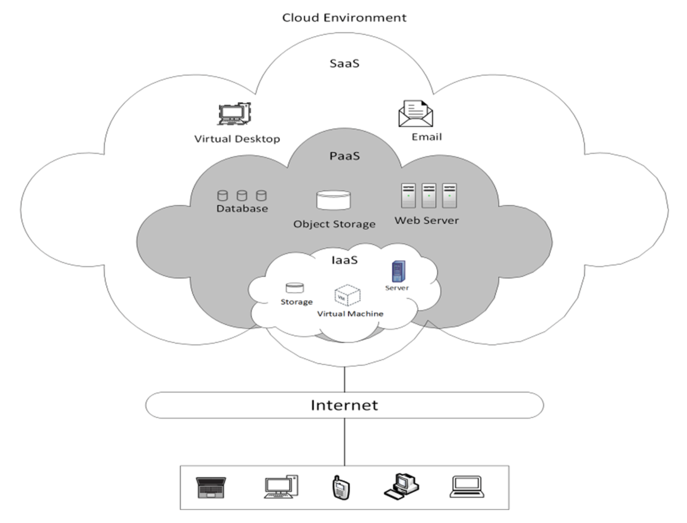
Service models for CC
Software as a service (SaaS)
Enables clients to use applications provided by the cloud over the Internet such as email and office tools.
In this model, the service provider is responsible for controlling the network, infrastructure, storage. and all application data and underlying infrastructure are situated (placed) in the data centers of the service provider.

Slide 10
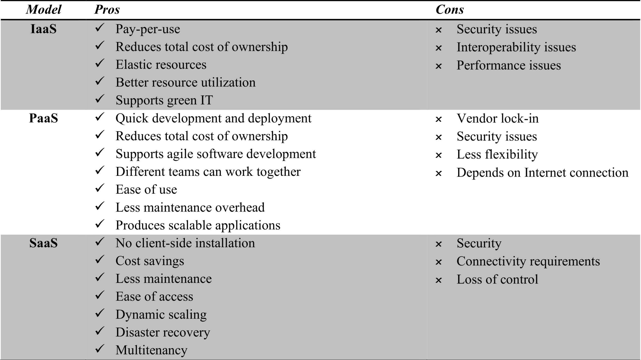
Comparison between service models

Slide 11
MCC service models
Mobile app as a service
Mobile network as a service
Mobile community as a service
Mobile multimedia as a service
Mobile data as a service
Mobile cloud infrastructure as a service

Slide 12
MCC applications
Mobile Learning:
M-learning combines e-learning and mobility
Traditional m-learning has limitations on high cost of devices/network, low transmission rate, limited educational resources
Cloud-based m-learning can solve these limitations
Enhanced communication quality between students and teachers
Help learners access remote learning resources
A natural environment for collaborative learning

Slide 13
MCC applications
Mobile Healthcare:
M-healthcare is to minimize the limitations of traditional medical treatment (e.g. Small storage, medical errors, …)
M-healthcare provides mobile users with convenient access to resources(e.g. medical records)
M-healthcare offers hospitals and healthcare organizations a variety of on-demand services on clouds

Slide 14
MCC applications
Mobile Gaming:
M-game is a high potential market generating revenues for service providers.
Can completely offload game engine requiring large computing resource (e.g., graphic rendering) to the server in the cloud.
Offloading can also save energy and increase game playing time (eg. MAUI allows fine-grained energy-aware offloading of mobile codes to a cloud)
Rendering adaptation technique can dynamically adjust the game rendering parameters based on communication constraints and gamers’ demands

Slide 15
MCC applications
Mobile Commerce:
M-commerce allows business models for commerce using mobile devices.
Examples: Mobile financial, mobile advertising, mobile shopping…
M-commerce applications face various challenges (low bandwidth, high complexity of devices, security, …)
Integrated with cloud can help address these issues
Example: Combining 3G and cloud to increase data processing speed and security level.

Slide 16
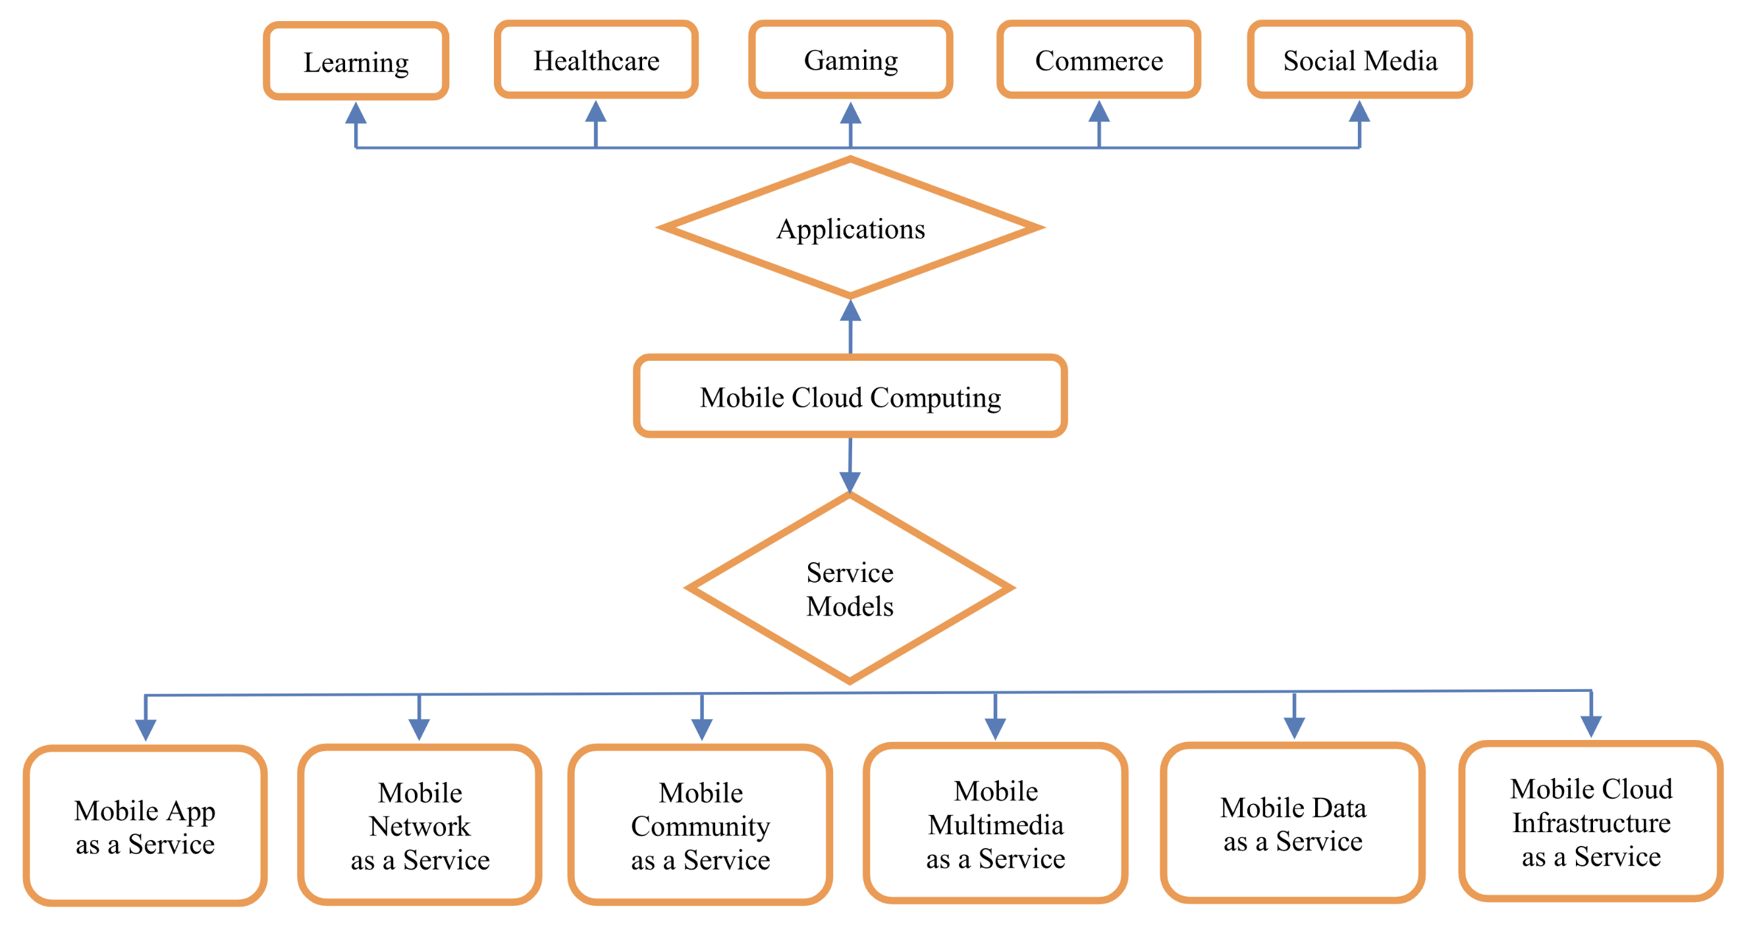
MCC Summary Diagram

Slide 17
Advantages of MCC
Extending battery lifetime:
Computation offloading migrates large computations and complex processing from resource-limited devices to resourceful machines.
Remote application execution can save energy significantly.
Many mobile applications take advantages from task migration and remote processing.
Improving data storage capacity and processing power:
MCC enables mobile users to store/access large data on the cloud.
MCC helps reduce the running cost for computation intensive applications.
Mobile applications are not constrained by storage capacity on the devices because their data now is stored on the cloud.

Slide 18
Advantages of MCC(2)
Improving reliability and availability:
Keeping data and application in the clouds reduces the chance of lost on the mobile devices.
MCC can be designed as a comprehensive data security model for both service providers and users:
Protect copyrighted digital contents in clouds.
Provide security services such as virus scanning, malicious code detection, authentication for mobile users.
With data and services in the clouds, then are always available even when the users are moving.

Slide 19
Advantages of MCC(3)
Dynamic provisioning:
Dynamic on-demand provisioning of resources on a fine-grained, self-service basis
No need for advanced reservation
Scalability:
Mobile applications can be performed and scaled to meet the unpredictable user demands
Service providers can easily add and expand a service

Slide 20
Advantages of MCC(4)
Multi-tenancy:
Service providers can share the resources and costs to support a variety of applications and large number of users.
Ease of Integration:
Multiple services from different providers can be integrated easily through the cloud and the Internet to meet the users’ demands.

Slide 21
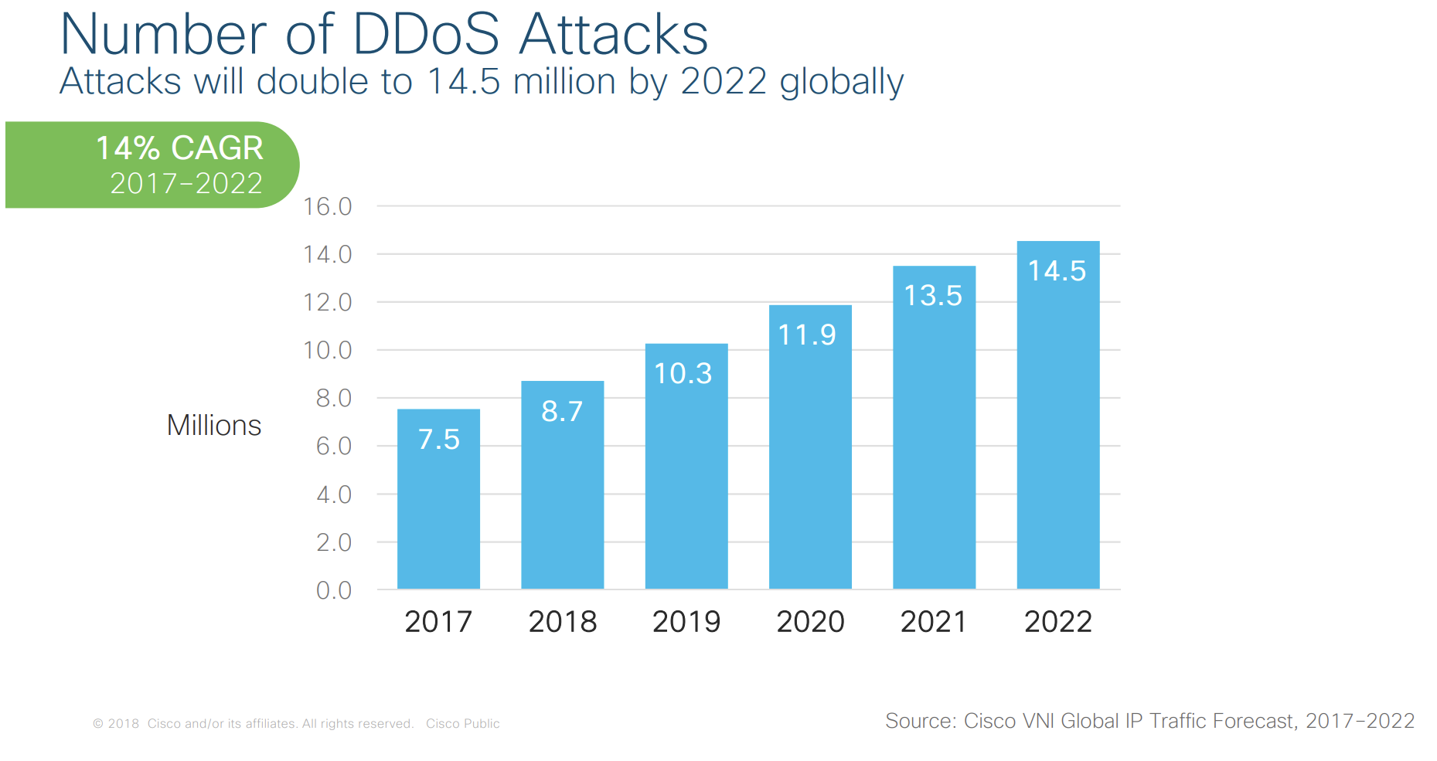
MCC security challenges
Protecting user privacy and data/application secrecy from adversaries is key to establish and maintain consumers’ trust in the mobile platform, especially in MCC.
MCC security issues have two main categories:
Security for mobile users
Securing data on clouds

Slide 22
Different type of attacks
Denial of service (DoS)
DoS is a kind of attack that floods a target system with many requests to use its resources in the extreme and makes the service unavailable for legitimate users. In a DDoS attacks are categorized into two types, reflector, and direct attack.
HTTP, XML, ICMP, TCP, and UDP flooding attacks are examples of direct attacks, while the Smurf attack, based on ICMP Echo request packets, is an example of reflector attacks.

Slide 23
Different type of attacks(2)
User-to-root (U2R)
In a user-to-root (U2R) attack, the attacker sniffs the password of a user and gains access to its account.
A known example of this type of attack is the buffer overflow which occurs when data are added to a buffer to exceed its size and overwrite adjacent memory locations.
Remote-to-local (R2L)
The remote-to-local (R2L) attack is a kind of attack which considers unauthorized local access from a remote machine. An attacker gets access to a machine as a valid user by utilizing the existing weaknesses of this machine’s security.

Slide 24
Different type of attacks(3)
Side-channel attack
A side-channel attack is a type of attack in which the information of side channels like power, cache, and time is exploited to get access to sensitive information of a VM.
VM escape
A kind of attack in which an intruder achieves the ability to read and write his content by accessing another host operating system or VMs’ memory is known as VM escape.

Slide 25
Different type of attacks(4)
Hyperjacking
In this attack, the entire control of a server is taken by placing a rogue hypervisor so that the attacked VM is completely oblivious to its presence. For instance, one reason for hyperjacking can be to install rootkits. Hyperjacking is done when the attacker gains direct access to the main hypervisor.
Hypercall vulnerabilities
Hypercall vulnerabilities are attacks that occur when a malicious guest penetrates the VM with the utilization of hypercall interfaces (used by the guest OS to make privileged requests) and gaps in the hypercall handler of the hypervisor. This attack causes substantial performance degradation of the hypervisor.

Slide 26
Virtualization Techniques on MCC
Introduction
Preliminaries
Proposed Methods
Conclusions

Slide 27
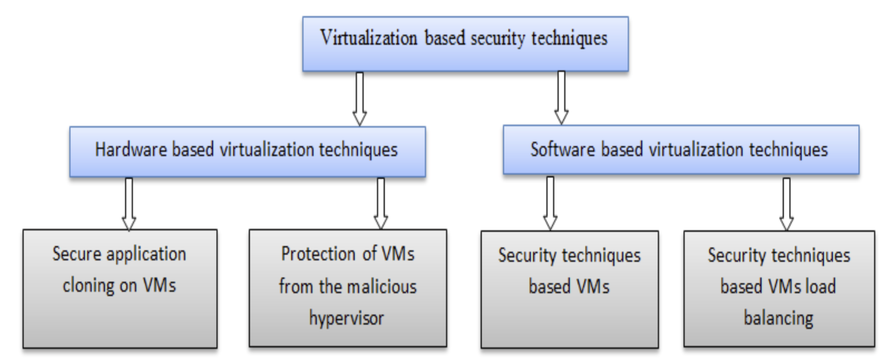
Techniques for security

Slide 28
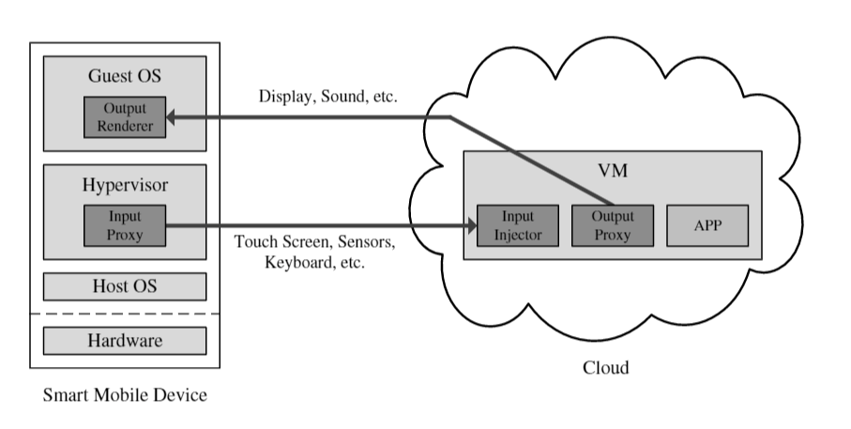
Secure application cloning on VM
Secure Mobile Cloud Platform (SMOC)
1. Sharing resource which means that a mobile application can freely change the running location.
2. Ensuring security even though the operating system of the mobile device has been attacked.

Slide 29
Strengths & Drawbacks
Pros:
The security of mobile device operating system is ensured even when the latter is attacked.
A secure environment is also provided by hardware virtualization on untrusted mobile devices.
The freely execution location of mobile application whether on the mobile device or cloud.
Cons:
It assumes that both hypervisor and cloud are always secure, so if the adversary succeeds to penetrate them, the data of the user would be in risks.
Dynamic migration of mobile application within VMs on the cloud.

Slide 30
Protect VMs from malicious hypervisor
Hardware-Assisted Secure Virtual Machine (H-SVM)
The mechanism protects the guest virtual machine for monitoring the malicious VM or hypervisor by isolating its memory virtualization. It proposed a new flexible and efficient mechanism of memory protection by allowing restricted roles for the hypervisors and decoupling the memory isolation from memory allocation that is usually executed by the hypervisor. Therefore, the handler takes some roles of hypervisor such as scheduling VMs. The mechanism of changing the hardware architecture presents drawbacks regarding the deployment cost and not suitable for immediate deployment.

Slide 31
Strengths & Drawbacks
Pros:
The work ensures the protection of the virtual machines under a vulnerable hypervisor.
Cons:
Hardware architecture changes are not practical due to high deployment cost in the current cloud platform.

Slide 32
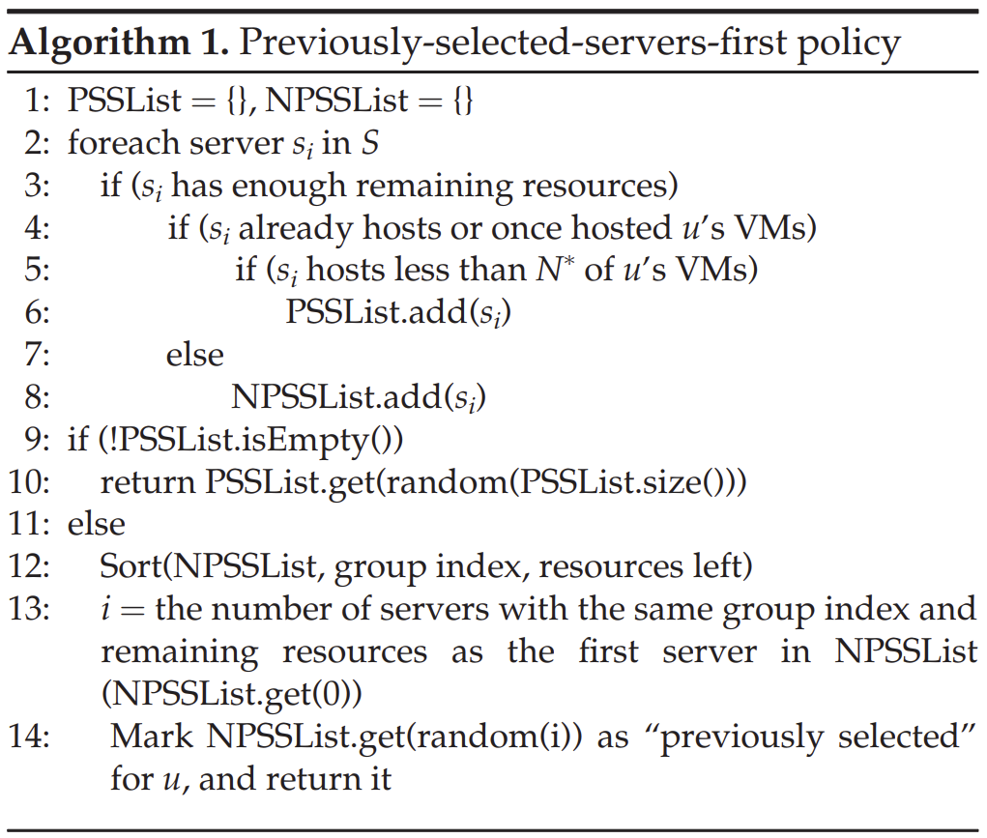
Security on VM techniques
A new secure VM allocation policy called Previous Selected Servers First Policy (PSSF).
The policy satisfies the requirements of security, workload and power consumption.

Slide 33
Strengths & Drawbacks
Pros:
The policy protects the VMs allocated on the same host to be co-located from malicious user location.
Cons:
The policy does not secure the interaction between VMs that allocated on different host.
The policy does not secure the mobile user data while moving from the mobile device to the cloud.
The absence of data isolation while VMs communicate between each other.
Decrease the efficiency and coverage attacks only on the host.

Slide 34
Load balancing based techniques on VM
A security scheme called Security-aware Provisioning and Migration Scheme (SWAP) for provisioning and migrating thin virtual machine or phone clone for preventing the covert channel attacks.
The proposed scheme includes two techniques. The first one is provisioning of new phone clones where this technique works with mobile communication history to avoid users’ phone clone to host with other strangers’ thin virtual machine. The second technique is responsible for migrating the phone clones from one host to another when the threats of attacks increase.

Slide 35
Strengths & Drawbacks
Pros:
Successfully minimized the risk of phone clones’ attacks compared with naïve provisioning and migration algorithm.
Trade-off between security and load balancing.
Cons:
The works does not assume that two phone clones in the same host can attack each other when they have a link of communication between each other.

Slide 36
Load balancing based techniques on VM
Load balancing VM-allocation policy
An approach to minimize the co-resident attacks in cloud environment. This work improved VM allocation policy, which extends PSSF tool (Previous Selected server first) with three additional policies: security, power consumption, and load balance to enhance the effectiveness and the efficiency of the cloud platform environment. Moreover, they apply several experiments on the simulation cloud platform CloudSim and the obtained results show a remarkable robustness against co-resident attacks.

Slide 37
Strengths & Drawbacks
Pros:
The policy protects the VMs allocated on the same host to be co-located from malicious user
Trade-off between security, load balancing, power consumption.
Cons:
The absence of data isolation while VMs communicate between each other (such tasks of distributed application).
Migration of VMs: they do not consider the migration attacks which can happen due to the vulnerabilities of migration algorithm.

Slide 38
Virtualization Techniques on MCC
Introduction
Preliminaries
Proposed Methods
Conclusions

Slide 39
Conclusions
Limitations:
Proposed virtualization-based solutions lack of mechanism that ensures the communication between VMs located on different servers.
Solutions are always given with great assumptions, and are only worked on part of the systems.
Many solutions assume that hypervisor is always protected, which directly controls the whole VMs. Also, some solutions provided security for phone clones on the cloud side, but not on mobile devices.

Slide 40
Thank you!

