Slide 1


NTPT: On the End-to-End Traffic Prediction in the On-Chip Networks
Yoshi Shih-Chieh Huang¹, June 16, 2010
Kaven Chun-Kai Chou¹
Chung-Ta King¹
Shau-Yin Tseng²
¹Department of Computer Science, National Tsing Hua University, Hsinchu, Taiwan
²SoC Technology Center, Industrial Technology Research Institute, Hsinchu, Taiwan

Slide 2
Outline
Motivation
An observation from application’s traffic trace
Proposed Design
Table-driven solution
Evaluations
On Tilera’s TILE64
Conclusion and Future Works
Notes:
This is the outline. First, I will give a motivating example to explain what we observe in a real application, and explain the problem we tried to solve.
Second, I will introduce the idea of our proposed design for the problem.
Evaluations are given for validating the performance of our design.
And finally, I will give the summary and the introduce some of the future works we are working on.

Slide 3
Motivation
Consider the LU decomposition in SPLASH-2 running on a many-core machine
Observe the communication trace between any pair of the nodes
End-to-end traffic / pair-wise communication
0
1
2
3
4
5
6
7
8
9
10
11
12
13
14
15
Notes:
We are interested in whether the communications have some regular patterns, especially between two end-point cores.
For observing the pair-wise communication , we ported a LU decomposition application in SPLASH-2 to the many-core machine, where 16 cores are used.
By Taking this figure as an example, in the following slides, we show the communication trace from core 7 to core 4.

Slide 4
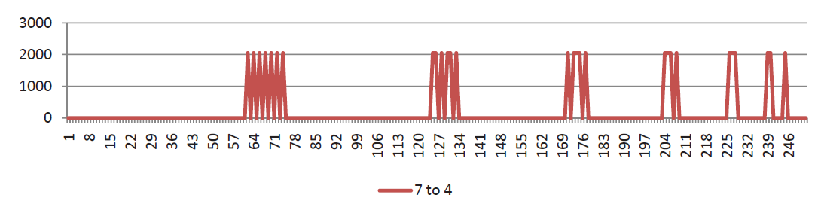
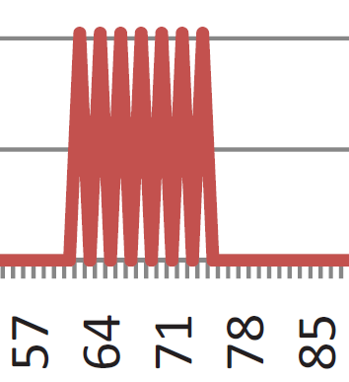
Key Observation
Consider the end-to-end traffic from node 7 to node 4:
Payload (8 bytes)
Time
(1K cycles)
Node 7 to node 4
Regular end-to-end
traffic pattern!
Notes:
After executing the LU decomposition, we get a lot of trace data which are end-to-end forms. For helping the explanation, here we only show the incoming data from router 7 to router 4.
It is easy to see that the transmission is somewhat periodical and some implicit patterns are inside.
It motivates us to think the following questions.

Slide 5
Key Questions
Can the end-to-end traffic pattern be recognized at runtime?
If so, can the end-to-end traffic pattern be predicted at runtime?
What if we can?
Controlling the injection rate for end-to-end flow control
Performing dynamic routing based on workload
Remapping tasks
Controlling the power mode of switches and links
…
Notes:
So here we have some key questions to think.
First, can the pair-wise traffic pattern be recognized at runtime?
Second, once it can be recognized at runtime, can we predict the following traffic pattern?
Once they are possible, we can use them as the indications for some purposes.
For example, we can control the injection rate. We can also use it as the indication for dynamic voltage/frequency scaling, and so on.
So now, we define our problem domain: the problem domain is on chip-level multiprocessor with on-chip networks.
And our proposal is a hardware design for end-to-end traffic recognition and prediction.

Slide 6
Key Idea
We believe that application-driven prediction is the best way to predict the traffic patterns in the on-chip network
In contrast to switch layer prediction
Prediction-based flow control for network-on-chip traffic, DAC 2006
Domain: chip-multiprocessors with on-chip networks
Proposal: A hardware design for end-to-end traffic recognition and prediction

Slide 7
Overview of the Design
Processing
Element 1
Processing
Element k
…
NIC
NIC
Predictor_{k}
Predictor₁
On-Chip Network
Notes:
Here is the overview of our design.
As the figure shows, there are many processing elements from 1 to k. Each processing element connects to the on-chip network via the network interface card.
Here, the predictors are attached to the network interface cards. It is a dedicated hardware.
Note that we monitor the output traffic. Our design is independent of the underlying topology of the network-on-chip.

Slide 8
Traffic Pattern Recognition
Monitor outgoing traffic to each destination node
payload
time
Sampling period
Sampling period
Sampling period
Sampling period
Sampling period
payload
5
4
3
3
5
0
3
3
2
1
0
time
Notes:
We have to recognize the outgoing traffic pattern. By taking a node as an example. As the top figure shows, the x-axis is the time, and the y-axis is the transferred data.
The transmission can be drawn as a time series, and the transmission may seem as a continuous curve.
Here, we are going to do a discrete prediction since it is difficult to do a continuous prediction. We split the time series to several sampling period, and in each sampling period, the volume of transmission is recorded and quantized to a corresponding level.
As the bottom figure shows, the transmission can be recognized as 0,3,3,3,5. This makes it possible to save the continuous transmission by simple numbers.

Slide 9
Traffic Prediction
Last value predictor
Use the traffic of current sampling period to predict the traffic of the next period
Easy, small, but low accuracy
payload
5
4
3
3
5
0
3
3
2
1
0
time
miss
hit
hit
miss
2/4 = 50% accuracy
Notes:
So far, the transmission can be described as discrete integers.
The most intuitive way to predict the next number is based on the previous one. As the figure shows, while the first number is 0, we guess the next one is also zero. Apparently, this guess misses. And the following three transmissions may be hit. Finally, the fourth guess will be wrong.
The last value predictor is simple to implement, and if the transmissions are stable, the prediction may has high accuracy. However, most applications have bursty behaviors, and the transmissions are not very smooth curves. This fact is found in previous works, and we also have similar results in our evaluation. So the performance of last value predictor is not good in many cases.
Therefore, we went back to the core of the problem, the main sources of the traffic are from the running application on the cores. So these discrete values should have some periodical behaviors. Once the periodic behaviors are discovered, the repetitive behaviors should be predictable.

Slide 10
Traffic Prediction (cont’d)
Intuition: more accurate prediction by tracking longer traffic history
Pattern-oriented predictor
Traffic pattern register
Indexing into a table for prediction of traffic in the next sampling period
index | Prediction
0 | nil
1 | nil
2 | 3
3 | nil
… | …
0332 | 2
0333
0334 | 2
0335 | nil
… | …
0333
Problem:
Big and sprase Tables!
(History length=4)
5
Notes:
As a result, we develop a pattern-oriented predictor, which tracks the recent transmitted payload as the indexing number. For example, the first four values are 0,3,3,3. It will be the index number to a second level table, so we can predict that the volume of the next transmitted payload is 5.
However, there is a big problem that the table grows dramatically, and many entries may be unused and the whole table is a sparse table, so we apply many size-reducing techniques in the design. The details are in the paper. Here we describe the main idea of NTPT. If you are interested in the techniques for reducing sizes, please refer to the paper.

Slide 11
Last Value Predictor Versus Pattern-Oriented Predictor
 | Last Value Predictor | Pattern-Oriented Predictor
Accuracy | X | O
Space Overhead | O | X

Slide 12
Network Traffic Prediction Table (NTPT)
NTPT-based predictor = last value predictor (LVP) + simplified pattern-oriented predictor (SPOP) + selector
The appropriate predictor is chosen by the selector
Simplified POP = many space reduction techniques
Similar to branch prediction in computer architecture
SPOP
LVP
Selector
POP
Notes:
So, what is NTPT? In brief, NTPT comprise the pattern-oriented predictor and last value predictor.
There is a selector which chooses the suitable one according to the situation.
For example, while a program has a stable and continuous transmission, the last value predictor works fine.
While a program has some periodical behaviors, the pattern-oriented predictor performs better.
Currently, the selector is implemented as a 2-bit saturating selector. Further study on this part is included in our following works.
We may investigate more novel and suitable predictors and also a more clever selector.

Slide 13
Evaluation Setup
Emulate the NTPT-based predictor on the Tilera TILE64
LU decomposition in SPLASH-2 ported to TILE64
16 nodes for executing application
16 nodes for emulating NTPT-based predictors
The following two figures show that NTPT-based predictor has a good tradeoff between
The accuracy of prediction
The space overhead
Notes:
We evaluate NTPT on the Tilera Tile64. As the previous motivating example, we ported the LU decomposition program in SPLASH-2 to the machine. 16 cores executes the parallel LU decomposition thread, and corresponding 16 cores are used for emulating the NTPT-based predictor.

Slide 14
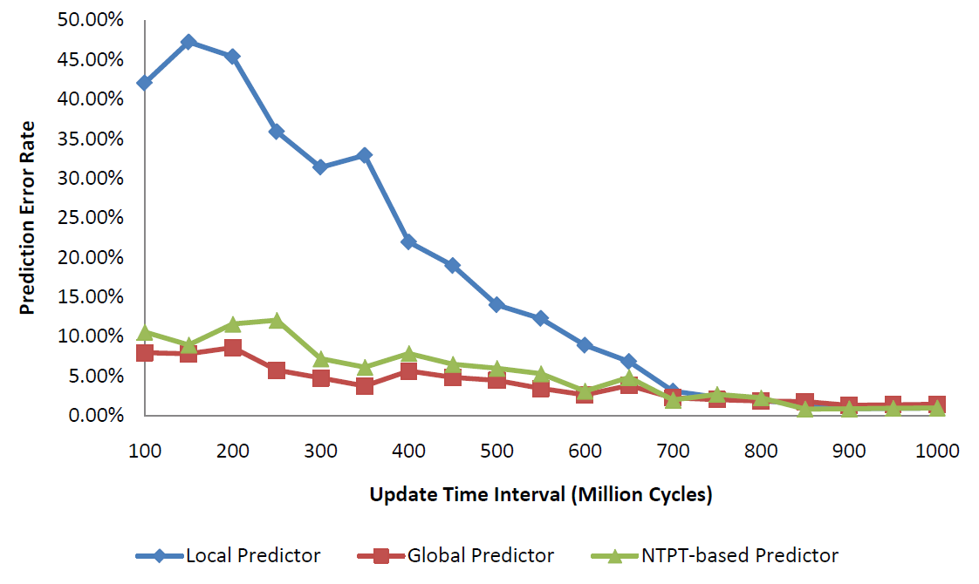
Prediction Error Rate
Sampling Period (Million Cycles)
Last Value Predictor
Pattern-Oriented Predictor
Notes:
First is the accuracy. As this figure shows, the blue line is the last value predictor. It performs bad in most time. Until the sampling period is very long, all the three predictors have good accuracy; however, it is meaningless since a program is very possible to transmit something for a given time.
And the best one, the red line, is pattern-oriented predictor, since we do not limit the number of entries in the pattern-oriented predictor. That is, it can remember any combination of the transmission patterns.
And the green line is NTPT-based predictor. As you can see, its error rate is around 5% to 10%, slightly worse than pattern-oriented predictor. However, let us see the next figure.

Slide 15
Prediction Table Size
Required memory size (in terms of entry)
History length
Notes:
This figure shows that the observed new patterns in NTPT is relatively fewer than in pattern-oriented predictor. The reason is that some stable transmission behavior may be predicted by the last value predictor, so those patterns will not be inserted into the prediction table.
This implies that last value predictor is value helpful to reduce the size of the prediction table, and the limited number of entries may be utilized effectively.

Slide 16
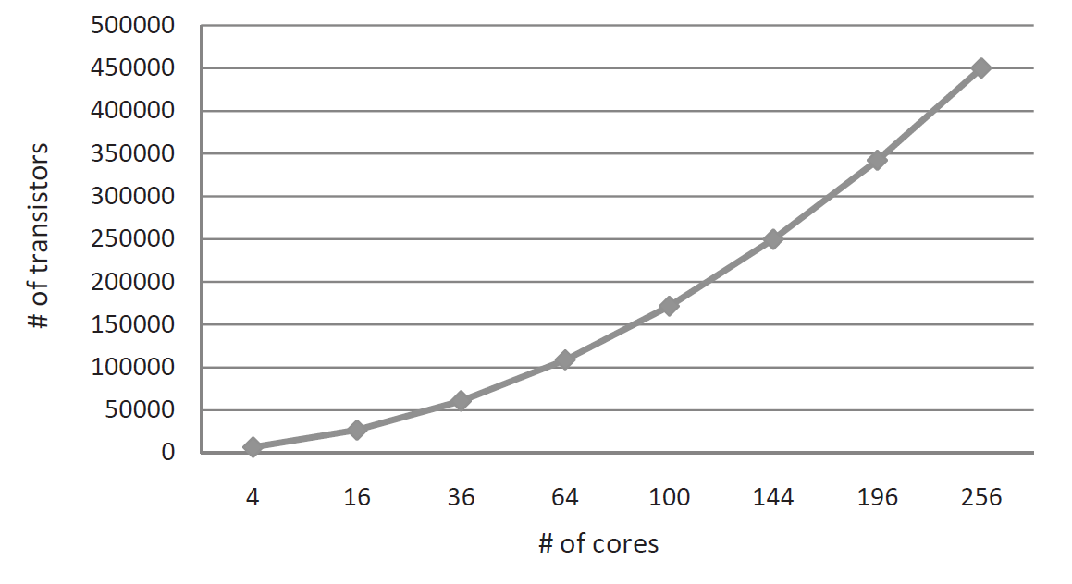
Estimated Area Overhead
0.11% in AsAP
0.017% in TILE64
Notes:
This figure shows the estimated area overhead. In our paper, we gives a formula. The exact size of NTPT-based predictor can be calculated. We estimate it in terms of transistor.
NTPT occupies 0.11% in UC Davis many-core chip AsAP, and 0.017% in Tilera Tile64. The area overhead is quite low, so it is very possible to put this design into the real implementations.

Slide 17
Conclusion and Future Works
A hardware design for recognizing and predicting end-to-end traffic on chip-multiprocessors using on-chip interconnection networks
Traffic patterns recognition at runtime
Traffic behavior prediction at runtime
NTPT has good prediction accuracy with low hardware overhead
Ongoing works
Injection rate control for congestion avoidance in NoC
Dynamic voltage/frequency scaling for routers and links
Previous works use switch-layer perspective
Buffer/link utilization in router
Notes:
In summary, in this paper, we proposed an idea for predicting the application-level end-to-end traffic. We believe that the sources of the traffic are from the application. We sample the traffic periodically and use a hybrid design for the tradeoff between accuracy and area overhead.
Currently, we are working on applying NTPT to do some further research. We use the result of NTPT to control the injection rate for avoiding the congestion, and we also use the result of NTPT to do DVFS for the routers and links in the on-chip networks. Until now, we have some elementary results. If you are interested in our work, please feel free to discuss with us in the poster session. We appreciate your opinions and suggestions. Thank you.

Slide 18
Thank you!

Slide 19
Backup Slides

Slide 20
More Techniques for Table Reduction
Merging the tables corresponding to different destinations
Using the least recently used (LRU) replacement strategy
Quantizing the values in the tables
…
SPOP
LVP
Selector

Slide 21
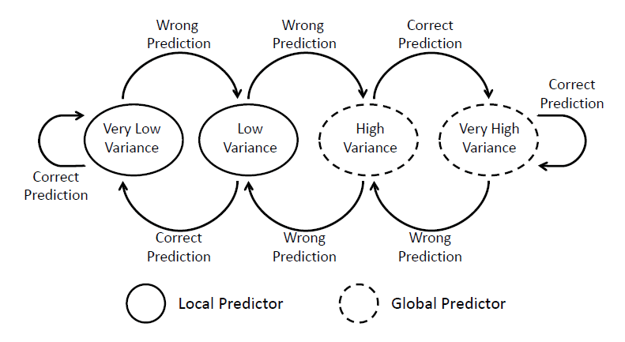
Design of Selector
LVP
POP

Slide 22
Selected Related Works
Switch-layer prediction
Prediction-based flow control for network-on-chip traffic, DAC 2006
Compile-time prediction
Reducing NoC energy consumption through compiler-directed channel voltage scaling, PLDI 2006

